Slide 1
This term in PSHE our topic is: Celebrating Difference
Lesson 2 – Family Conflict

Slide 2
Vocabulary:
Family Conflict Solve it together
Solutions Resolve

Slide 3
Calm Me

Slide 4
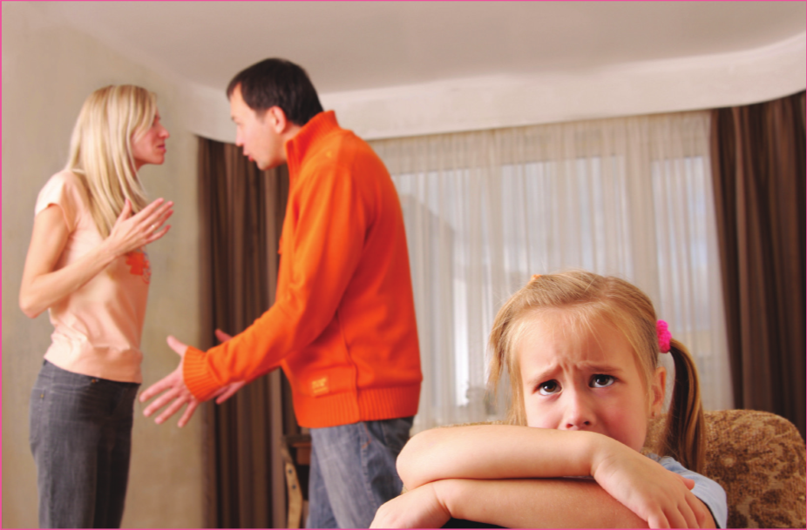
Open my mind
What do you they see in the picture. What are the people feeling? What has just happened?

Slide 5
Open my mind - continued
It is normal for there to be conflict in families and there are ways to solve it.
All children have the right to be safe. Who do you think the child in the picture could talk to if she is worried she might not be safe?
Yes, she could talk to her teacher or another trusted adult.

Slide 6
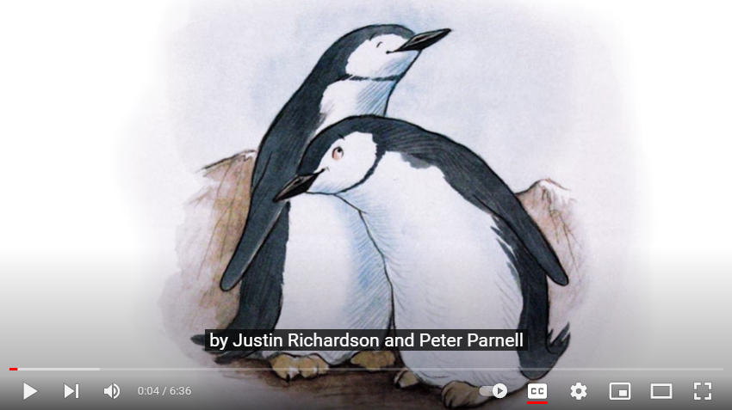
And Tango Makes Three – Watch up to 3:47. Can you think of any solutions? Then watch the end of the story to find out what happened.

Slide 7
Solve It Together
Choose one of the conflict scenarios and use the Solve it Together steps to try to come up with a solution.

