Slide 1
Thursday 22nd April 2021
LO: To use a dictionary to find the definition of unknown words.

Slide 2
Let’s read the story of Lazy Jack again. As we read it, I’d like you to highlight any words you don’t know the meaning of on your copy of the text.

Slide 3
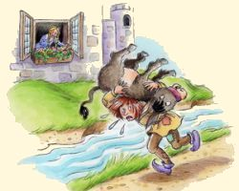
This is the story of Lazy Jack

Slide 4
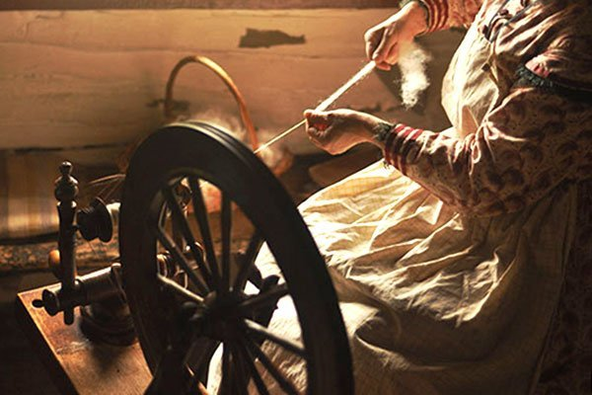
Lazy Jack
Once upon a time there was a lazy boy called Jack who lived with his mother. They were very poor. His mother worked hard spinning but Jack did nothing. In the summer, he basked in the sun. In the winter, he dozed by the fire.

Slide 5
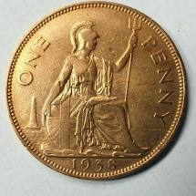
One day his mother said that if he didn’t work for his porridge, she would throw him out of the house. So Jack went to work for a farmer. At the end of the day, he was paid one bright, new penny but on the way home he dropped it in a stream. ‘You stupid boy,’ said his mother, ‘you should have put it in your pocket.’ ‘I’ll do so next time,’ promised Jack.

Slide 6
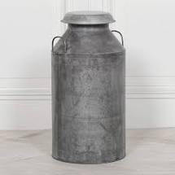
The next day Jack went to work for the farmer again. At the end of the day, he was paid with a jar of milk. Remembering what his mother had told him, Jack tipped it into his pocket. ‘You stupid boy,’ said his mother, ‘you should have carried it on your head.’ ‘I’ll do so next time,’ promised Jack.

Slide 7
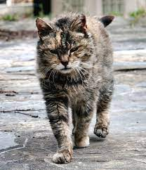
The next day Jack went to work for a miller. At the end of the day, he was paid with a tomcat for catching mice. Remembering what his mother had told him, Jack tied it onto his head. ‘You stupid boy,’ said his mother, ‘you should have tied it up with string and lead it along behind you.’ ‘I’ll do so next time,’ promised Jack.

Slide 8
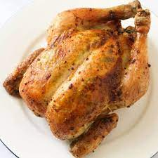
The next day Jack went to work for a baker. At the end of the day, he was paid with a roast chicken. Remembering what his mother had told him, he tied it up with string and pulled it along behind him. ‘You ninny hammer,’ said his mother, ‘you should have put it in your nap sack.’ ‘I’ll do so next time,’ promised Jack.

Slide 9
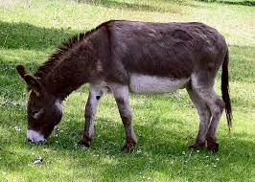
The next day, Jack went to work for a cattle-keeper. At the end of the day, he was paid with a donkey. Remembering what his mother had told him, he tried to squeeze it into his knapsack.

Slide 10
On his way home, Jack passed the home of a beautiful girl. Unfortunately, the doctors had said that she could not speak until she had laughed. Her father had promised that the first person to make her laugh could marry her. Along came Jack with the donkey on his back and its legs poking into the air. Now the sight was so strange and so comical that the girl burst out laughing – and Jack became both married and wealthy. So they all lived in great happiness.
Snip snap snout – My story is out!

Slide 11
What did you think of the story? Did you like it?
Why? Why not?

Slide 12
Let’s share the words we don’t know the meanings of.

Slide 13
These might be some of the words: spinning basked dozed miller tom cat ninny hammer knapsack comical

Slide 14
Now you are going to use your dictionary with your learning partner to write the word and the definition. Let’s just recap how to use a dictionary.

Slide 15
Once you have finished, can you use each new word in a sentence?

Slide 16
Thursday 22nd April 2021
LO: To use a dictionary to find the definition of unknown words.

