Slide 1
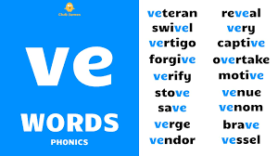
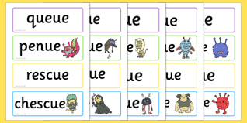
Friday 12th March.
LO – I know ue and ve.

Slide 2
No word in English ends in ‘’u’’ or ‘’v’’. ‘’ue’’ or ‘’ve’’ must be written.
Group 2
Prove Remove leave Value Statue Flame Continue Barbeque Forgive Believe
Group 3
Approve Revive Relative Expensive Issue Virtue Rescue Fatigue Pursue Tissue
Group 1
Dive Drive Slave Gave Give Love Blue True Glue

Slide 3
Things to remember.
Remember: The sound uv is spelt uve
Love Dove Glove Above
Word of the week.
Friend
It has 6 letters
Friend ends in end
Friday is at the end of the week.
My friend is coming out on Friday

Slide 4
Task.
Remember: The sound uv is spelt uve
Love Dove Glove Above
Write down 8 of the words that you are unsure of in your magpie book. If you need to, write down the definitions too.
Try to spell these words correctly in future and friend should be spelt correctly from now on. ☺

