Slide 1
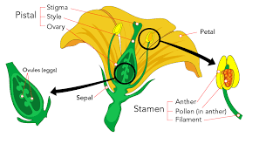
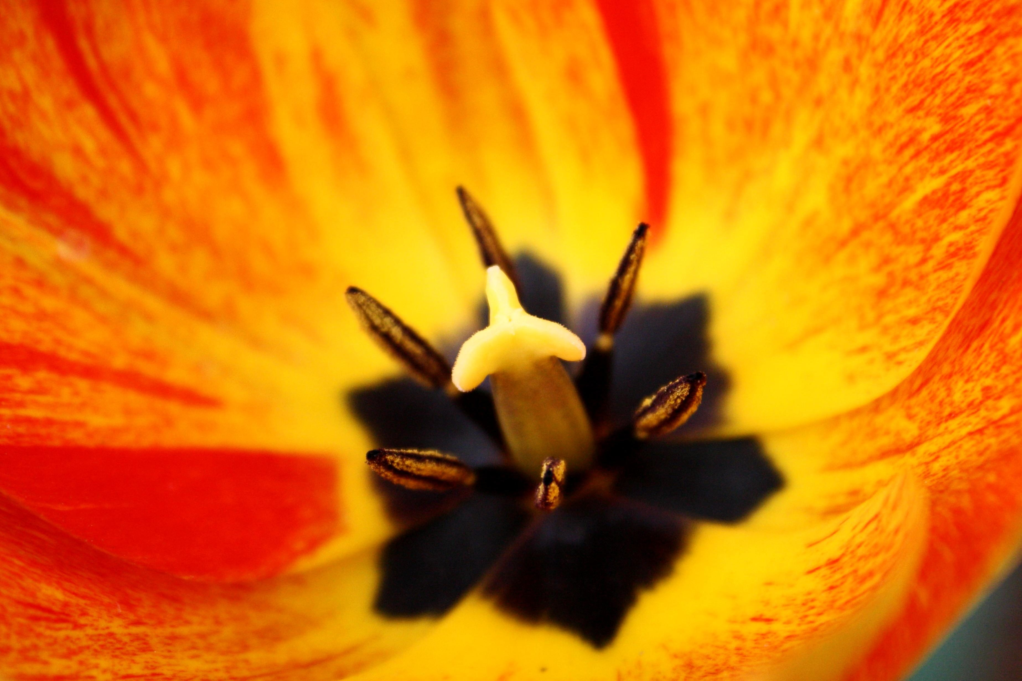
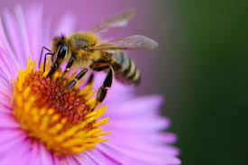
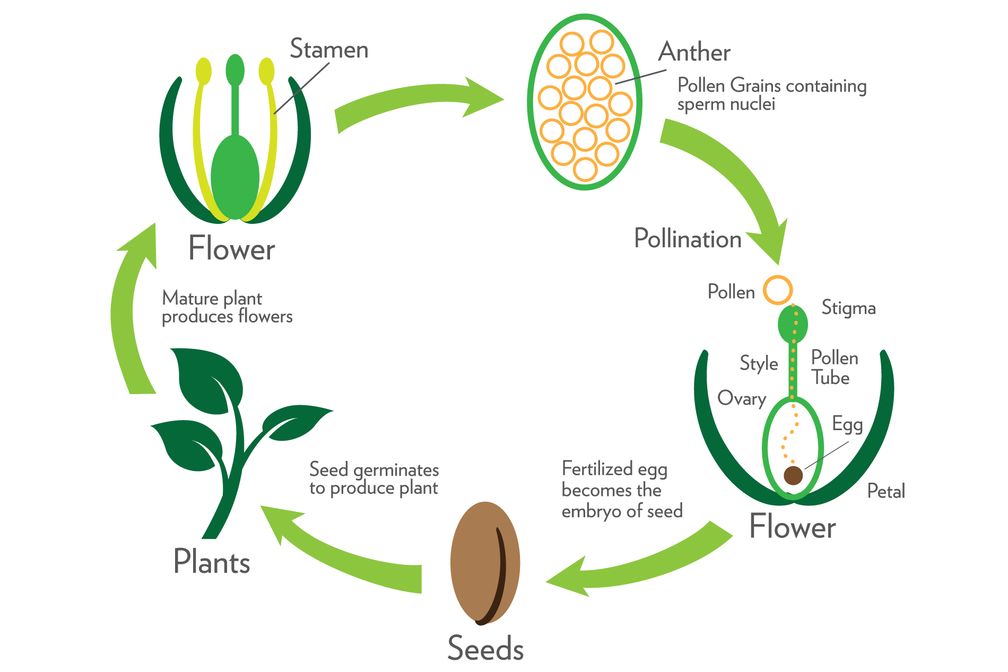
Plants

Slide 2
Vocabulary
Grow, seed, bulb, (tuber), leaf (petiole), root (root hairs), stem, flower (petals, sepals, stamens, ovary, pollen, eggs), fruit, germination, seedling, water, light, temperature, nutrients, reproduction, pollination (wind, insect), fertilisation, seed dispersal

Slide 3
LO: To know about different types of pollination.
LO: To use science words.

Slide 4
Let’s recap:
Pollination is the act of transferring pollen grains from the male anther of a flower to the female stigma.

Slide 5
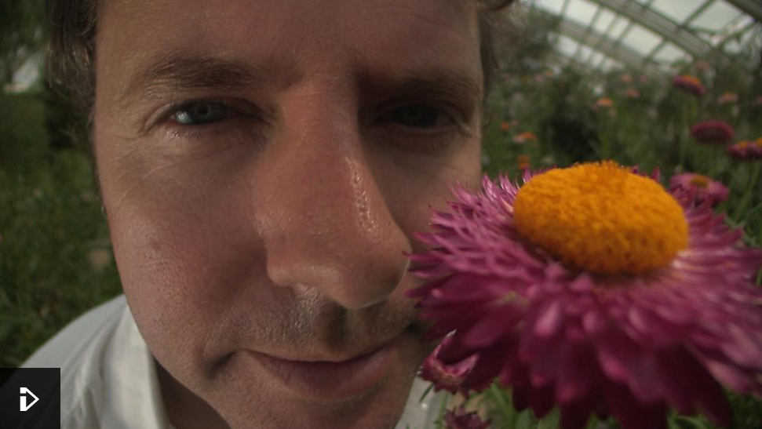
We found out about insects pollinating flowers last week. There are some other animals that might help to pollinate a flower too.
Watch this clip to find out more.

Slide 6
Can you think of any other ways that pollen might be transferred?

Slide 7
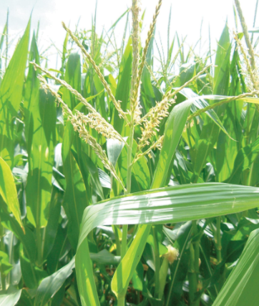
Wind Pollination
While some plants use insects to help them transport their pollen, others rely on wind. These plants are usually less colourful as they do not need to attract insects. The wind carries pollen from one plant to another. Rice is an example of a wind-pollinating plant.

Slide 8
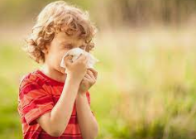
Wind pollination is a less coordinated way of pollinating, as it relies on a huge amounts of pollen being blown in any direction, depending on the wind.
Wind pollinating plants can cause some people to experience hay fever during the Spring and Summer due to the large amounts of pollen in the air.

Slide 9
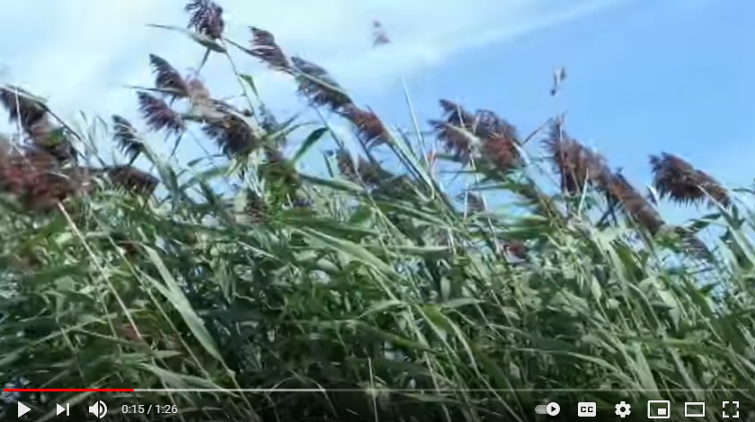
Watch this clip to find out more about wind pollination.

Slide 10
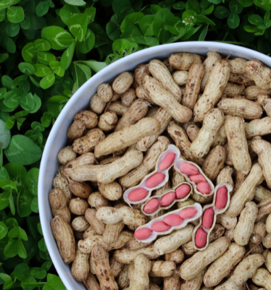
Self Pollination
Some plants self-pollinate. They transfer the pollen grains from the anther to the stigma on the same flower. These plants do not need a pollinator, such as an insect, in order to reproduce.
Only a few plants self-pollinate. Examples include peanuts, orchids, peas and sunflowers.

Slide 11
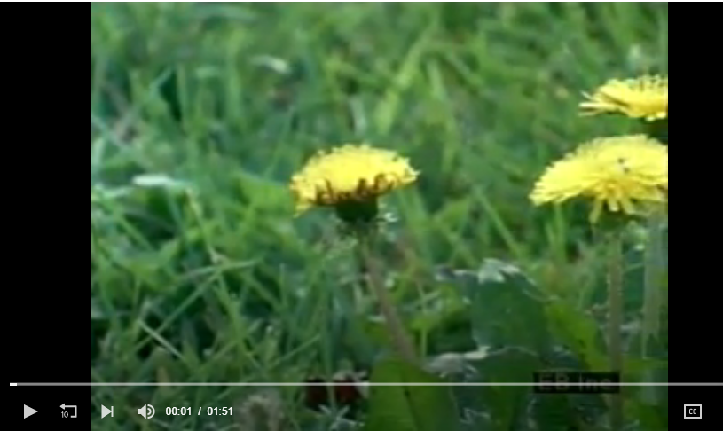
The dandelion uses wind pollination, and sometimes self pollination. Watch the clip up to 01:30

Slide 12
Your task:
Create a facts file about the different types of pollination:
Insect pollination, wind pollination and self pollination.
Remember to use science words. Use slide 2 to help you with the spelling. You might also want to draw some diagrams to help you explain.

