Slide 1
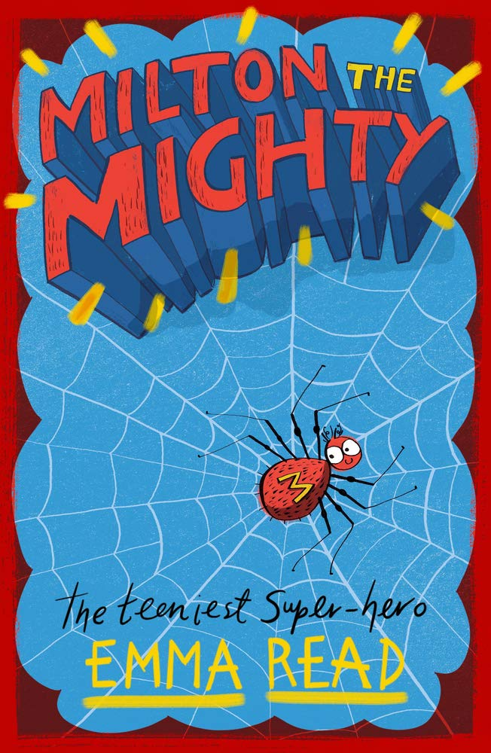
Milton The Mighty
Emma Read
https://www.chickenhousebooks.com/wp-content/uploads/2019/04/Milton-The-Mighty_SAMPLE_forwebsite.pdf
Up to the end of the first paragraph on page 4

Slide 2
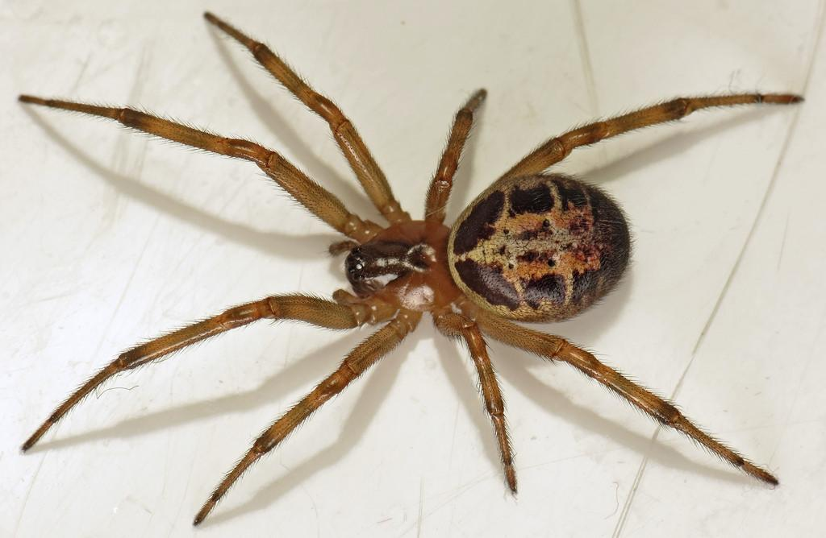
Vocabulary Check
strolling - walking in a relaxed way
peculiar - unusual or strange
evacuate - remove from a place of danger to a safer place
a false widow spider
cowering - crouching down in fear

Slide 3
Quick Quiz
What type of spider is Milton?
Is this a fiction or non-fiction text?
What are the names of the two house humans?
True or false: Milton is a small spider.
Where does the dad suggest him and his daughter evacuate to after seeing Milton?

Slide 4
Partnered Talk A
What do the words ‘scream’, ‘wobbler’ and ‘shaking’ tell us about Zoe’s dad?

Slide 5
Individual Thinking
Do you agree with Zoe that spiders aren’t scary or did you agree with her dad? Give reasons for your answer.
I agree with ____________ because

Slide 6
Partnered Talk B
What does Zoe do that suggests that she disagrees with her dad’s evacuation idea?

Slide 7
Solo Work
But then he heard footsteps – fast ones. It was Zoe again. She was sprinting down the stairs (even though her dad always told her off for that), with the dreaded cup-and-birthday-card combo in her hand.
What do you predict will happen next? Will Milton get away? How will he manage it? Or will Zoe trap him?
Notes:
Make sure that class understand that the dreaded cup and birthday combo mean that Zoe is planning on trapping Milton.

Slide 8
Milton The Mighty
Emma Read
https://www.chickenhousebooks.com/wp-content/uploads/2019/04/Milton-The-Mighty_SAMPLE_forwebsite.pdf
Pages 4 - 6

Slide 9
Vocabulary Check
zigzagging
singed - slightly burnt

Slide 10
Quick Quiz
Where might Milton end up if Zoe catches him?
What tactic does Milton use to get across to safety?
True or false: Milton’s friend helps him to escape.
Where does Milton hide behind?
What is the name of his friend who seems him running?

Slide 11
Partnered Talk
Can you summarise what has happened so far in the story in 10 seconds?
Don’t forget that you MUST include all of the key points.Practice with your partner.

Slide 12
Individual Thinking
What type of voice do you think Milton has? Why?

Slide 13
Solo Work
How do you feel as a reader whilst Milton is trying to escape being caught by Zoe? What do you want to happen next?

