Slide 3
Which one of these is the odd one out?

Slide 4
Which one of these is the odd one out?
Notes:
Only one with spots – not found in the shape drawer at school
2d shape with staright sides, I can see squares on the 3d shapes as they have square faces
Cuboid – the only one to have rectangular faces
The only one to have a curved side

Slide 7
Sometimes I make an x with my arms as I say hexagon
Both six and hexagon have an x in them

Slide 8
Which shape is the hexagon?
Have a think

Slide 9
Have a go at question 1 on the worksheet

Slide 10
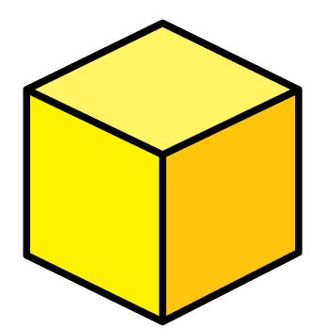
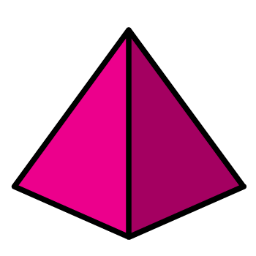
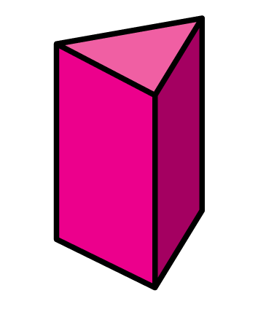
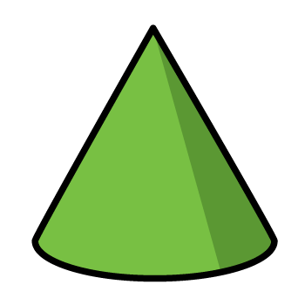

Slide 11
Which of these shapes are cylinders?
Have a think

Slide 12
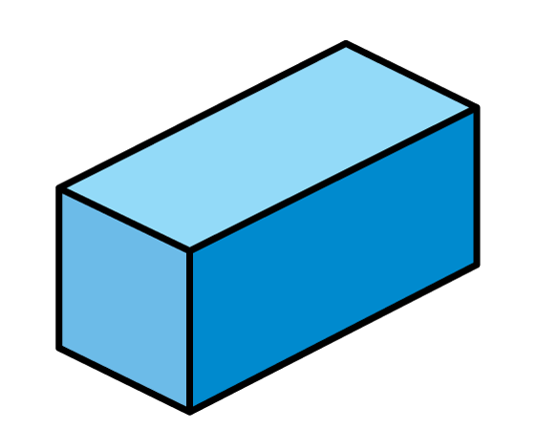
Which shapes can you see?
Have a think
Cone
Sphere
Pyramid
Cylinder
Cube
Cuboid

Slide 13
Have a go at questions 2, 3 and 4 on the worksheet

Slide 14
Shape Tally Total
Triangles
3
Squares
1
Pentagons
1
Hexagons
3

Slide 15
Have a go at question 5 on the worksheet

