Slide 1
Journey to the Jungle

Slide 2
Thursday 10th February 2022
LO: To plan a recount.

Slide 3
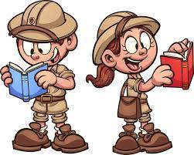
Yesterday, we imagined that we are exploring a jungle of our very own!

Slide 4
Today we are going to imagine that we have visited our jungle. When we have got back to our tent, we are going to write a letter to our friend, telling them all about our expedition.

Slide 5
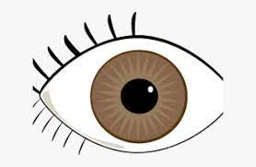
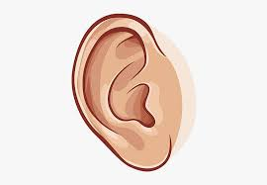
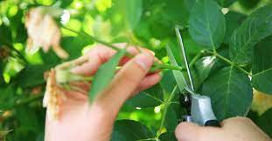
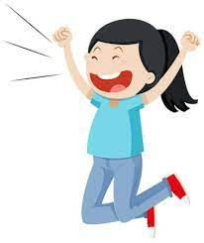
We might want to tell them
what we saw,
what we heard,
what we did and
how we felt.

Slide 6
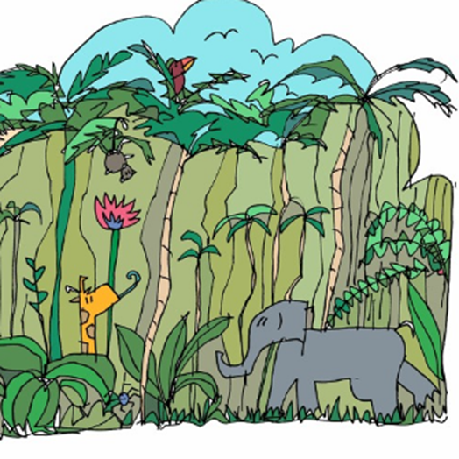
Let’s listen to the text.
Click on the picture to listen (From 0.22 seconds)

Slide 7
Now, let’s go through the text and look at the underlying structure. This means that we see what each part of the text is about. We call this boxing up.
As I show you each part of the text, tell your partner what it is about.

Slide 8
Jungle Log: 31st January, 2022
Today has been an amazing day of discovery! I woke early and got ready for my trek into the Atlanti Jungle. I was excited and couldn’t wait to see what lay ahead of me.
State when the exploring happened, sum up the day & tell reader how you felt, e.g. Today has been amazing. I was so …

Slide 9
I packed my rucksack and put on my sturdy walking boots. I made sure my camera was working because I wanted to record as much of the day as possible. I left the camp at 6am.
What you did before you set off, e.g. I put on my …

Slide 10
First, I trudged through the dense forest and collected samples of the plant life. My favourite was a thorny bush. It had tiny, yellow flowers growing on it, which smelt like ice cream!
Event 1 – what happened? First, …

Slide 11
Next, I studied some of the mesmerising insects that were crawling up the rough bark of every tree. One insect looked like a caterpillar but had 2 sets of wings and tiny hands on the ends of its 20 legs. Excitedly, I photographed as many creatures as I could because I wanted to show my explorer friends what I had discovered.
Event 2 – what happened? Next, …

Slide 12
After a short tea break, I measured the circumference of the tallest trees to work out how old they were. One measured 10 metres around and was so tall that I couldn’t see the top of it. It reminded me of the beanstalk in a famous children’s story. Next, I trekked to a clearing and found a beautiful plunge pool. The water was turquoise and tiny neon fish were splashing on the surface. I tried to catch one, but they were too fast for me.
Event 3 – what happened? After a short break, …

Slide 13
Then it was time for a rest. I lounged on pink grass, soaking up the purple sun beams and listened to the strange jungle noises around me.
Event 4 – what happened next? Following that, …

Slide 14
Finally, I headed back to camp because the sun began to set. It sets quickly in Oreno and I was worried I might get lost. When I got to my tent, I unpacked my rucksack and stored my plant samples safely. I’m really looking forward to where my wardrobe will take me next week!
Round off your report and tell the reader what you did at the end of the day. Finally, … When I got back …

Slide 15
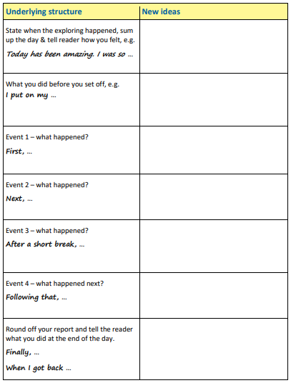
Now make your own plan using the boxing up grid. Remember to refer to your through the telescope picture to give you ideas.

