Slide 1
Forces and Magnets
This half term, our science topic is:

Slide 2
LO: To know what gravity is.
LO: To predict using cause & effect.

Slide 3
Vocabulary
force push pull contact force
distance force gravity force arrow
movement (associated terminology) magnetic magnetism poles (north, south) attract repel non-magnetic
These are some of the words we will be using over the course of the unit.

Slide 4
What is gravity?
The force that pulls things to the centre of Earth (and other planets) is called gravity.

Slide 5
Did you know?
Gravity also holds Earth and the other planets in their orbits around the Sun.
The force of gravity also exists on the Moon but it is not as strong as it is on Earth. This is because the Moon is much smaller than our planet.

Slide 6
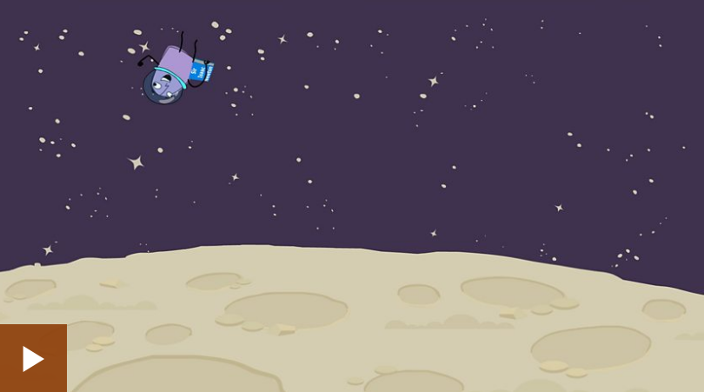
What is Gravity?

Slide 7
Is gravity always the same?
Imagine being on the moon.
Imagine being in a space station.
What would be different from being on Earth? Why?

Slide 8
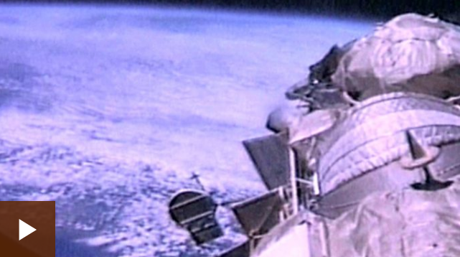
Let’s watch a short video to find out about life in a space station.

Slide 9
Today we are going to carry out a fair test.

Slide 10
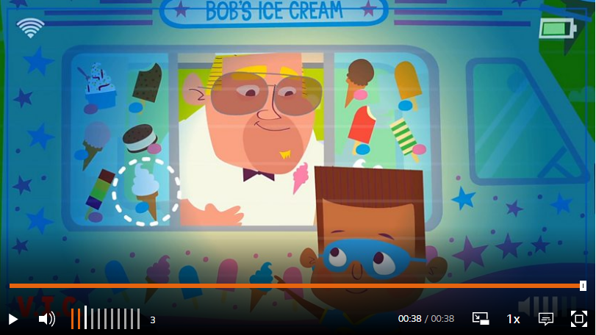
Today we are going to carry out a fair test.
What is a fair test?

Slide 11
How does the height at which we drop a ball effect how high it bounces?
How do you thing we can test this? Remember we must only change one thing. Everything else must stay the same to keep the test fair.
Look at the pictures on the next slide to give you some ideas.

Slide 12
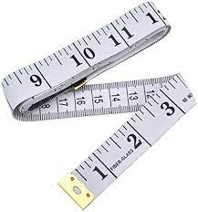
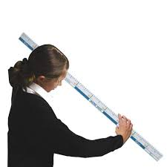

Slide 13
You are going to work in small groups of 3 or 4.
When you have decided how you are going to carry out your fair test, make sure that each person in your group has a job.
These jobs might include:
measure the height the ball is dropped from
drop the ball
measure how high the ball bounces
record the results

Slide 14
BEFORE: say what you think might happen.
AFTER: say what actually happened.
WHY: can you explain why?

Slide 15
Let’s go back to the question we started with
How does the height at which we drop a ball effect how high it bounces?
Can your results help you to answer this question?

Slide 16
Tell your partner 3 things you have learnt about gravity.

