Slide 1
Monday 17th January 2022
LO: To write a finding tale

Slide 2
Today, we are going to use our boxed up plan and start to write our finding tale.

Slide 3
Remember to magpie from the original text as much as you like.

Slide 4
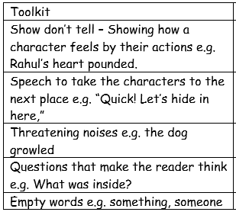
Also remember to include some or all of the features in the suspense toolkit.

Slide 5
Lastly, refer to your plan to help keep your story on track.
We are going to have 3 days to write our story and check, edit and improve it.

Slide 6
Today we are just going to write the first 2 paragraphs. We will do a shared write in school based on my plan, and then you will go ahead with your own two paragraphs.
For those of you working from home, I have included the first two paragraphs from the original text on the next slide .

Slide 7
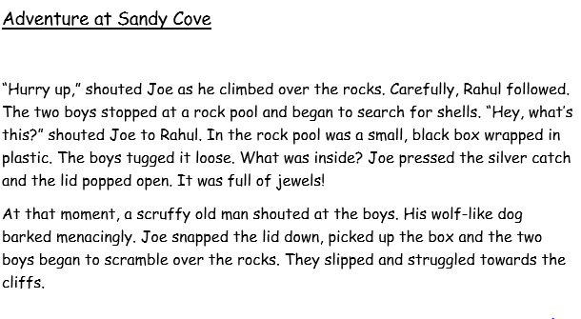

Slide 8
As you write, remember to keep reading what you have written to check it makes sense. Also check your spelling and punctuation.
I am sure you will remember to use your neatest handwriting too ☺

