Slide 1
Thursday 14th January
L.O. I can make arrays.
Multiplication and division

Slide 3
1) Count in 2s until you get to 20
2) Count in 5s until you get to 20
3) Can you count in 3s and get to 20?

Slide 4
1) Count in 2s until you get to 20
2) Count in 5s until you get to 20
3) Can you count in 3s and get to 20?

Slide 6
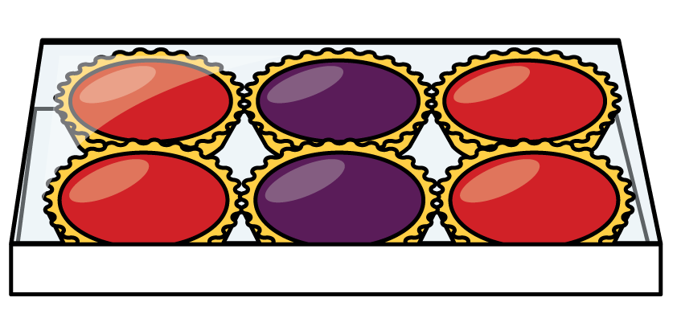
Arrays have rows and columns
Columns
Rows

Slide 7
How many columns are in these arrays?
There are columns.
4
There are columns.
2

Slide 8
How many rows are in these arrays?
2
There are rows.
4
There are rows.

Slide 9
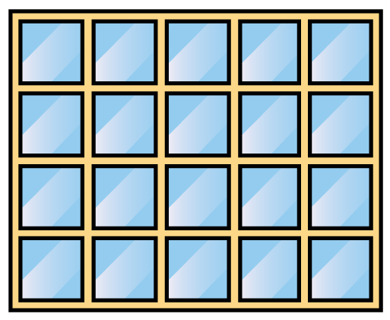
How many windows?
There are rows.
4
5
There are windows in each row.
There are windows altogether.
20

Slide 10
How many shells?
3
There are rows.
5
There are shells in each row.
15
There are shells altogether.

