Slide 1
14.6.21
LO – I can subtract amounts of money.

Slide 2
Let’s look at some questions together.

Slide 3
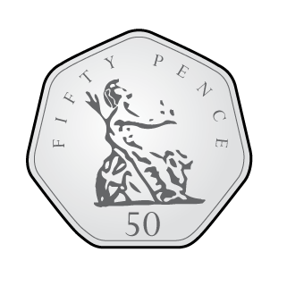
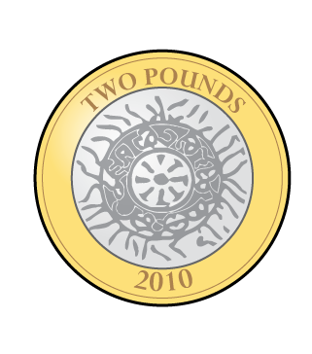
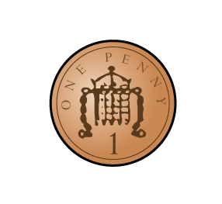
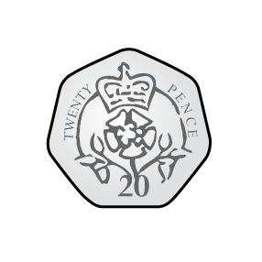
Ron has these coins. He spends 52p.
How much does he have left?
2) What is £1 subtract 20p?
3) What is £1 subtract 25p?
4) Complete the additions to make £1 each time
60p $+$ p $=$ £1 70p $+$ p $=$ £1
p $+$ 65p $=$£1 p $+$ 85p $=$ £1

Slide 4
Ron has these coins. He spends 52p.
How much does he have left?
2) What is £1 subtract 20p?
3) What is £1 subtract 25p?
4) Complete the additions to make £1 each time
60p $+$ p $=$ £1 70p $+$ p $=$ £1
p $+$ 65p $=$£1 p $+$ 85p $=$ £1
£2 and 21p
80p
75p
40
30
35
15

Slide 5
Let’s look at methods for subtracting money.

Slide 6
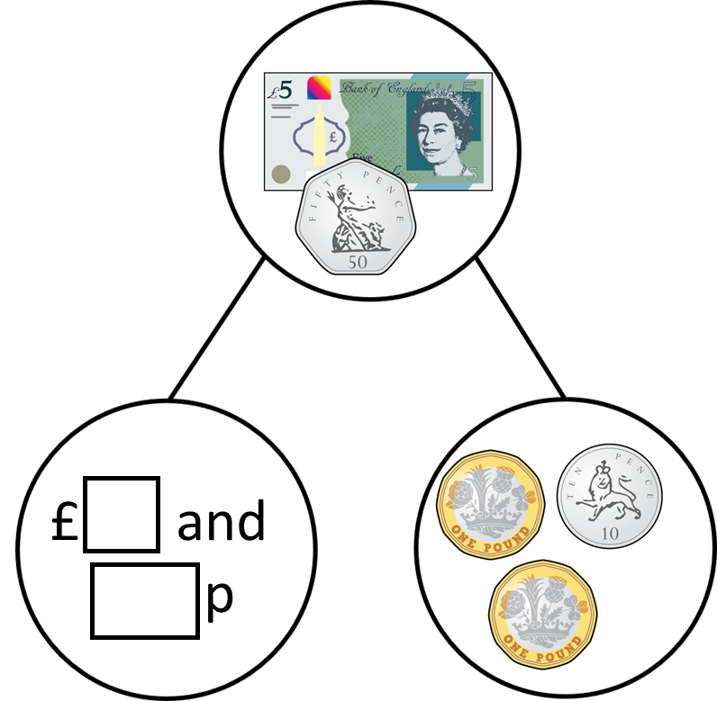
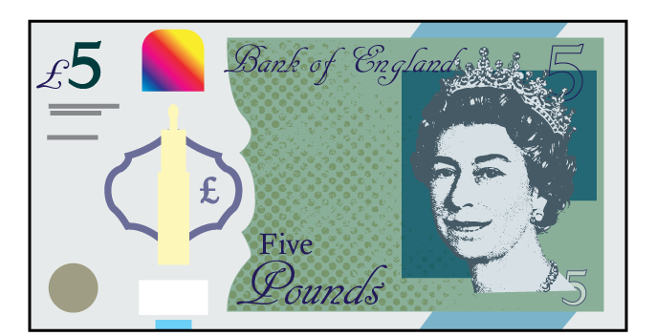
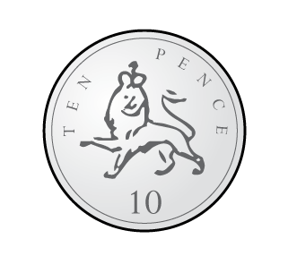
Complete the part-whole model.
3
40
I will exchange the £5 and 50p

Slide 7
Complete the part-whole model.
I will subtract the pounds then subtract the pence.
3
40
£5 and 50p $−$ £2 $=$ £3 and 50p
£3 and 50p $−$ 10p $=$ £3 and 40p

Slide 8
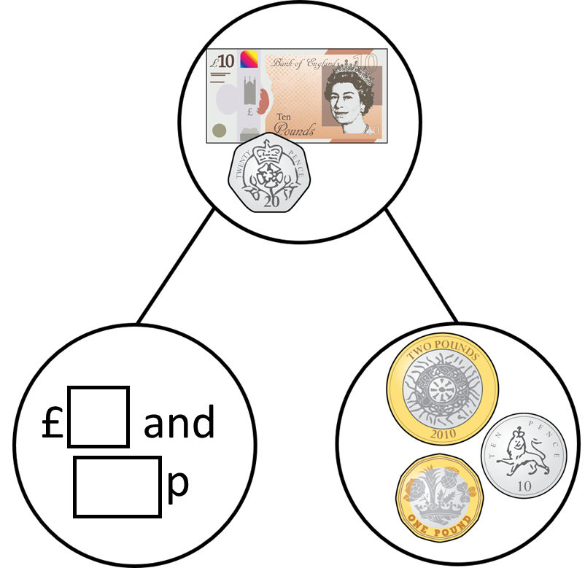
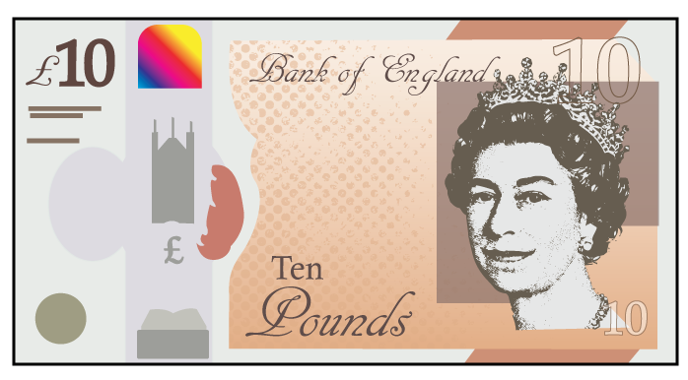
Complete the part-whole model.
Have a think
7
10
I will exchange the £10 and 20p

Slide 9
Complete the part-whole model.
I will subtract the pounds then subtract the pence.
7
10
£10 and 20p $−$ £3 $=$ £7 and 20p
£7 and 20p $−$ 10p $=$ £7 and 10p

Slide 10
Stick this question in your books. We will work through it together.

Slide 11
Now stick this question in your books. Can you answer it yourself?
Can you explain to your partner how you worked this question out?

Slide 12
Ron is using a number line to subtract £3 and 65p from £5
$−$ 5p
$−$ 60p
$−$ £3
£1 and 35p
£1 and 40p
£2
£5
£5 $−$ £3.65 $=$ £1.35

Slide 13
£5 $−$ £3 and 65p
I can count up to find the difference
$+$ 35p
$+$ £1
£3.65
£4
£5
The difference is £1 and 35p

Slide 14
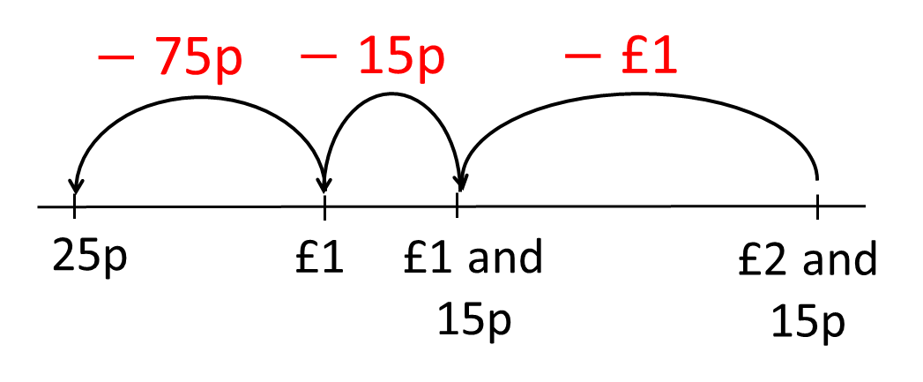
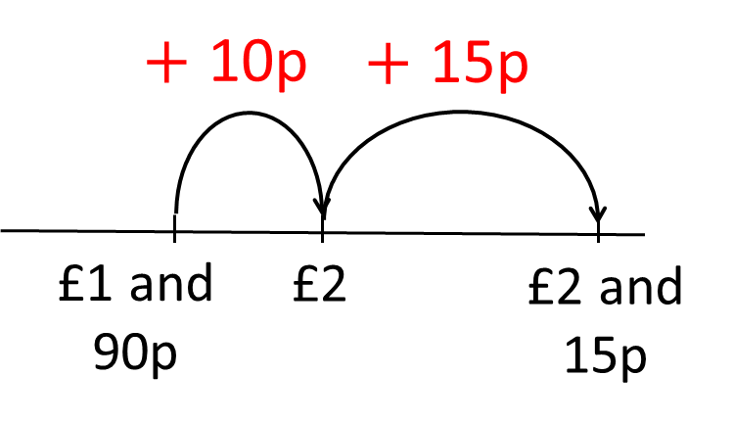
Complete the bar model.
£2 and 15p
£1 and 90p
Have a think
25p

Slide 15
£5 and 30p
£4 and 85p
45p
When the whole amount and the known part have a small difference, it is usually easier to count up.
£5 and 30p
45p
£4 and 85p
When the whole amount and the known part have a large difference, it is usually easier to take away the part we know.

Slide 16
Have a go at the rest of the questions on the worksheet
Work through the questions on your sheet. Work with your partner. Remember to ask for help if you need it.

Slide 17
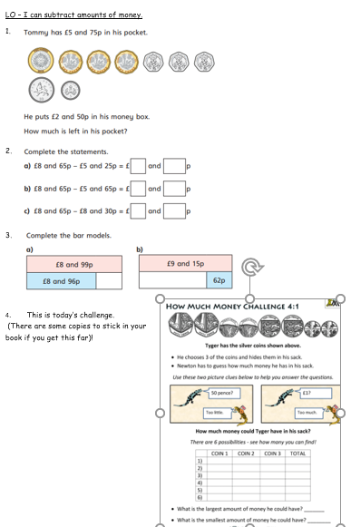
Have a go at the rest of the questions on the worksheet
Today’s worksheet.

