Slide 1
Journey to the Jungle

Slide 2
Monday 7th February 2022
LO: To explore new vocabulary in the text.
LO: To use a dictionary.

Slide 3
Monday 7th February 2022
LO: To use a dictionary.

Slide 4
We learnt the meanings of some new words last week when we found synonyms. Can you remember the definitions?
Let’s have a little quiz! Tell your partner the meaning.

Slide 5
discovery
something that is found or learned for the first time

Slide 6
trek
a long, challenging journey on foot

Slide 7
sturdy
strong and solid

Slide 8
trudge
to walk slowly

Slide 9
circumference
the distance around something circular

Slide 10
dense
packed together with not much space around

Slide 11
mesmerising
something that holds your complete attention

Slide 12
turquoise
a greenish - blue colour

Slide 13
Are there any other words in the text that you are not sure of?
Think about this as we say the text out loud.

Slide 14
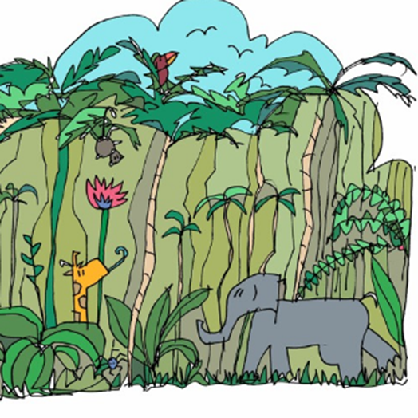
Click on the picture to listen (From 0.22 seconds)

Slide 15
Jungle Log: 31st January, 2022
Today has been an amazing day of discovery! I woke early and got ready for my trek into the Atlanti Jungle. I was excited and couldn’t wait to see what lay ahead of me. I packed my rucksack and put on my sturdy walking boots. I made sure my camera was working because I wanted to record as much of the day as possible. I left the camp at 6am.

Slide 16
First, I trudged through the dense forest and collected samples of the plant life. My favourite was a thorny bush. It had tiny, yellow flowers growing on it, which smelt like ice cream! Next, I studied some of the mesmerising insects that were crawling up the rough bark of every tree. One insect looked like a caterpillar but had 2 sets of wings and tiny hands on the ends of its 20 legs. Excitedly, I photographed as many creatures as I could because I wanted to show my explorer friends what I had discovered.

Slide 17
After a short tea break, I measured the circumference of the tallest trees to work out how old they were. One measured 10 metres around and was so tall that I couldn’t see the top of it. It reminded me of the beanstalk in a famous children’s story. Next, I trekked to a clearing and found a beautiful plunge pool. The water was turquoise and tiny neon fish were splashing on the surface. I tried to catch one, but they were too fast for me. Then it was time for a rest. I lounged on pink grass, soaking up the purple sun beams and listened to the strange jungle noises around me.

Slide 18
Finally, I headed back to camp because the sun began to set. It sets quickly in Oreno and I was worried I might get lost. When I got to my tent, I unpacked my rucksack and stored my plant samples safely. I’m really looking forward to where my wardrobe will take me next week!

Slide 19
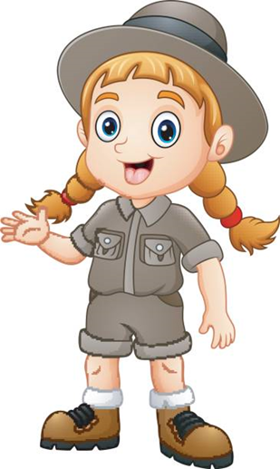
Let’s share any words we are not sure of. We will use our dictionaries to find the definitions and write these in our books.

Slide 20
Write a sentence using one of the new words (either from last week or today) to show that you understand the meaning.
Repeat this for more of the new words.

