Slide 1
Friday 5th November
L.O. – I can describe a setting using a short burst writing technique.

Slide 2
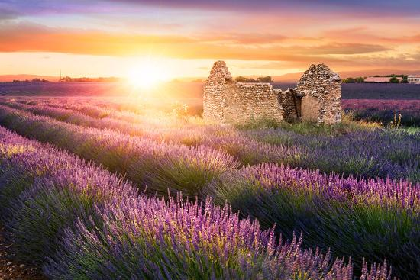
Create a thought shower in your books about this image. Think about the colours you can see.
What time of day is it?
Are there any people there?
Include your 5 senses, what can you see, hear, smell, taste, feel?
Where are you?

Slide 4
lavender fields
pastel sky
shabby building
feel the sun on my face
strong structure

Slide 5
The shabby structure, alone in the vast lavender fields.
Sun soaks my skin, as it sets in the pastel sky.

Slide 6
Now, using the ideas from your thought shower, and our class one, write your own short burst about this image. Focus on 5 key things from the image and make every word count. Use your adjective word mat as well to help you.

