Slide 2
Aim
I can plant seeds and bulbs and suggest how to care for them.
I can set up a test and make a prediction.
Success Criteria
I can follow instructions to plant a seed and a bulb.
I can suggest how to care for a plant so it grows well.
I can set up a simple test to show what plants need to grow well.
I can predict which plants will grow well and which will not.

Slide 3
We have been learning about…
Plants

Slide 4
Seeds and Bulbs
The first stage in the life cycle of most plants is a seed.
Seeds come in all shapes and sizes. Every plant has a different seed.

Slide 5
Seeds and Bulbs
Every single seed has the beginnings of a new plant inside it, along with a little store of food to help it grow.
When the conditions are right, the seed soaks up water and swells, and the tiny new plant bursts out of its shell. This is called germination.
Embryo:
The tiny root and shoot which will grow into the adult plant.
Food Store:
A store of food for the young plant to use until it has grown enough to make its own food.
Seed Coat:
A tough outer covering.

Slide 6
Seeds and Bulbs: Germination
Click the button below to find out more about germination.

Slide 7
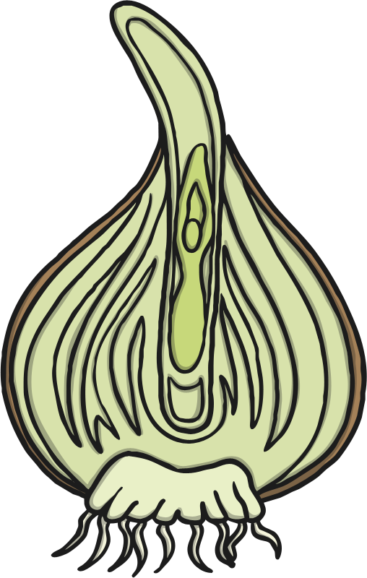
Seeds and Bulbs
Some plants grow first from a seed, and then develop a bulb that helps them to grow back year after year.
A bulb lets the plant rest underground over the winter when it is too cold, then grow back later in the year when conditions are right.
Flower Bud:
Future flower stored inside the bulb for protection.
Tunic:
A papery outer covering.
Scales:
Thick leaves that store the food.
Roots
Stem

Slide 8
Seeds and Bulbs
Here are some common plants that grow from bulbs.
Lilies
Daffodils
Allium
Snowdrops
Tulips

Slide 9
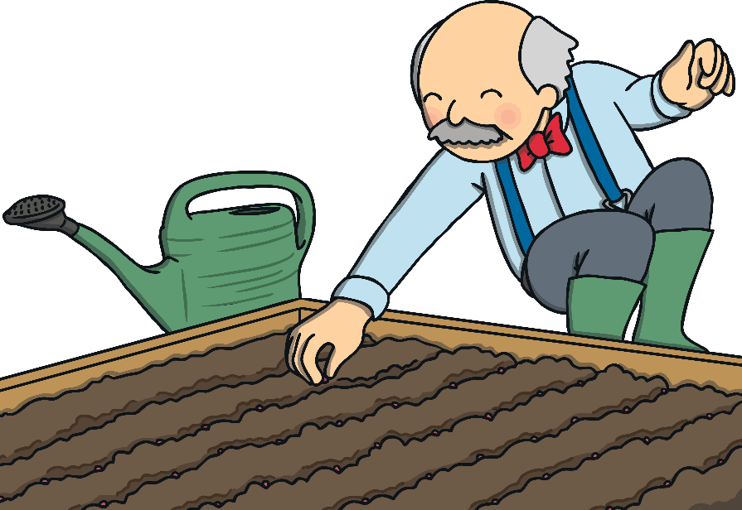
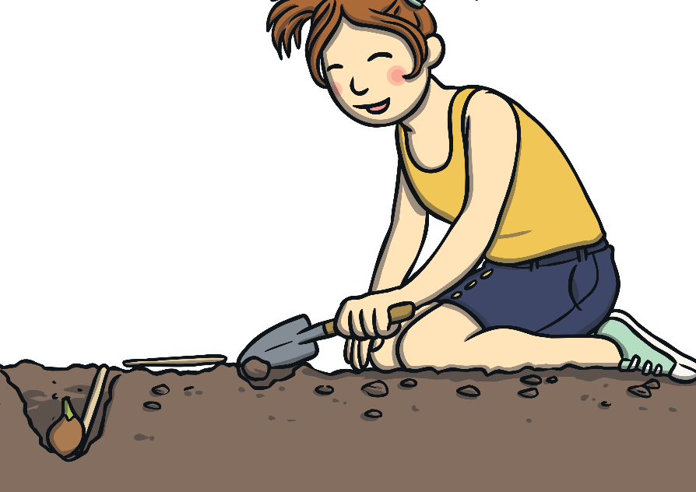
Task 1- Seeds and Bulbs
You are going to plant a seed and a bulb, so you can compare how they grow.
Comparing means looking closely to see what is similar and what is different.

Slide 10
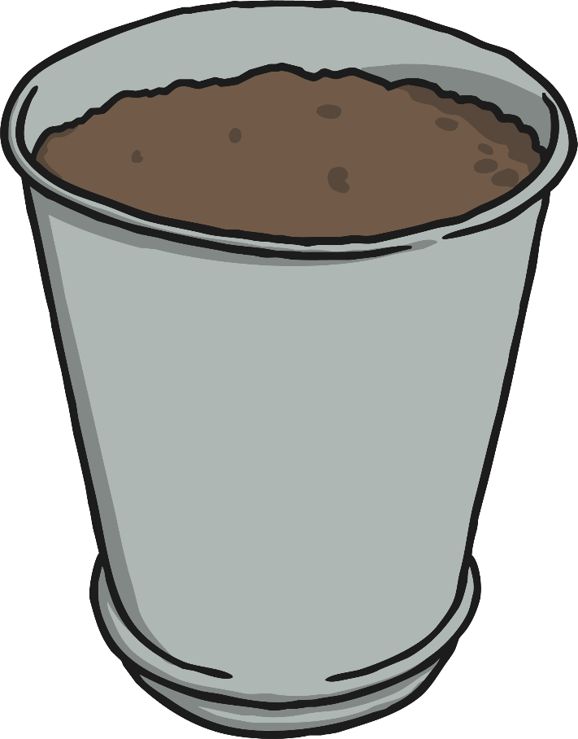
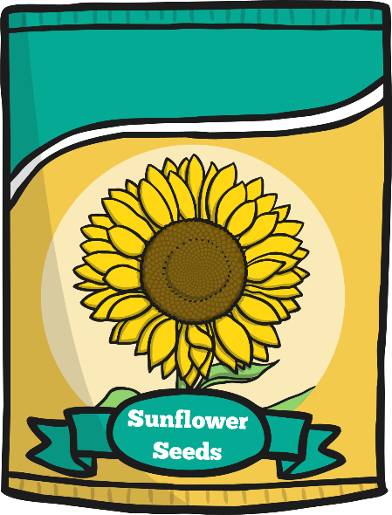
Planting
You will need:
1 seed e.g. sunflower seeds
1 bulb
Plant pots
Soil

Slide 11
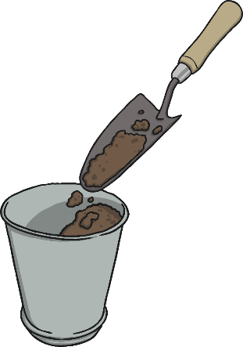
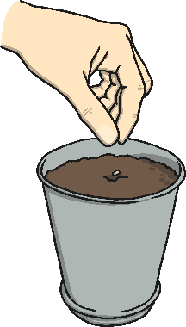
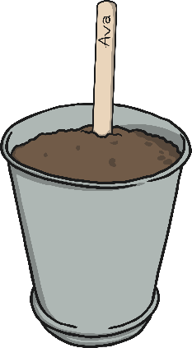
Planting
1
2
Fill your pot half full of soil.
Plant the seed or bulb in the soil.
3
4
Cover the seeds and bulbs with more soil.
Put the seeds and bulbs in a warm and sunny spot.

Slide 12
Task 2- What Do Plants Need to Grow?
Seeds and bulbs need to wait for conditions to be just right before seeds can germinate and bulbs can sprout new growth.
Make a list of what your plants will need so they can sprout and grow well?
How can we find out if you are right?

Slide 13
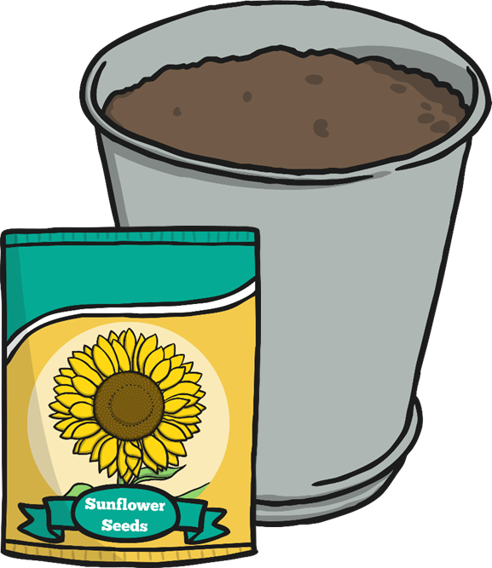
Task 3
Be sure to check on your seed and bulb everyday to observe any changes.
You could even keep a diary and record the changes you notice each day!

Slide 14
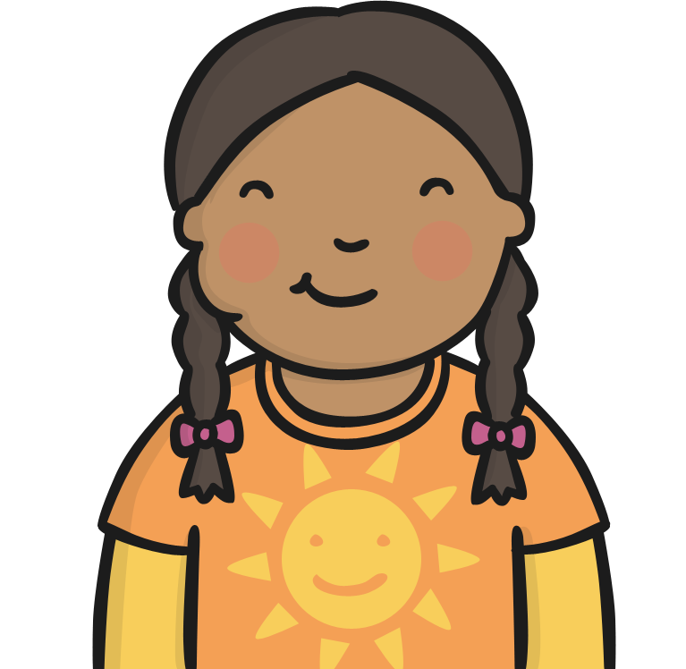
Seed or Bulb? Quiz
On the next slides are some foods that we eat.
Can you guess if the food is a seed or a bulb?

Slide 15
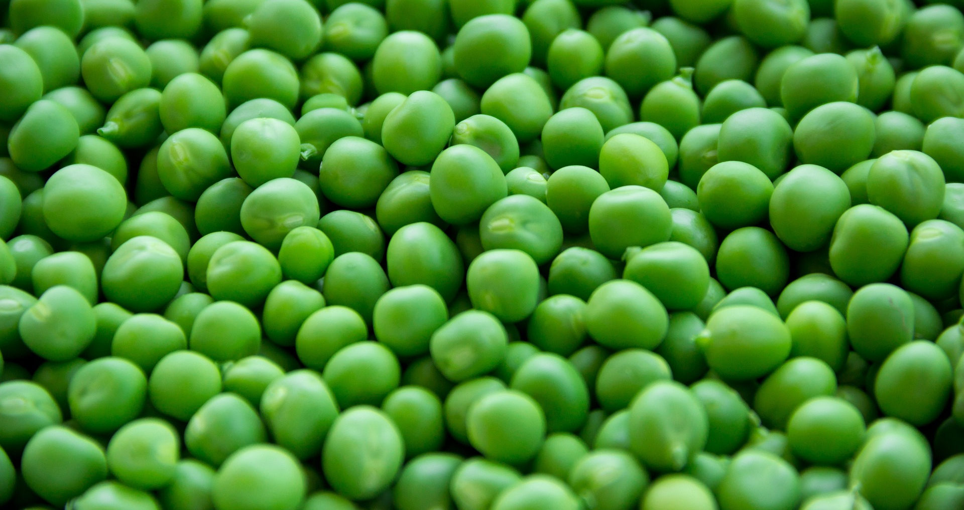
Peas
Seed
Bulb

Slide 16
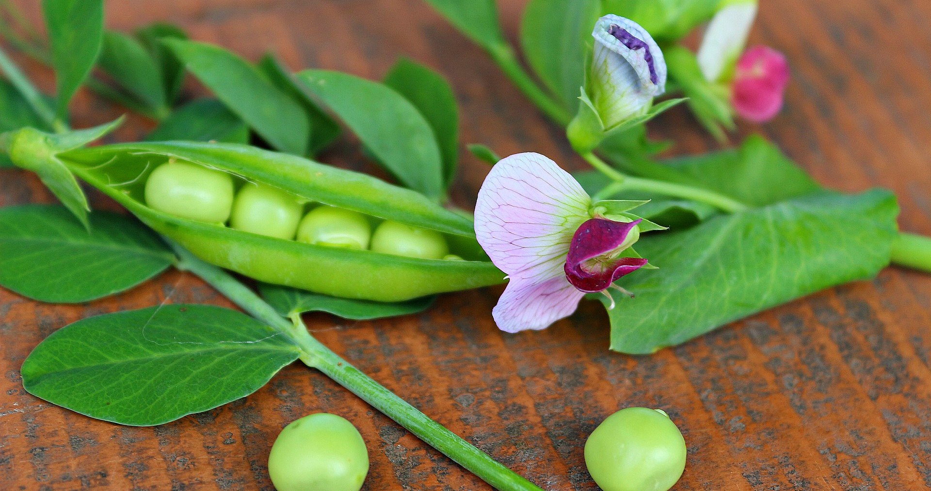
Peas
Correct!
A pea is a seed. Well done!

Slide 17
Peas
Bad luck!
A pea is actually a seed.

Slide 18
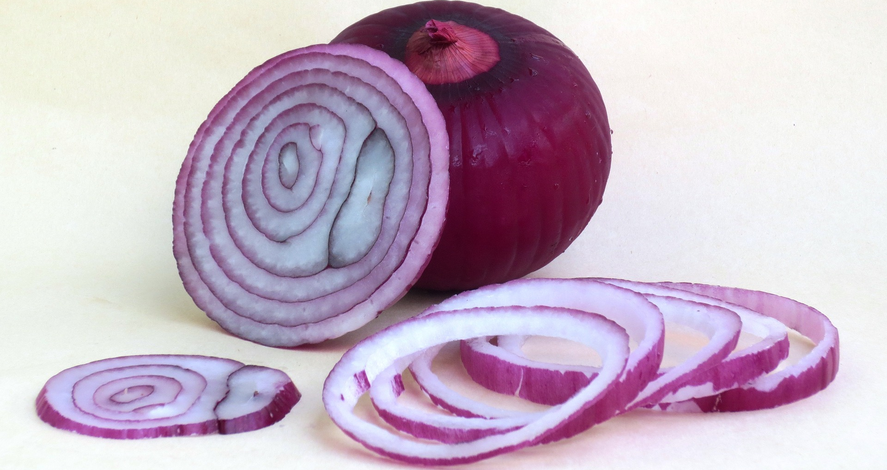
Onion
Seed
Bulb

Slide 19
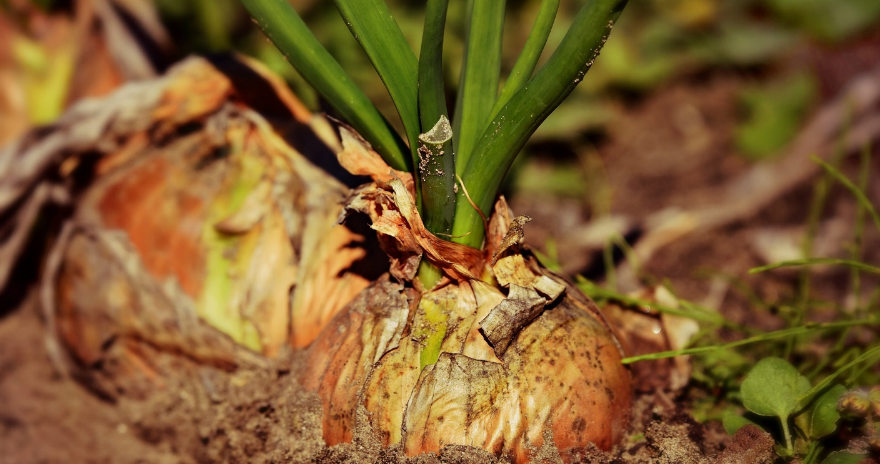
Onion
Correct!
An onion is a bulb. Well done!

Slide 20
Onion
Bad luck!
An onion is actually a bulb.

Slide 21
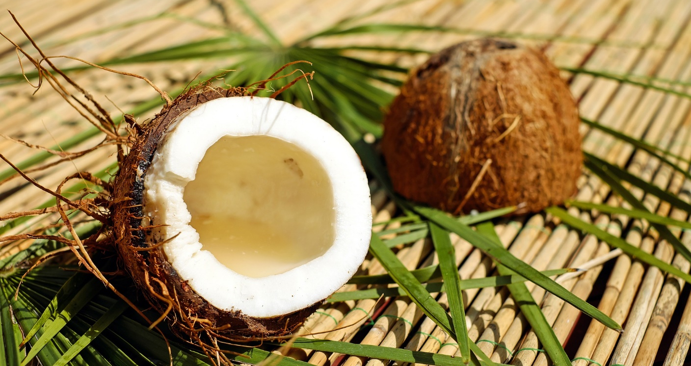
Coconut
Seed
Bulb

Slide 22
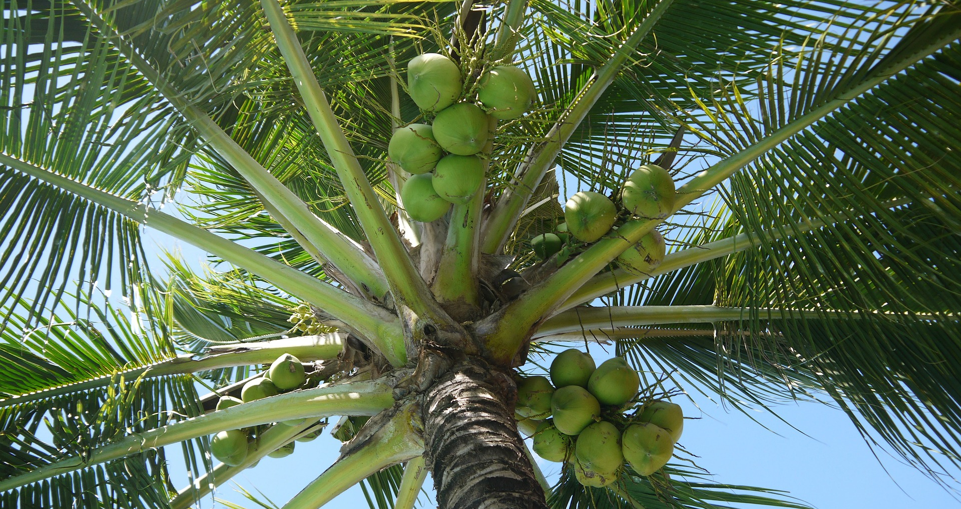
Coconut
Correct!
A coconut is a seed. Well done!

Slide 23
Coconut
Bad luck!
A coconut is actually a seed.

Slide 24
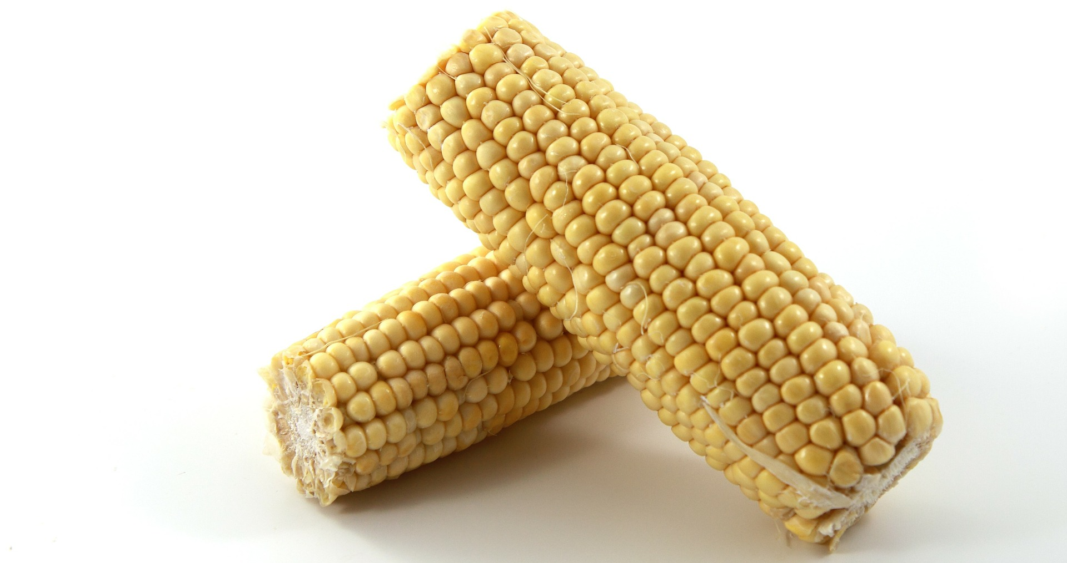
Sweetcorn
Seed
Bulb

Slide 25
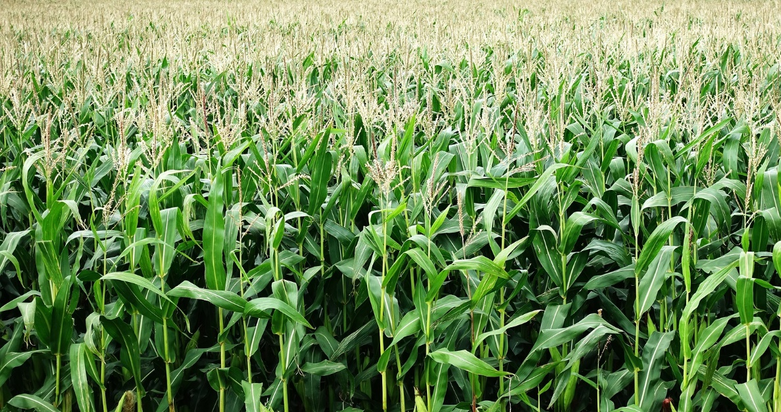
Sweetcorn
Correct!
A corn kernel is a seed. Well done!

Slide 26
Sweetcorn
Bad luck!
A corn kernel is actually a seed.

Slide 27
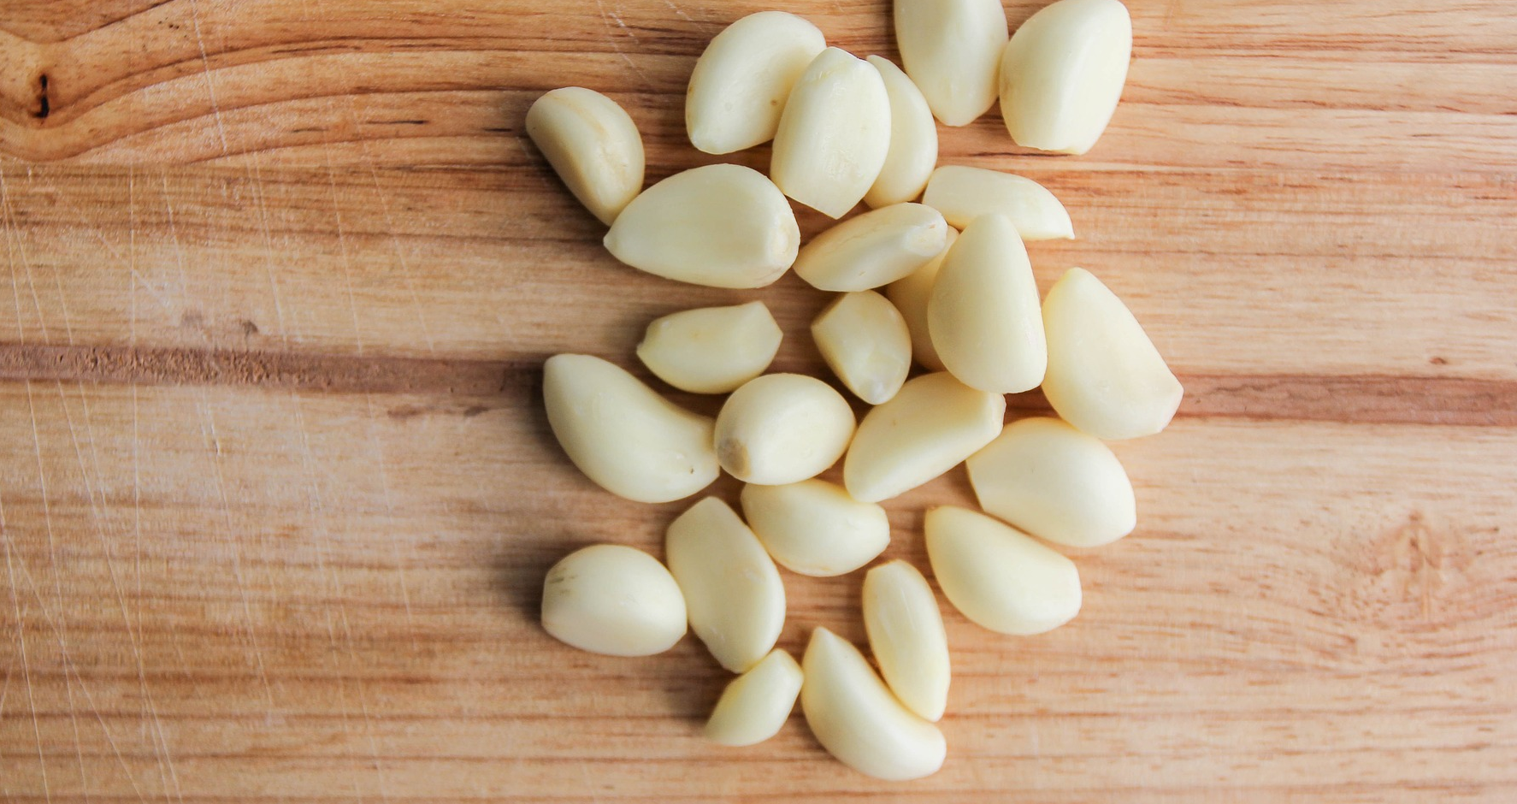
Garlic
Seed
Bulb

Slide 28
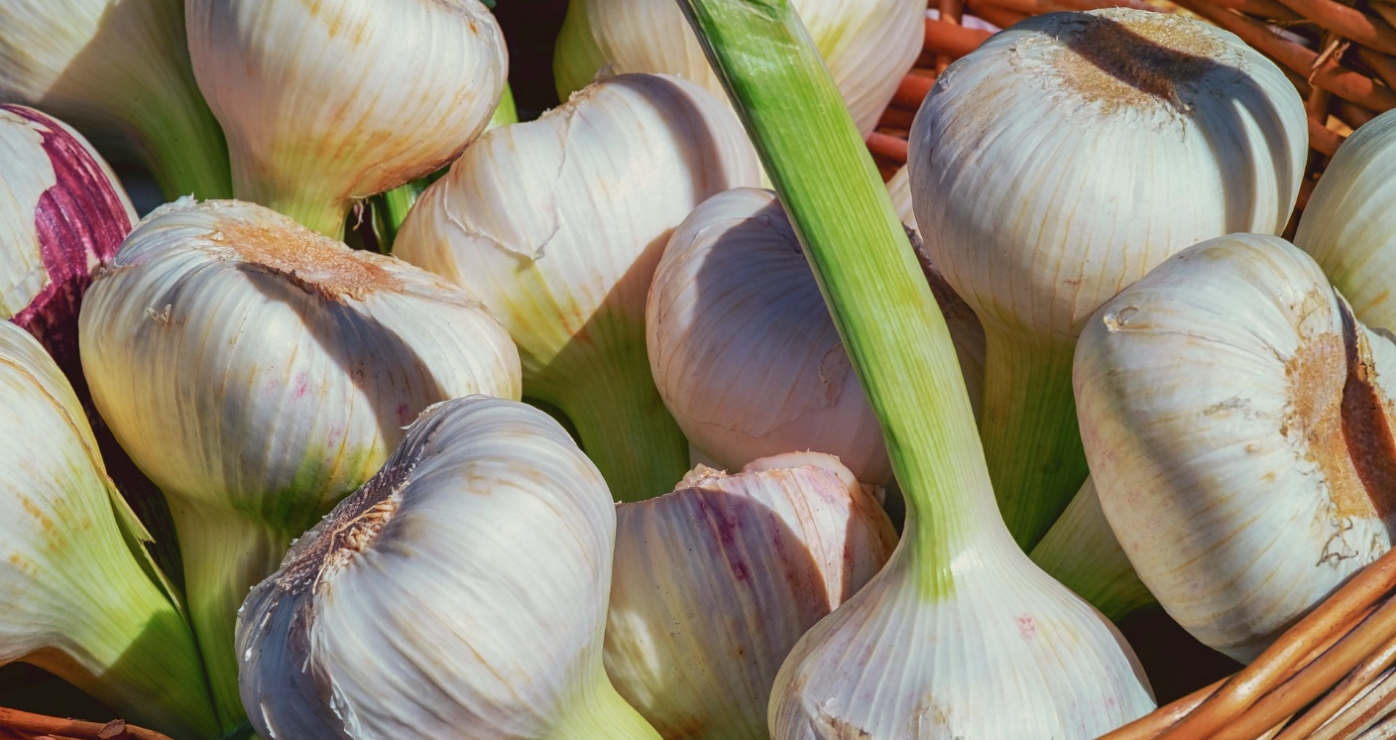
Garlic
Correct!
Garlic is a bulb. Well done!

Slide 29
Garlic
Bad luck!
Garlic is actually a bulb.

