Slide 1
11.11.21
L.O. – I can estimate answers.

Slide 2
1) Round 365 to the nearest 100
2) Round 8,392 to the nearest 100
3) Round 8,392 to the nearest 1,000
If you finish these questions, use the times tables grid in the front of your maths book to look at your 9x tables.

Slide 3
1) Round 365 to the nearest 100
400
2) Round 8,392 to the nearest 100
8,400
3) Round 8,392 to the nearest 1,000
8,000

Slide 4
£2,138
£1,279
Hang on, I’ll just work it out…
How? I haven’t written the numbers yet!
I have £3,800 in my bank, can I afford to buy the TV and the laptop?
2
1
3
8
STOP! I already know he can afford it.
+
1

Slide 5
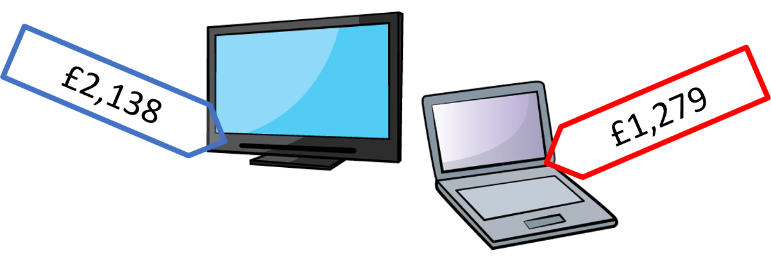
Ahhh, I see
Yes
£2,138 is quite close to £2,100
£1,279 is quite close to £1,300
£2,100 plus £1,300 is £3,400
so Ron has enough money.

Slide 6
But you’ve made £2,138 smaller so how can you know for sure?
Even if you added £2,200 and £1,300 it would be £3,500 so you would still have enough.

Slide 7
But you’ve made £2,138 smaller so how can you know for sure?
Even if you added £ 2,200 and £ 1,300 it would be £ 3,500 so you would still have enough.
I have rounded the numbers to estimate, which gives me a sensible but not exact answer.

Slide 8
Whitney has £437
Her uncle gives her £266
How much does Whitney have now?
£400
£437 rounded to the nearest 100 is _______
£266 rounded to the nearest 100 is _______
£300
The estimated answer is:
£400 + £300 =
£700

Slide 9
Dexter runs 3,015 m
Alex runs 1,657 m less.
How far does Alex run?
Have a think
3,000
3,015 rounded to the nearest 1,000 is ______
1,657 rounded to the nearest 1,000 is ______
2,000
The estimated answer is:
______ $−$ ______ = ______
3,000
2,000
1,000 m
Dexter
3,015
1,657
Alex
?

Slide 10
Complete question 1 in your books.

Slide 11
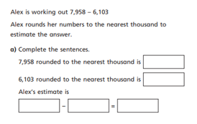
Now, lets complete question 2.
If you finish, complete the collumn addition to find out the actual answer for Alex’s sum.

Slide 12
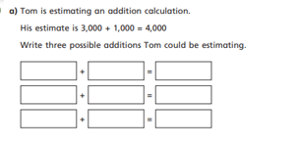
Complete question 3 in your books.
What are 3 questions Tom could be trying to work out?

Slide 13
An estimated calculation is 800 $+$ 300 $=$ 1,100
What additions could this be the estimate for?
A possible addition is:
______ + ______ = ______
Have a think
814
270
1,084
750
800
849
250
300
349

Slide 14
Name | Points
Eva | 3,568
Mo | 3,951
I will round to the nearest 1,000 to estimate our total points.
4,000 $+$ 4,000 $=$ 8,000
I will round to the nearest 100 to estimate our total points.
3,600 $+$ 4,000 $=$ 7,600
Whose estimate is more accurate?

Slide 15
Name | Points
Eva | 3,568
Mo | 3,951
Estimated total: 8,000
Estimated total: 7,700
Th | H | T | O
3 | 5 | 6 | 8
3 | 9 | 5 | 1
7 | 5 | 1 | 9
I think the exchanged digits haven’t been added.
Th | H | T | O
3 | 5 | 6 | 8
3 | 9 | 5 | 1
6 | 4 | 1 | 9
I think there must be a mistake.
This answer isn’t close to our estimates.
Estimating helped us find a mistake and check our answer.
1
1

Slide 16
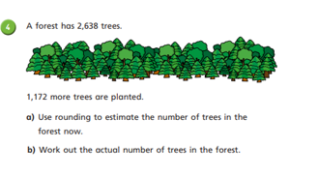
Use the methods we have been looking at to work out this problem.

Slide 17
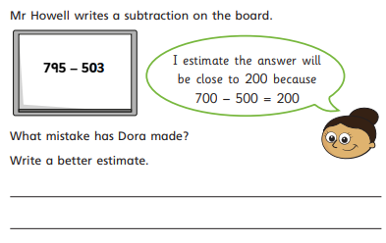
Plenary
Write your estimate for Mr Howell’s question on your whiteboard.

