Slide 1
Monday 29th November
L.O. I can write a diary entry from Edgar’s perspective.

Slide 2
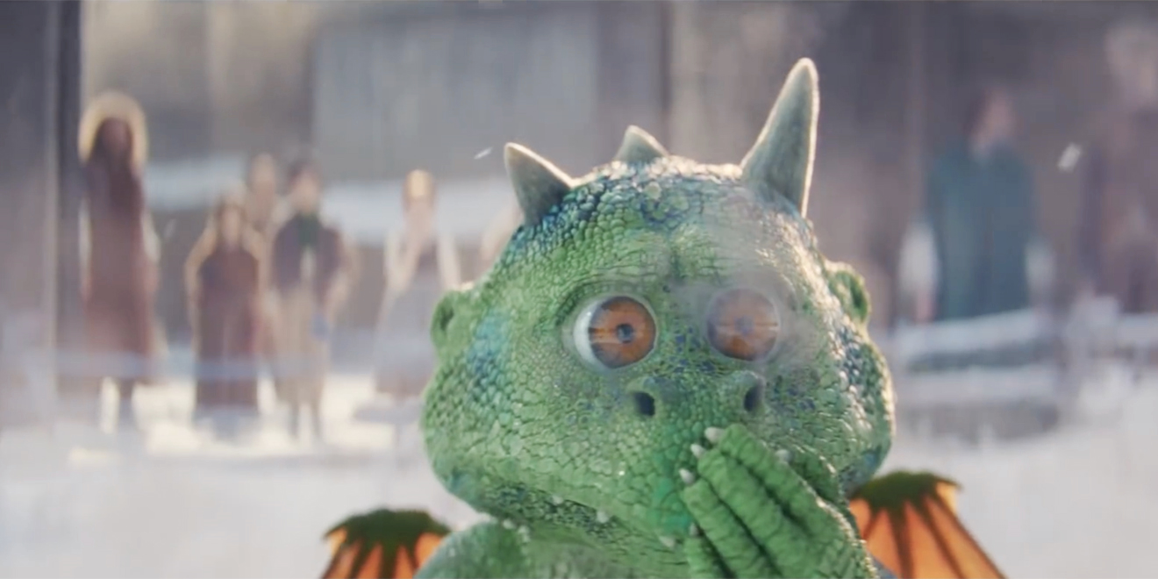
Diary entry
This week you are going to imagine that you are Edgar, and write a diary extract from his point of view about what happened.

Slide 3
Let’s quickly recap the features we need in a diary (recount)…

Slide 4
Date and time
You can write the date at the top of the page like this…
or it can be included in the first few sentences of a diary entry like this...
‘It is past midnight but I am still wide awake because my day has been so exciting.’
This is important because it tells the reader exactly when the diary is being written.

Slide 5
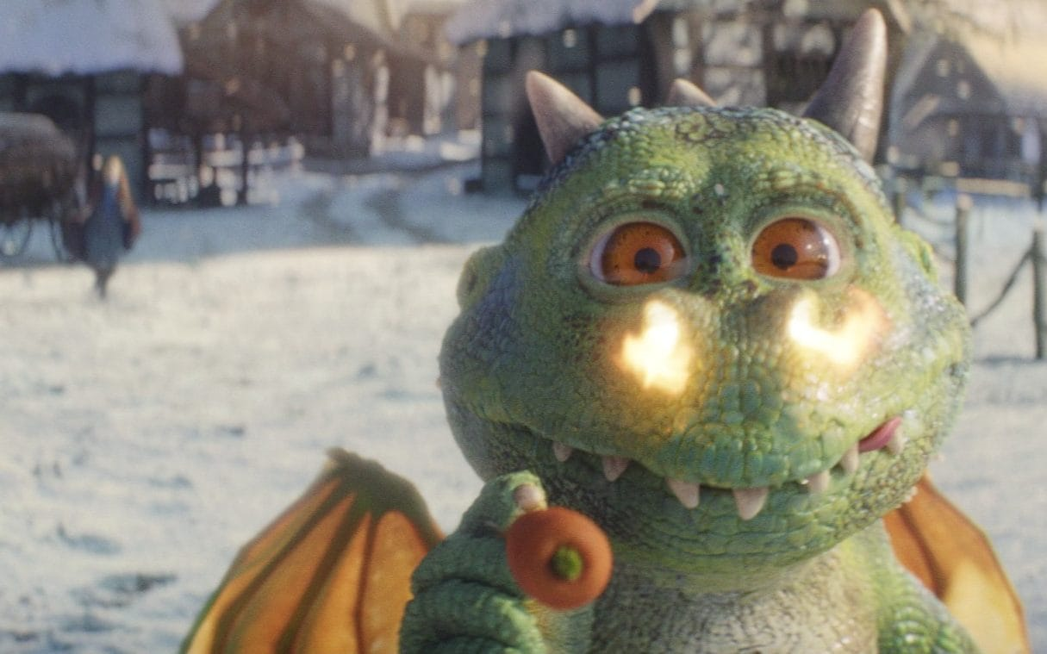
Past tense
When we write a diary, we write in the past tense. This is because we are writing about something that has already happened.

Slide 6
‘I’, ‘my’, ‘we’ and ‘our’
A diary entry needs to be written in first person. So you need to use words like ‘I’, ‘my’, ‘we’ and ‘our’.
I played with the new football I got for my birthday.
When my brother came home, we went inside our house. First person!

Slide 7
Chronological order…
You must write about the events in the order that they happened.
You only need to write about the most interesting and exciting parts of your day.

Slide 8
Describe feelings
A diary is usually a secret place to write how you feel about what has happened to you in the day.
In a diary, you might include feelings, hopes or fears that you wouldn’t want anyone to know about.

Slide 9
Time connectives
A diary is usually describing lots of events. To make sense of when these events happened it is helpful to include time linking words, such as ‘next’, ‘first’ and ‘then’.

Slide 10
We are only doing the first paragraph today, so we are not going past the melting of the snowman…
https://www.youtube.com/watch?v=AzIT3pbbZr8

Slide 11
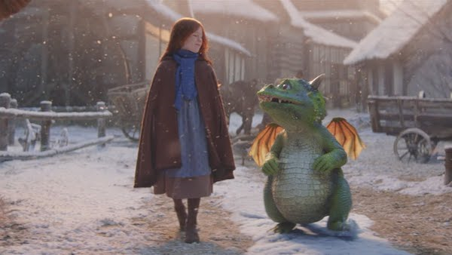
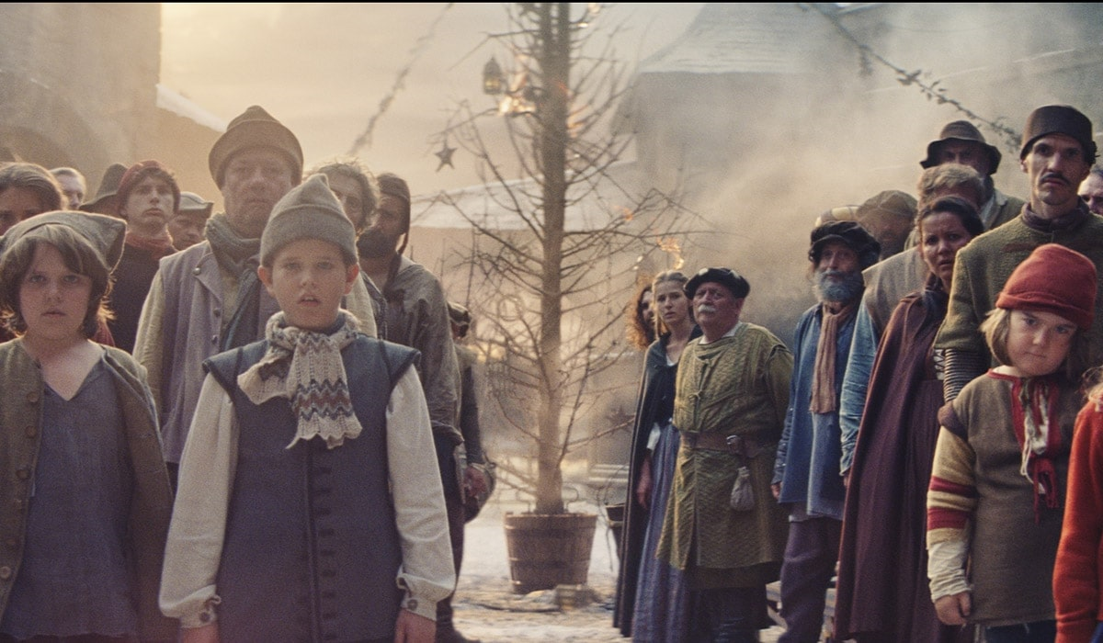
Date
When do you think this all took place?

Slide 12
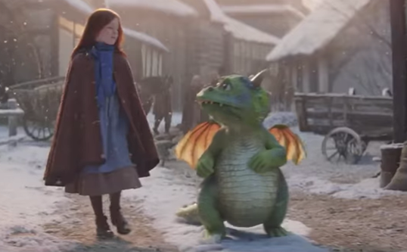
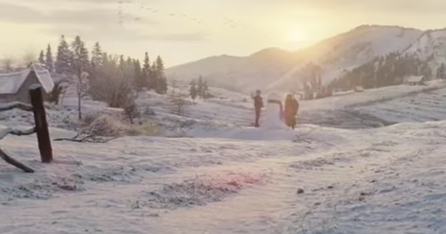
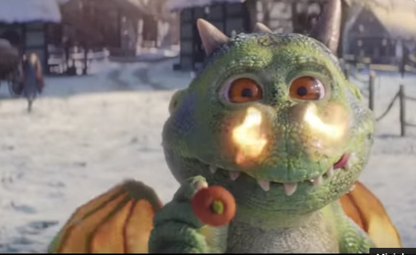

Slide 13
Edit your writing
- Editing your writing means that you are preparing for it to be read.
You might need to do some corrections (spelling mistakes, missing punctuation).
You might see a way of changing your writing to make it even better!
You MUST read through your writing!!!!

Slide 14
Edit your writing
- Capital letters e.g. Edgar, Ava, I
Full stops at the end of your sentences.
Finger spaces!
Does your sentence make sense?

Slide 15
Tuesday 30th November
L.O. I can write a diary entry from Edgar’s perspective.

Slide 16
New vocabulary

Slide 17
Hidden in the classroom are 5 new words and 5 definitions. You need to find them and match the words to their definitions.
Rules:
You must NOT run in the classroom.
If you move something to look for a word/ definition. You MUST put it back properly.

Slide 18
We are only doing the second paragraph today, so we are not going past the ice rink…
https://www.youtube.com/watch?v=AzIT3pbbZr8

Slide 20
Edit your writing
- Editing your writing means that you are preparing for it to be read.
You might need to do some corrections (spelling mistakes, missing punctuation).
You might see a way of changing your writing to make it even better!
You MUST read through your writing!!!!

Slide 21
Edit your writing
- Capital letters e.g. Edgar, Ava, I
Full stops at the end of your sentences.
Finger spaces!
Does your sentence make sense?

Slide 22
Wednesday 1st December
L.O. I can write a diary entry from Edgar’s perspective.

Slide 23
We are only doing the third paragraph today, so we are not going past when Edgar burns the Christmas tree and hides in his house…
https://www.youtube.com/watch?v=AzIT3pbbZr8

Slide 25
Edit your writing
- Editing your writing means that you are preparing for it to be read.
You might need to do some corrections (spelling mistakes, missing punctuation).
You might see a way of changing your writing to make it even better!
You MUST read through your writing!!!!

Slide 26
Edit your writing
- Capital letters e.g. Edgar, Ava, I
Full stops at the end of your sentences.
Finger spaces!
Does your sentence make sense?

Slide 27
Thursday 2nd December
L.O. I can write a diary entry Edgar’s perspective.

Slide 28
New vocabulary

Slide 29
Can you use each word into a sentence?
Valiant
Optimistic
Livid
Grand
Exquisite

Slide 30
We are writing the final paragraph today!
https://www.youtube.com/watch?v=AzIT3pbbZr8

Slide 32
Edit your writing
- Editing your writing means that you are preparing for it to be read.
You might need to do some corrections (spelling mistakes, missing punctuation).
You might see a way of changing your writing to make it even better!
You MUST read through your writing!!!!

Slide 33
Edit your writing
- Capital letters e.g. Edgar, Ava, I
Full stops at the end of your sentences.
Finger spaces!
Does your sentence make sense?

