Slide 2
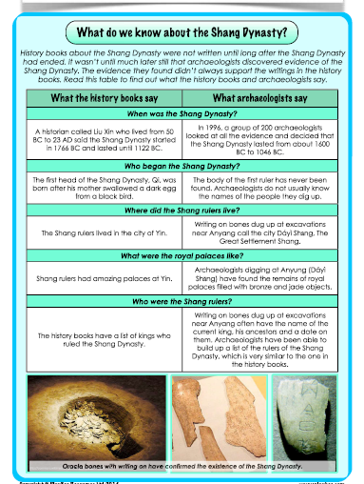
Let’s recap…
Look in your books from last time. Tell your learning partner a fact that you learnt during our last lesson about the Shang Dynasty.
Let’s share some facts with our class.

Slide 3
Today, we are going to find out how Shang society was organized, and we will use our note-taking skills to write down key facts.
These notes will help us to write a diary entry about the life of an ordinary person during the Shang Dynasty

Slide 4
What was it like to live in the Shang Dynasty?

Slide 5
Talk to your partner about each of these questions. How much can you remember from the video?

Slide 6
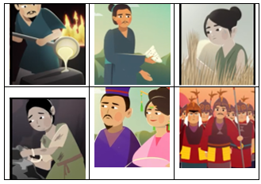
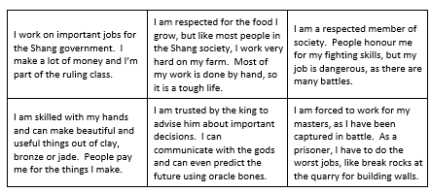
As we saw, life was hard for the Shang people, unless they were rich; however, things were not as simple as that. Shang society was divided into several different ‘classes’, each of which had its own strict place. The further down the ‘ladder’ of society they were, the harder life was for people.
Cut out the pictures and match them to the short descriptions – compare your decisions with your partner’s.
Work together to discuss and arrange the different classes from the richest down to the poorest on your grid (do not stick them down yet)
You can make changes as we learn more in the lesson.

Slide 7
Nobles were also high-ranking soldiers

Slide 8
What jobs did the Shang people do?

Slide 9
You should now be able check if your pictures and information boxes are correct. Stick them down on the grid and then write these labels in the empty spaces:
Slave/prisoner king/ruler farmer
priest craftsman soldier/nobleman

Slide 10
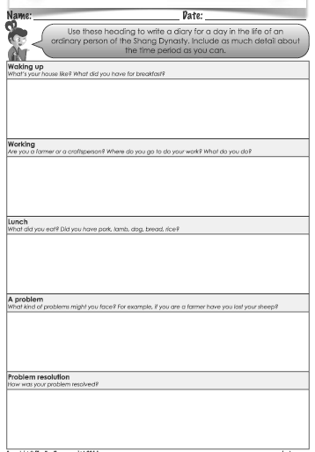
You will be stepping into the (tatty) shoes of a lower class member of Shang society – a lowly farmworker perhaps, or maybe a slightly better-off craftsperson, or even a bottom-of-the-pile slave who was captured in the last battle.
You will be writing a diary entry to show a day in the life of your chosen Shang person. It should include details of where you live, your job and an event that involves at least one member of a different class.
Make notes on this worksheet using what you have learnt so far.
Then add details as you learn more on the next screens.

Slide 18
Time to write your diary entry!

