Slide 1
18.11.21
L.O. – I can find equivalent lengths cont.

Slide 2
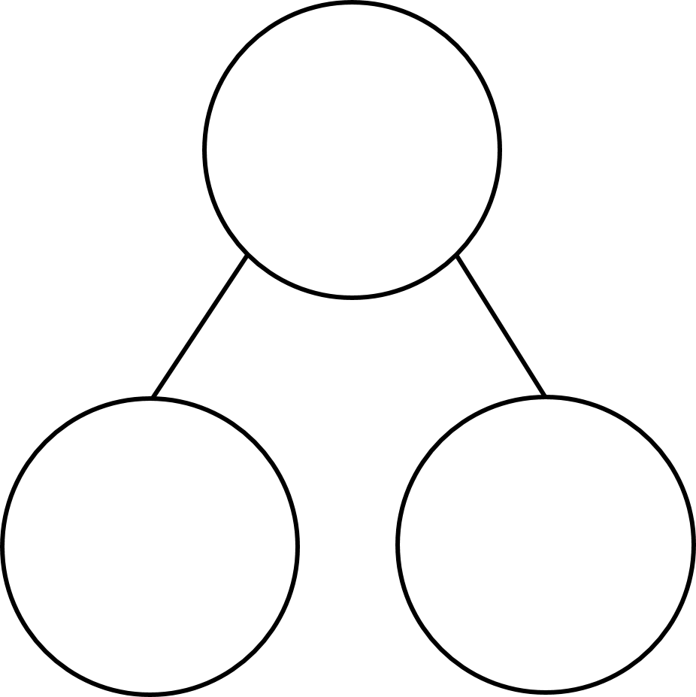
Complete the sequence.
10, 20, 30, 40, _____, _____
2) How many tens are in 38?
3) Complete the part-whole model.
72
If you finish, practise your 9x tables on your whiteboard.
2 ones

Slide 3
Complete the sequence.
10, 20, 30, 40, _____, _____
50
60
2) How many tens are in 38?
3 tens
3) Complete the part-whole model.
72
7 tens
2 ones

Slide 4
centimetres
0
1
2
3
4
5
6
7
8
9
10
0
10
20
30
40
50
60
70
80
90
100
millimetres
100 mm = 10 cm
60 mm = 6 cm
70 mm = 7 cm
50 mm = 5 cm
8 cm = 80 mm
0 cm = 0 mm
4 cm = 40 mm
1 cm = 10 mm
3 cm = 30 mm
2 cm = 20 mm
9 cm = 90 mm

Slide 5
4 cm =
1 cm = 10 mm
40 mm
1 cm | 1 cm | 1 cm | 1 cm
1 cm
10 mm
10 mm
10 mm
10 mm
10 mm
20 mm =
2 cm
1 cm
1 cm
10 mm
10 mm

Slide 6
60
6 cm
59
5 cm 9 mm
58
5 cm 8 mm
57
5 cm 7 mm
51 mm
52 mm
56
5 cm 6 mm
55
5 cm 5 mm
54
5 cm 4 mm
5 cm
1 mm
50 mm
2 mm
53
5 cm 3 mm
52
5 cm 2 mm
51
5 cm 1 mm
mm
50
5 cm
cm and mm

Slide 7
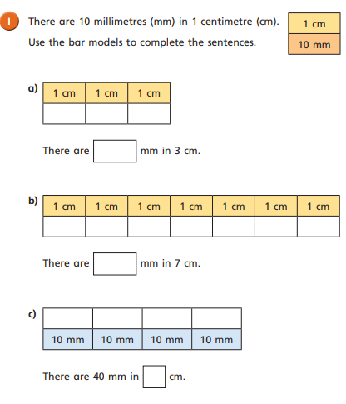
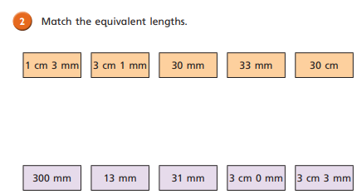
Work through questions 1 and 2 on your worksheet.

Slide 8
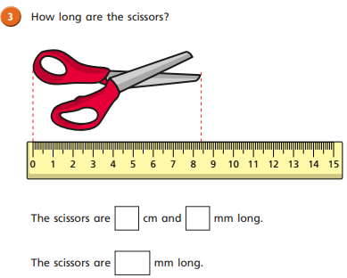
Now, complete question 3.
If you finish, measure some items on or around your tables and record their measurements in your maths book in cm and mm.

Slide 9
20 mm
45 mm
Have a think
82 mm
2 cm
4 cm 5 mm
8 cm 2 mm
cm
40 mm
45 mm
48 mm
50 mm
41
42
43
44
46
47
4 cm
4 cm
5 mm
4 cm
8 mm
5 cm

Slide 10
1 cm = 10 mm
53
5 cm and 3 mm = ____ mm
53 mm
53 mm
5 cm | 3 mm
50 mm
3 mm
5 cm
50 mm + 3 mm =
53 mm

Slide 11
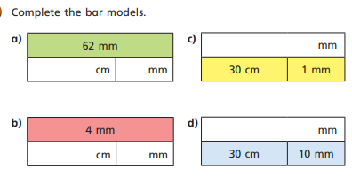
Now, finish the question on your work sheet.
There is a challenge question to complete as well.
If you finish both, find some more items to measure, record them in cm and mm.

