Slide 1
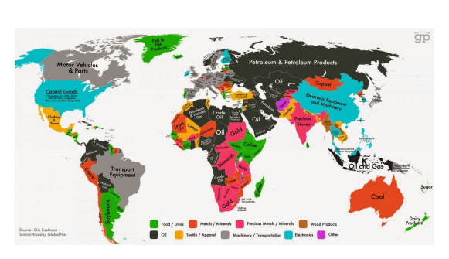
International/ Global Trade Natural Resources

Slide 2
31.01.22 LO: To know which natural resources are traded the most.

Slide 3
Flashback!
International trade is the exchange of goods and services between countries.

Slide 4
TTYP- What is import and export?
If something is imported it is bought from another country and if some is exported it is sold to another country.

Slide 5
Natural resources are all the land, forests, energy sources and minerals existing naturally that can be used by people and traded.

Slide 6
We live on a planet that has all the resources we need to survive.
TTYP- Can you think of any natural resources?
Humans and other life forms depend on natural resources to survive.

Slide 7
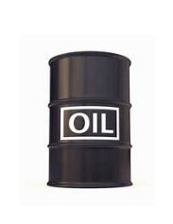
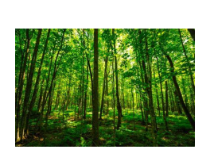
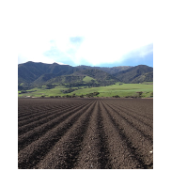
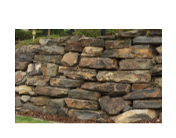
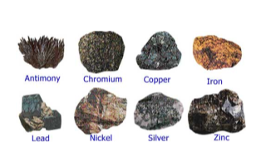
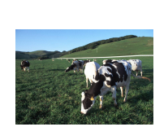
Water
Forest/ Plants
Common natural resources
Soils
Rocks
Minerals
Agriculture
Agriculture is another word for farming. It includes both growing and harvesting crops and raising animals, or livestock.

Slide 8
International trade in natural resources is important because:
Each resource occurs more commonly in some parts of the world than others.
Humans are reliant on natural resources for survival and if the resources are not available in a country then they must be imported.
Countries can earn money by exporting natural resources to other countries.

Slide 9
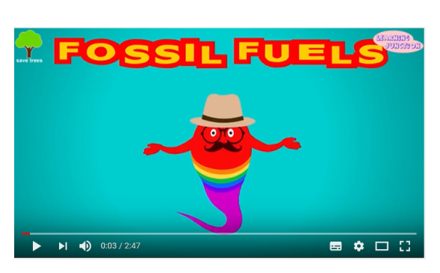
Fossil fuels are natural fuels such as coal or gas.
Fossil fuels are formed from the remains of ancient animals and plants, buried deep inside the Earth for several years. Let's watch this video and learn a little more about it...

Slide 10
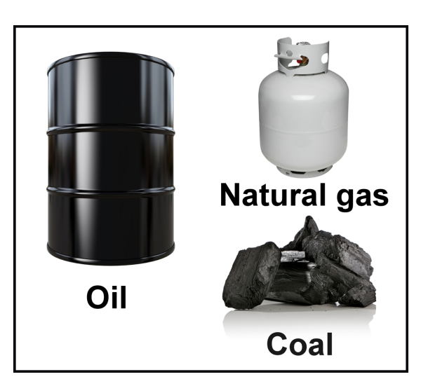

Slide 11
One of the most traded natural resource is oil, it is an important natural resource for fuel. On the next slide, is a map showing where most of the world's oil is produced. The Middle East is the world's largest producer of oil. As a class, can you plot the other producers of oil on the map, starting with the biggest provider.

Slide 12
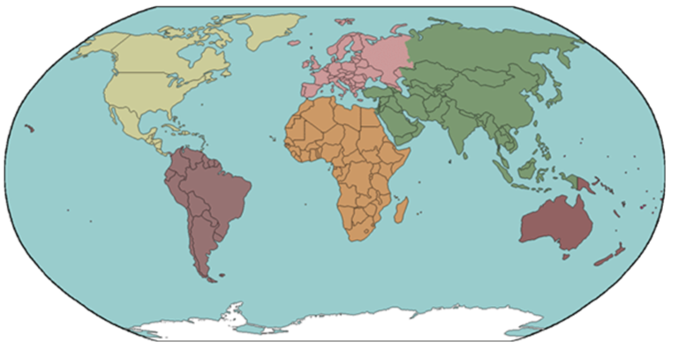
3. North America
7. South America
1. Middle East
4. Africa
6. Europe
2. Russia
5. Asia
8. Australia

Slide 13
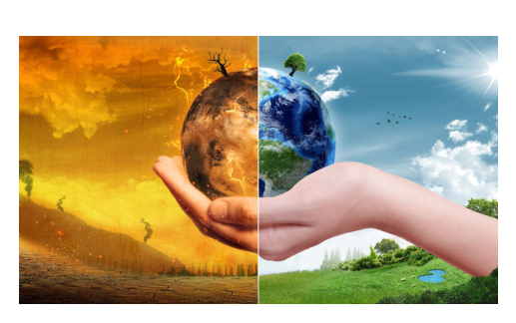
Burning fossil fuels can have a negative impact on our environment. It releases carbon dioxide which is a gas that causes climate change which leads global warming.
What can we do to help decrease global warming?

Slide 14
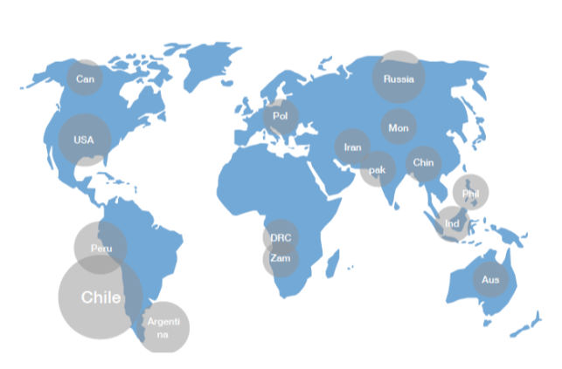
The map below shows where most of the world's nickel and copper is mined. These materials are used for making batteries and are in increasing demand as more electric cars are being made, which are much cleaner for our the environment.

Slide 15
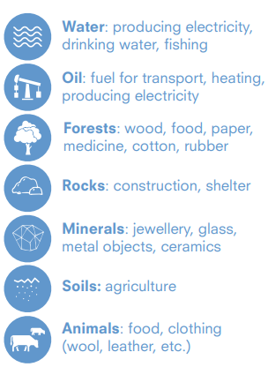
In your books, create a spider diagram (below) listing the most commonly traded natural resources.
List all the resources below. Draw a small picture and include what the resource is used for.
Natural Resources

Slide 16
Challenge:
Give two reasons why international trade is so important.
One disadvantage of mining fossil fuels.

