Slide 1
18.03.21 LO: To know how to multiply by 4.

Slide 2
Vocab
array
bar model
remainder
repeated addition
multiplication sentence
division statement
equal
multiply
divide
times-tables
sharing
grouping
division facts
factor

Slide 3
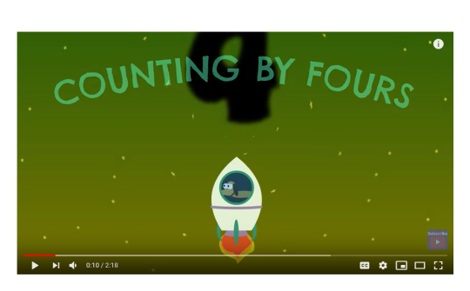

Slide 4
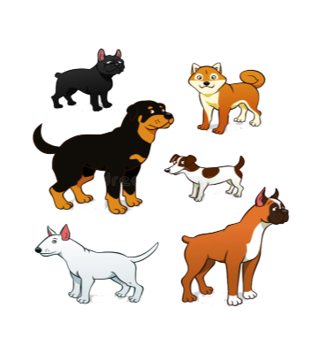
There are 6 dogs.
How many dog legs are there in total?
Write a multiplication statement to work out the answer.
There are ___ dogs. Each dog has ___ legs.
6 x 4 = ___
There are ___ dog legs in total.

Slide 5
An owner comes in to the shop and wants to buy 5 bags of dog food.
The owner pays 20 £1 coins in total for the 5 bags.
Is this the correct amount?

Slide 6
How much does it cost in total for 4 bags of dog food?
___ x ___ = ____
It costs ___ £1 coins in total for 4 bags of dog food.

Slide 7
There are 7 dogs.
How many dogs legs are there in total?
___ x ___ = ____
There are ___ dog legs altogether.

Slide 8
There are 32 dog legs in total.
How many dogs are there?
There are ___ dogs because ___ x ___ = ___

Slide 12
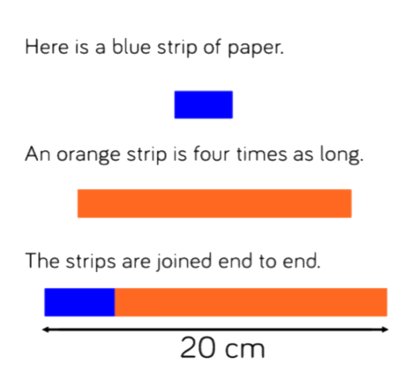
Class discussion:
How long is the blue strip?
How long is the orange strip?
Explain how you know?

