Slide 1
Friday 28th January L.O. – I can create a dream mobile.

Slide 2
Recently, we have been thinking about dreams and goals in our PSHE lessons.
What is a goal?
Can you remember the goal you wrote down for yourself in your book?
What is the difference between a dream and a goal?

Slide 3
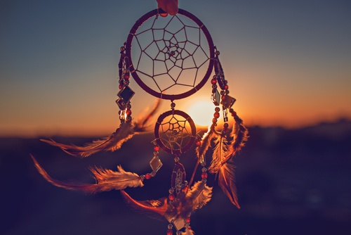
Today we are going to be creating our very ow dream mobiles.
Have you seen these before?
Do you know what they are used for?

Slide 4
The dream catcher is one of the oldest and widespread symbols associated with Native American culture.
It’s commonly believed that the iconic hoop-and-web form is meant to protect sleepers from bad dreams by “catching” them, while letting good dreams pass through.

Slide 5
We are going to be creating our own dream mobiles in this lesson. I am going to show you some different examples and you can decide from there which one you would like to create.
Your dream mobile should be a reflection of you. This means the design should represent you and should be unique and different to everyone else's in the class.

Slide 6
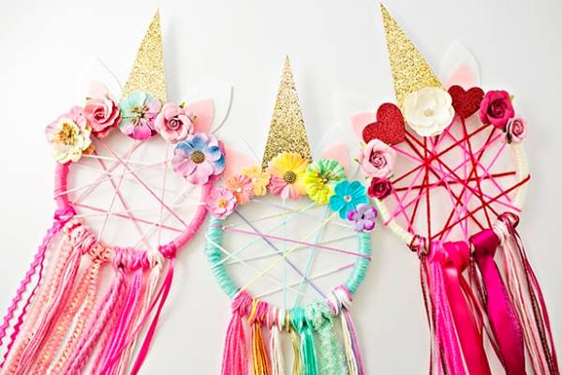

Slide 7
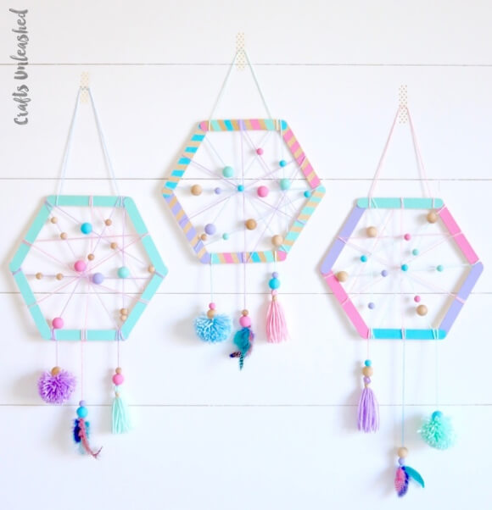

Slide 8
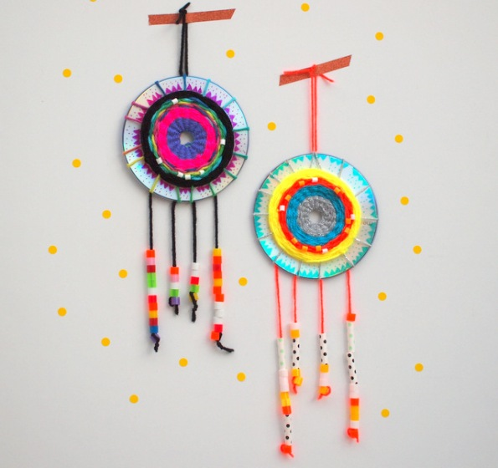

Slide 9
Each one of those designs were special and different. I hope it has given you some inspiration for today’s lesson.
There are some materials available to use such as pipe cleaners, lollipop sticks, feathers, string and coloured paper.
It is up to you to come up with a design that best fits you!

