Slide 2
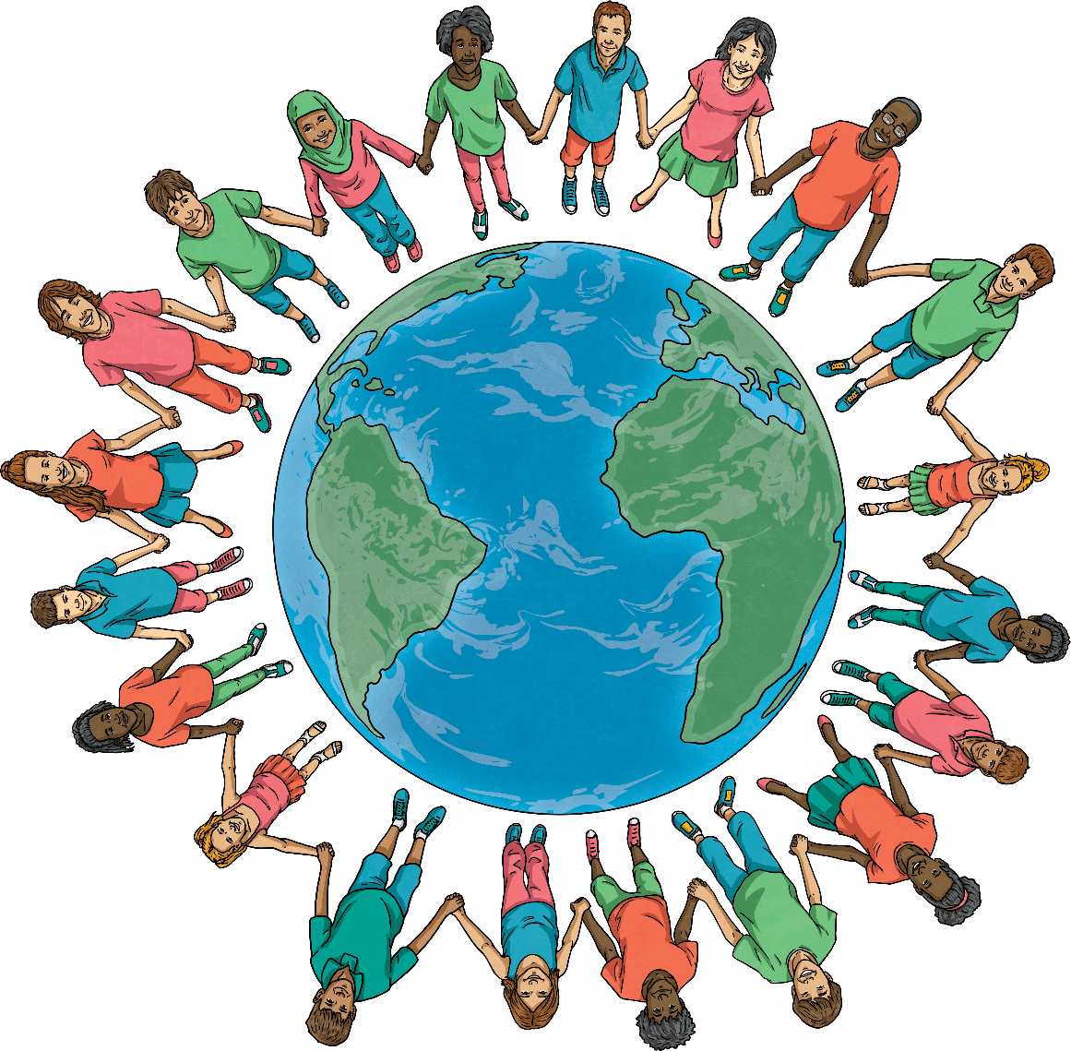
What Is World Religion Day?
World Religion Day is celebrated annually on the third Sunday of January.
The aim of World Religion Day is to promote understanding and peace between all religions and to encourage people to learn about other faiths and their followers.
It was initially started by followers of the Bahá’í faith.

Slide 3
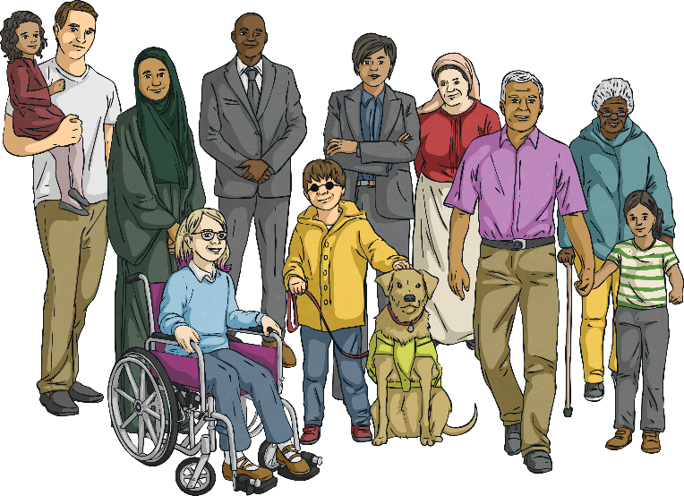
The Bahá’í Faith
The Bahá’í faith was founded in 1863 in Iran. The Bahá’í faith believes that:
All religions have common features and that all religions should be respected;
All human beings are different but equal;
There is one God who is known by different forms in all religions, such as Buddha, Moses, Jesus and the Prophet Muhammad (Peace Be Upon Him);
The diversity between the religions is due to the way people think about god;
We all have the same rights regardless of our religion or creed.

Slide 4
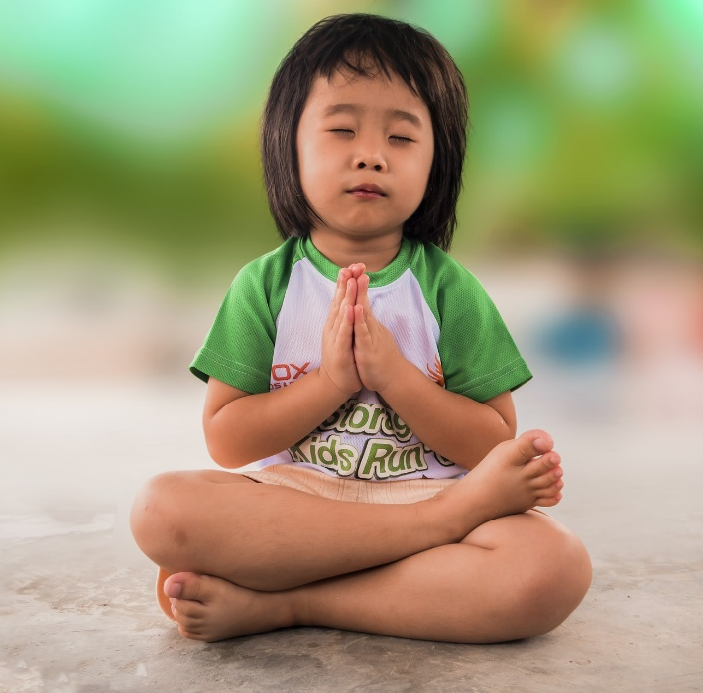
Why Do We Celebrate
World Religion Day?
World Religion Day invites members of all religious groups from across the globe to recognise that all religions have a common spiritual goal. It aims to promote inter-faith understanding and harmony and unite people, regardless of their beliefs.
World Religion Day also seeks to overcome historical differences between religious groups. Throughout history, many conflicts and wars have been caused by arguments over religion and beliefs. The day aims to overcome this and achieve a peaceful understanding between faiths.

Slide 5
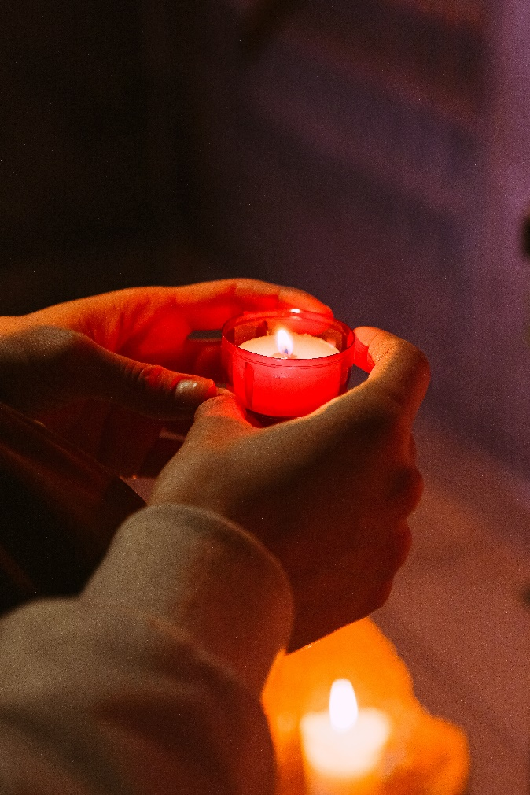
How Do We Celebrate
World Religion Day?
World Religion Day is celebrated in a variety of ways. Many organisations celebrate the day by holding interfaith events, where faith leaders get together to give talks and lectures.
People are encouraged to talk with and to listen to people from faiths different from their own and to understand the basic principles of other religions.
  There is time to reflect on the universal message of the six main religions – treating each other with respect and understanding, to create a better world for everyone.

Slide 6

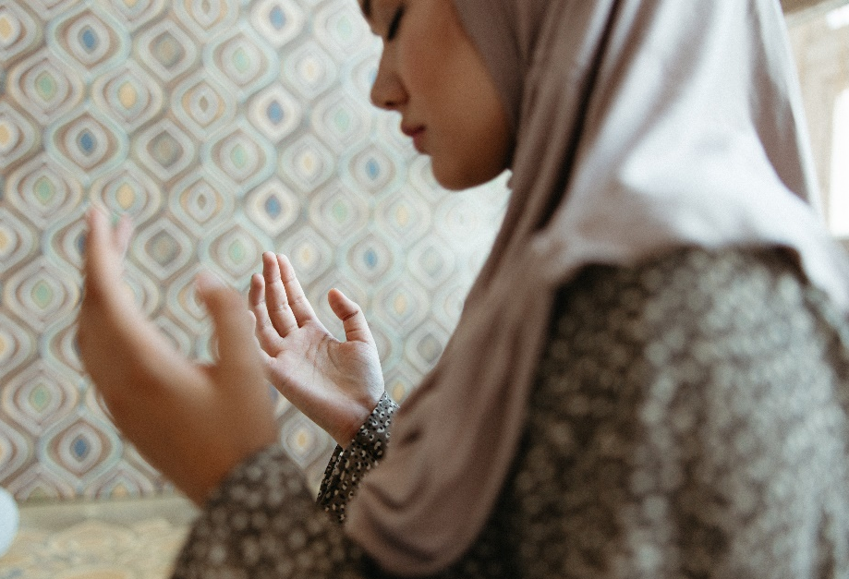





What Are the Six
Major Religions?
Nearly 75% of the world practices one of these six religions:
Christianity:
Judaism:
Hinduism:
Buddhism:
Sikhism:
World Religion Day promotes their similarities and the role religion has played in uniting people across the planet.
Islam:

Slide 7





Similarities
The Bahá'í faith believes that all religions have things in common and teaches that all religions should be respected.
What do all religions have in common?
The love of a higher being or God;
A holy book;
A place of worship.
World Religion Day is celebrated to promote interfaith understanding, which means involving many different religions and uniting them together.

Slide 8
Similarities
Christianity:
In everything, do to others as you would have them do to you.
Judaism:
What is hateful to you, do not do to your neighbour.
Hinduism:
This is the sum of duty; do not do to others what would cause pain if done to you.
Buddhism:
Treat not others in ways that you would find hurtful.
Sikhism:
I am a stranger to no one and no one is a stranger to me. I am a friend to all.
Islam:
Not one of you truly believes until you wish for others what you wish for yourself.
Can you spot similarities here?
What words are repeated?

Slide 9
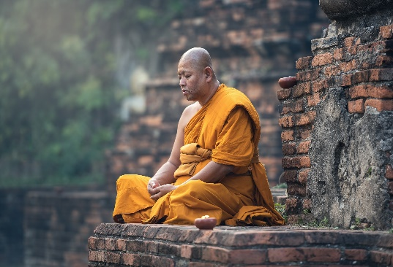
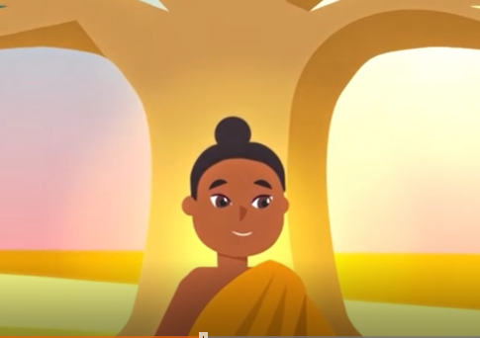
Take one religion
Today, we will be learning about a religion that we do not usually find out about in Year 5:
Buddhism:

Slide 10
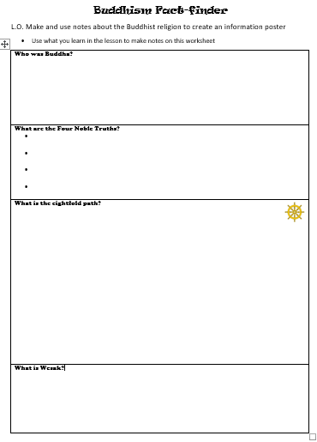
Make notes in your Buddhism Fact-finder worksheet as we find out more about this religion. You will then use this to create an information poster for other classes to read.

Slide 11
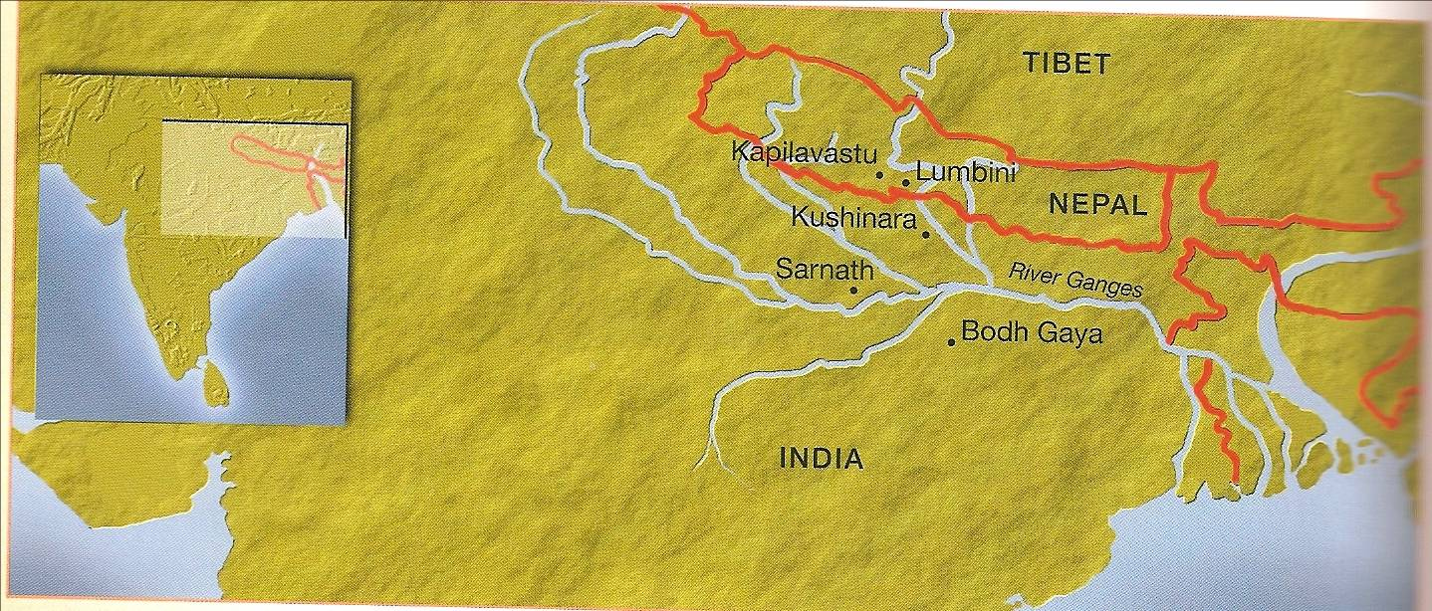
In Buddhism there is one person whose life and teaching helps people to understand more about life. Buddhists believe he was the wisest teacher of all. His name was Siddharta Gautama but he is known by his special title; the Buddha.
He was born in a town called Lumbini, in India, near Nepal about 2500 years ago. He was the son of a king and a queen.

Slide 12
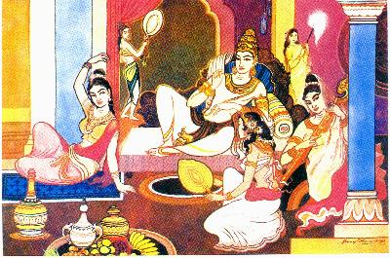
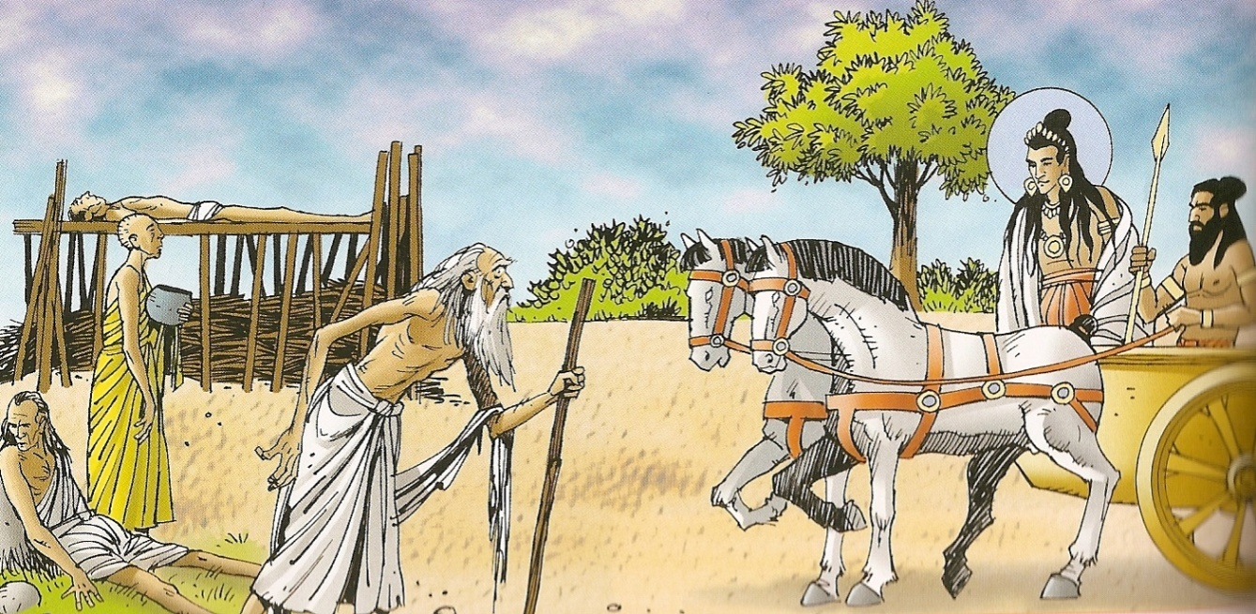
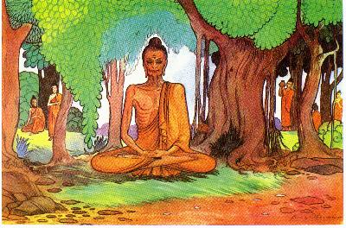
The King did not want his son to see suffering so he decided Siddartha should live a life of luxury sheltered from the realities of the world.
The King tried to protect Siddartha from the realities of the world but Siddartha was not happy living like a prisoner. One day he went out hunting and he saw four sights:
  Old age
  Sickness
  Death
  A holy man
Each of the four sights made Siddartha sad and this made him think about life. He decided that he must leave home in a quest for enlightenment. He spent six years travelling around India and then sat under the BODHI tree (meaning tree of wisdom); it was there he gained enlightenment.

Slide 13
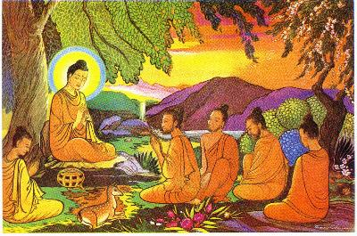
Being enlightened meant that he understood how life should be lived, and he decided to share his understanding with others.
Buddha realised that there was suffering in the world because of four noble truths:
Suffering happens all the time because people always want more or something better than what we have.
Because we don’t have what we want we suffer and feel upset.
If we accept what we have and stop wanting more we will become happy.
This will stop suffering.

Slide 14
Can you think of any situations in life when you wanted more or something better than what you had?
How did it make you feel?
What would Buddha have said to you?
People who follow the teachings of Buddha, known as Buddhists, always try to think about situations in their life with the four noble truths in mind. This is easier said than done, however, and they need the help of some extra guidelines.
This is called the Noble Eightfold Path.

Slide 15
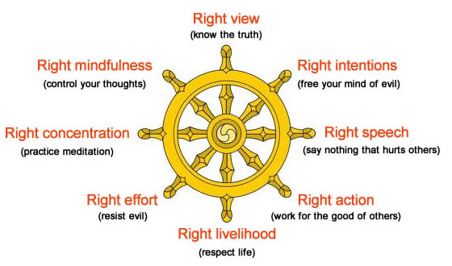
The Noble Eightfold Path.

Slide 16

The first part of the Noble Eightfold Path is simply to know the truth. A follower of Buddhism will always seek to find out the truth, rather than accept anything they see, read or hear without questioning it first.
In what modern-day situations would this be very good advice?

Slide 17
The Noble Eightfold Path.

Slide 18
The second and third parts of the Eightfold Path are having the right intentions and carrying those thoughts through – these are very important to Buddhists in their daily lives.
How many of you are the sort of people who would pick up someone else’s coat and hang it up if you saw it lying in the corridor?
Have you ever said ‘no’ when a friend has suggested doing something that you know your parents wouldn’t want you to do, even though there would have been no way of them finding out?
Did any of you pick up the tokens on the floor without being asked? Did you put them all back?!

Slide 19
The Noble Eightfold Path.

Slide 20

The fourth part of the Eightfold Path is central to the teachings of Buddha. It can be very easy to say something that hurts someone else, even if it’s not done on purpose. Choosing the right speech requires a lot of self-control and consideration of others’ feelings and circumstances.
How easy is it to react to someone’s seemingly hurtful actions or speech by retaliating with something equally hurtful?
Buddha would say that we need to stop and think first: why did the person do that? What might they be going through that has resulted in them saying something hurtful? What could we say to help them feel better?
Each time the sponge ball is thrown to a person, pass them a compliment too!

Slide 21
The Noble Eightfold Path.

Slide 22
The fifth part of the Eightfold Path is to choose the right actions, so that what you do will be for the good of others.
This is something that you could do in those small, everyday actions; for example, holding the door open for someone or helping your parents with the vacuuming.
We have been thinking about our dreams and goals for adult life in PSHE lessons. Can you think of any careers that would fulfil this part of the Eightfold Path?

Slide 23
The Noble Eightfold Path.

Slide 24
The sixth part of the Eightfold Path is to respect life, property and morality. This pulls together the other parts of the Path that we have looked at so far, in that you should respect everyone and everything around you, and choose to make the right decisions and say the right things.
Easier said than done! In order to help Buddhist do these things, they need to follow the final two parts of the Eightfold Path.

Slide 25
The Noble Eightfold Path.

Slide 26


Meditation is a way of focusing your mind, which helps to control your thoughts. So much of being a Buddhist requires self-control, so it is important for them to spend time regularly meditating.
Can you control your mind to see either the rabbit or the duck?
Can you force yourself to believe that all these stripes are actually parallel and not wonky at all?
These are just simple optical illusions, but meditation helps a Buddhist to reach a higher level of self-control in their daily life.

Slide 27


Wesak
It’s not all meditation and thinking of others – like other religions, there are times of celebration. One of the most important festivals in the Buddhist calendar is Wesak (or Vesak), which is always celebrated on the full moon in May.
Wesak celebrates Buddha’s birthday and in many countries, Buddhists will visit a temple for services and teaching. They will offer the monks food, candles and flowers.

Slide 28
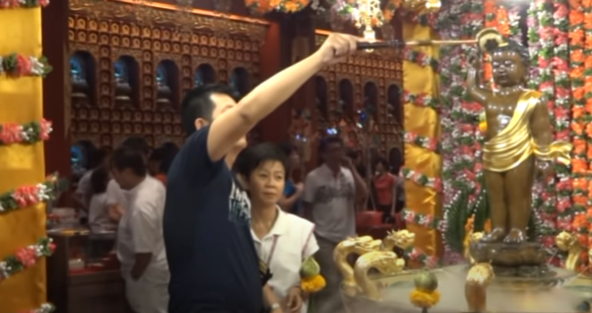
Water is poured over the shoulders of statues of the Buddha as a reminder to purify the mind from greed, hatred and ignorance.
Gifts are taken to an altar to be offered to the Buddha statues. This shows respect and gratitude to the Buddha for his life and teachings.
Watch this video and try to spot the different parts of Wesak.

Slide 29

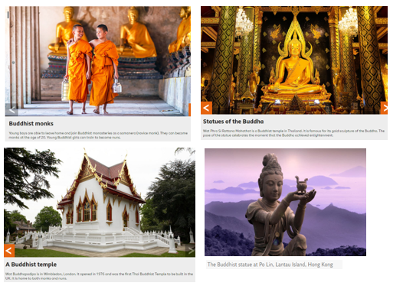
You should now have plenty of information about Buddhism on your fact-finder sheet.
Now you can produce a poster about Buddhism – you could include information from everything you have found out about, or you could choose to focus on just one element; for example, the Eightfold Path, or how Buddhists celebrate Wesak.
Use the poster frame and photo sheet to help you organise and illustrate your poster.

