Slide 1
Thursday 21st January
L.O. I can write multiplication sentences using pictures.
Multiplication and division

Slide 2


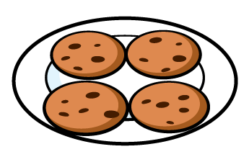
Year 2 | Week 11 | Day 4

Slide 4




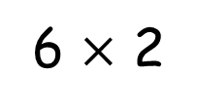
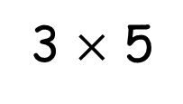
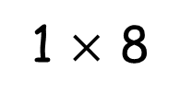
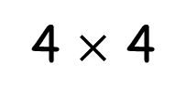
Some of these are incorrect, can you draw a correct representation?
3 $×$ 5
4 $×$ 4
1 $×$ 8
6 $×$ 2

Slide 5
Some of these are incorrect, can you draw a correct representation?
3 $×$ 5
4 $×$ 4
1 $×$ 8
6 $×$ 2

Slide 7

What do you see?
3
4
There are ____ equal groups of ____
3
4
There are ____ lots of ____
3
4
____ multiplied by ____

Slide 8

What do you see?
Have a think
6
2
There are ____ equal groups of ____
6
2
There are ____ lots of ____
6
2
____ multiplied by ____

Slide 9

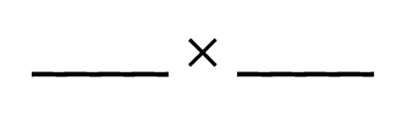
Have a think
4
5
There are ____ equal groups of ____
4
5
There are ____ lots of ____
4
5
____ multiplied by ____
4
5
____ $×$ ____

Slide 10
Have a go at question
1 on the worksheet

Slide 11
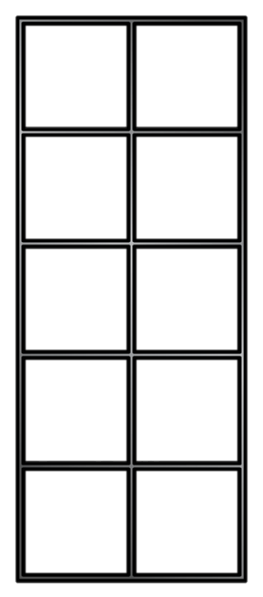
6
3
There are ____ lots of ____
6
3
____ multiplied by ____
6
3
____ $×$ ____
Notes:
How could I represent this?

Slide 12
Have a go at questions 2 and 3 on the worksheet

Slide 13
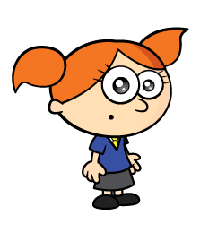

Have a think
I think I can write 4 different multiplications
I think there are 8

Slide 14
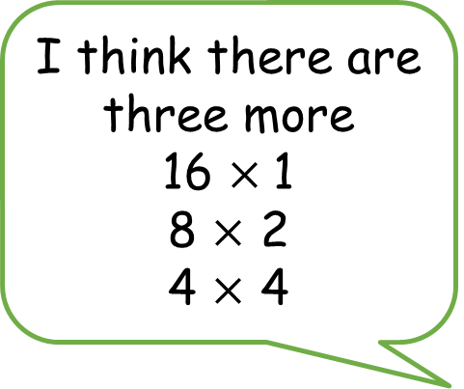
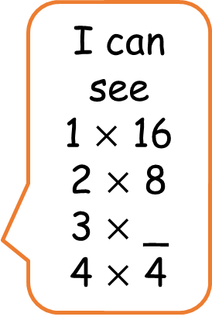
I think there are three more
16 $×$1
8 $×$ 2
4 $×$ 4
I can see
1 $×$ 16
2 $×$ 8
3 $×$ _
4 $×$ 4

Slide 15
Have a go at the rest of the questions on the worksheet

Slide 16

Challenge
There are four plates.
There are three cookies on each plate.
How many cookies are there altogether?
Drawn an image and write a calculation to represent the problem.

