Slide 1
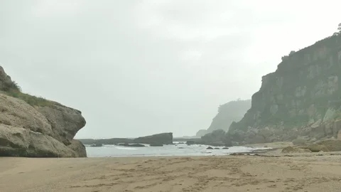
Adventure at Sandy Cove

Slide 2
Monday 22nd March 2021
LO: To use ‘show not tell’.

Slide 3
First of all, let’s remind ourselves of the story:
We can listen to the text here and follow along with the text on our copy.

Slide 4
Today we are going to remind ourselves about ‘show not tell’. Can anyone remember what it is?

Slide 5
That’s right! It’s when we show the reader how someone is feeling instead of telling them.
Which one sounds better?
Rahul was really scared.
Rahul’s heart pounded.
Can you say why?

Slide 6
Telling Showing
Joe was scared. Joe froze.
The hair on the back of his neck stood up. Joe’s heart raced.

Slide 7
Telling Showing
Zara was sad.
Jonny felt shy.
Tom was angry.
He was frightened.
She was nervous.
Use drama to act out the feeling and see what happens to your body, face, voice and breathing. For each one, try to write 2 or 3 ideas.

Slide 8
This is how I’d like you to write it out in your books.
Joe was scared.
Joe froze.
The hair on the back of his neck stood up.
Joe’s heart raced.
Then leave a line before the next one. Remember to take your time and use your neatest, most beautiful handwriting.

Slide 9
Monday 22nd March 2021
LO: To use ‘show not tell’.

