Slide 1
Journey to the Jungle

Slide 2
Friday 4th February 2022
LO: To find the features of a recount.

Slide 3
Let’s start by saying the text out loud with actions.

Slide 4
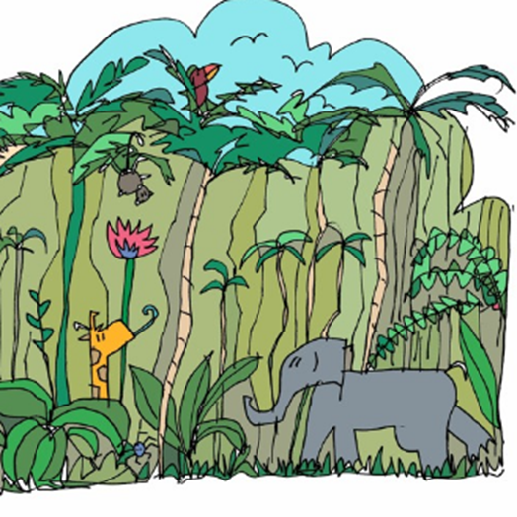
Click on the picture to listen (From 0.22 seconds)

Slide 5
Jungle Log: 31st January, 2022
Today has been an amazing day of discovery! I woke early and got ready for my trek into the Atlanti Jungle. I was excited and couldn’t wait to see what lay ahead of me. I packed my rucksack and put on my sturdy walking boots. I made sure my camera was working because I wanted to record as much of the day as possible. I left the camp at 6am.

Slide 6
First, I trudged through the dense forest and collected samples of the plant life. My favourite was a thorny bush. It had tiny, yellow flowers growing on it, which smelt like ice cream! Next, I studied some of the mesmerising insects that were crawling up the rough bark of every tree. One insect looked like a caterpillar but had 2 sets of wings and tiny hands on the ends of its 20 legs. Excitedly, I photographed as many creatures as I could because I wanted to show my explorer friends what I had discovered.

Slide 7
After a short tea break, I measured the circumference of the tallest trees to work out how old they were. One measured 10 metres around and was so tall that I couldn’t see the top of it. It reminded me of the beanstalk in a famous children’s story. Next, I trekked to a clearing and found a beautiful plunge pool. The water was turquoise and tiny neon fish were splashing on the surface. I tried to catch one, but they were too fast for me. Then it was time for a rest. I lounged on pink grass, soaking up the purple sun beams and listened to the strange jungle noises around me.

Slide 8
Finally, I headed back to camp because the sun began to set. It sets quickly in Oreno and I was worried I might get lost. When I got to my tent, I unpacked my rucksack and stored my plant samples safely. I’m really looking forward to where my wardrobe will take me next week!

Slide 9
Today we are going to find the features of a recount text.
First of all, have a look at the text with your partner. What are the features that you notice?

Slide 10
Now, let’s underline the features as we find them, using the key to show what each colour refers to.

