Slide 1


Slide 3
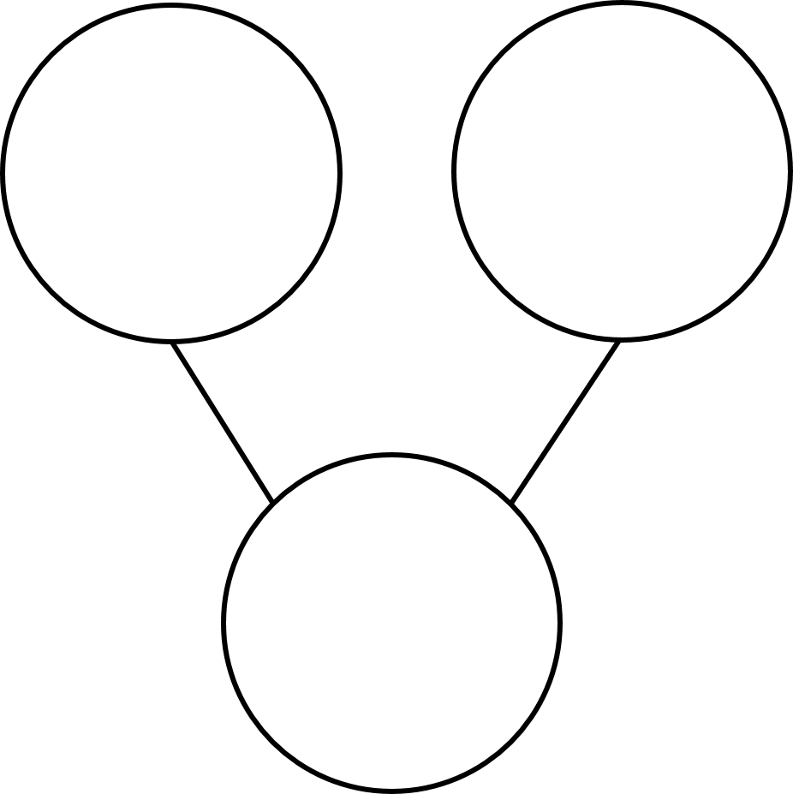
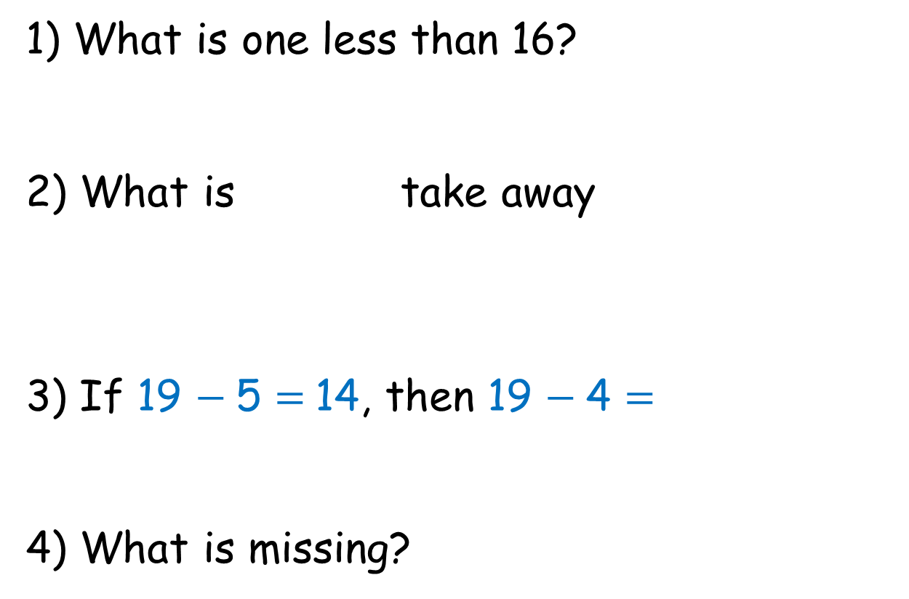
1) What is one less than 16?
2) What is take away
3) If 19 $−$ 5 = 14, then 19 $−$ 4 =
4) What is missing?
5
15

Slide 4
1) What is one less than 16?
2) What is take away
3) If 19 $−$ 5 = 14, then 19 $−$ 4 =
4) What is missing?
15
12
15
5
10
15

Slide 6

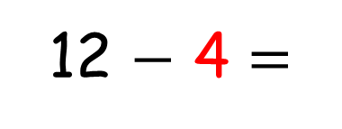
Subtraction
Counting back
I can use a
number track
to count back.
8
12 $−$ 4 =
4
3
2
1
6 | 7 | 8 | 9 | 10 | 11 | 12 | 13 | 14 | 15 | 16 | 17 | 18 | 19 | 20

Slide 7



Remember to count 4 jumps.
4
3
2
1
7 | 8 | 9 | 10 | 11 | 12 | 13 | 14 | 15 | 16
I can count back 4!
12, 11, 10, 9
12
$$−$$
4
$$=$$
9
8

Slide 8
Try it again, Tiny.
4
3
2
1
7 | 8 | 9 | 10 | 11 | 12 | 13 | 14 | 15 | 16
12,
11,
10,
9
OK! I will.
13
$$−$$
4
$$=$$
9

Slide 9







Have a think
Counting back
using a number line
6
7
8
9
10
11
12
13
14
15
16
17
18
19
20
13
$$−$$
4
$$=$$
9
15
$$−$$
8
$$=$$
7
11
$$−$$
6
$$=$$
5

Slide 10



Have a think
There were 13 muffins.
6 muffins were eaten.
How many muffins are left?
6
5
4
3
2
1
6
7
8
9
10
11
12
13
14
15
16
17
18
19
20
13
$$−$$
6
$$=$$
7

Slide 11
Using your number line, have a go at completing the number sentences on the board.

Slide 12


Have a think
Twelve snowflakes fell on my glove.
7 snowflakes melted.
How many snowflakes are left?
12
$$−$$
7
$$=$$
5

Slide 13

Have a think
There were 17 cars in the carpark.
After school only 9 cars are left.
How many cars drove away?
8
7
6
5
4
3
2
1
6
7
8
9
10
11
12
13
14
15
16
17
18
19
20
17
$$−$$
8
$$=$$
9

Slide 14
Have a go at question 1 and 2 on your worksheet.
Use the practical resources if you need to.

