Slide 1
Wednesday 5th January L.O. – I can write creatively using a short burst writing technique.

Slide 2
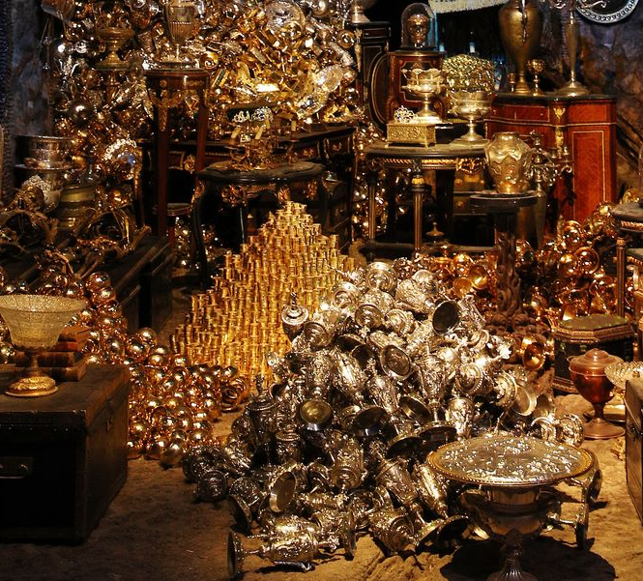
Create a thought shower in your books about this image. Think about the objects you can see. What time of day is it? Are there any people or animals there? Include your 5 senses, what can you see, hear, smell, taste, feel? Where are you? How are you feeling?

Slide 4
my long lost Auntie’s country manor
spectacular
mesmerising
blinding like the sun
treasure glistening in my eyes

Slide 5
The light reflects from the mesmerising treasure, blinding like the sun.
Visiting my long lost auntie and discovering an enormous pile of spectacular riches.

Slide 6
Now, using the ideas from your thought shower, and our class one, write your own short burst about this image. Focus on 5 key things from the image and try to make every word count.

