Slide 3
Which is longer?
How long is the line?
How long is the line?
cm
cm

Slide 4
Which is longer?
How long is the line?
How long is the line?
9 cm
cm
11 cm
cm

Slide 6
0
10
20
30
40
50
60
The bookcase is 50 cm long

Slide 7
The two bookcases together are 100 cm long
0
10
20
30
40
50
60
70
80
90
100
No no no, the two bookcases together are 1 m long
The bookcase is 100 cm long which is equivalent to 1 m long.

Slide 8
Annie is comparing lengths to 1 metre
The table is longer than 1 metre

Slide 9
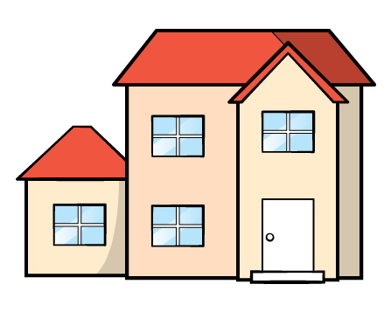
Annie is comparing lengths to 1 metre
The dolls house is shorter than 1 metre
1 m $=$ 100 cm

Slide 10
Annie makes a table to show her results.
Shorter than 1 m | Longer than 1 m

Slide 11
Have a go at question 1 on the worksheet

Slide 13
Ron and Amir have been measuring
their arm span.
Here is part of a tape measure.
Ron
How long is Ron’s arm span?
Ron’s arm span is 1 m and 4 cm

Slide 14
Amir’s arm span is longer than Ron’s.
Amir
How long is Amir’s arm span?
Have a think
Amir’s arm span is 1 m and 13 cm

Slide 15
Have a go at the rest of the questions on the worksheet

