Slide 1
09.06.21
LO: To systematically order possible combinations to solve a problem.

Slide 2
Key vocabulary:
Multiplication
Number sentence Less than (<) Equally Share Division Compare Greater than (>) Least Most
Partition Statement More than Equal (=) Remainder Multi-step

Slide 4
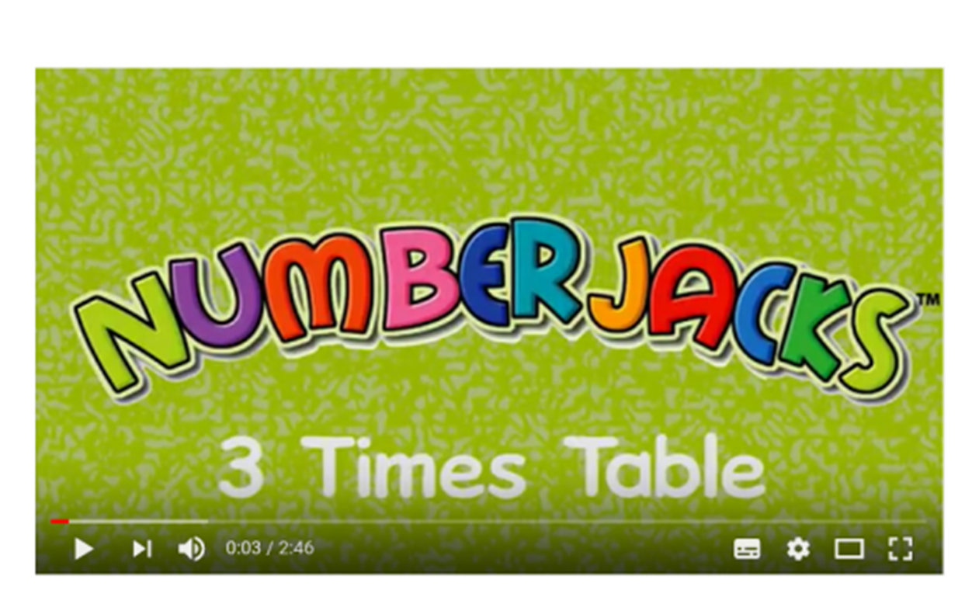

Slide 6
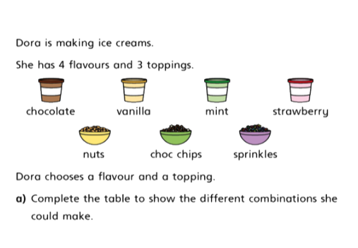

Slide 7
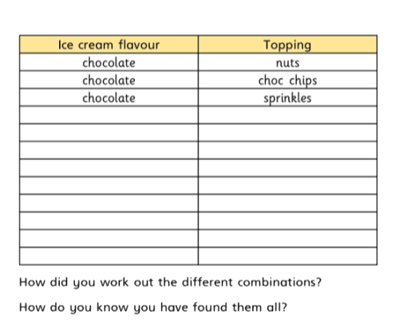
Complete the table in your books…

Slide 8
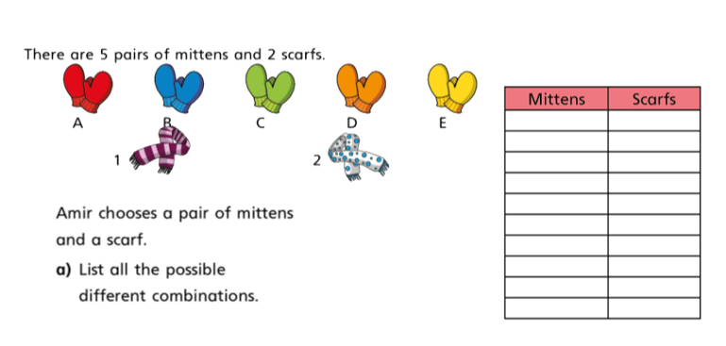
Complete the table in your books…

Slide 9
Continued…

Slide 10
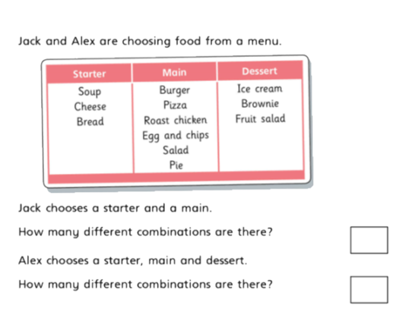

Slide 11
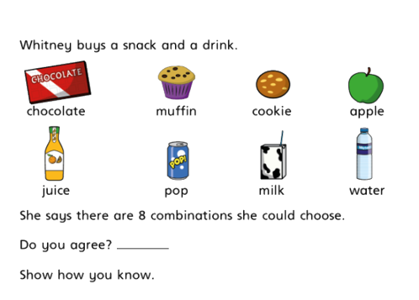
Complete the question in your book…
Complete the challenges if you finish.

Slide 12
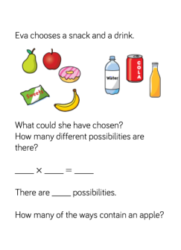
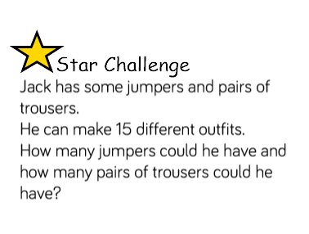
Complete the challenges if you finish.

Slide 13
Class discussion:

