Slide 1
Tuesday 25th January 2022
LO: To write a diary entry

Slide 2
Warm up – Emotions (this slide is also on a printable sheet)
Now we are going to watch the film, but pause at different points and think about how the girl is feeling.
How is the girl feeling? How do you know? Happy? Excited? Confident? Try to be precise in labelling the emotion but also thinking about why she is feeling that way. What changes about the way she is feeling. Confusion? Disappointment? These are the points to stop at:
1m, 1m22s, 1m 26s, 1m 38s, 1m 47s, 2m 04s, 2m 09s, 2m 14s, 2m 36s, 2m 41s, 2m 49s and 3m 39s

Slide 3
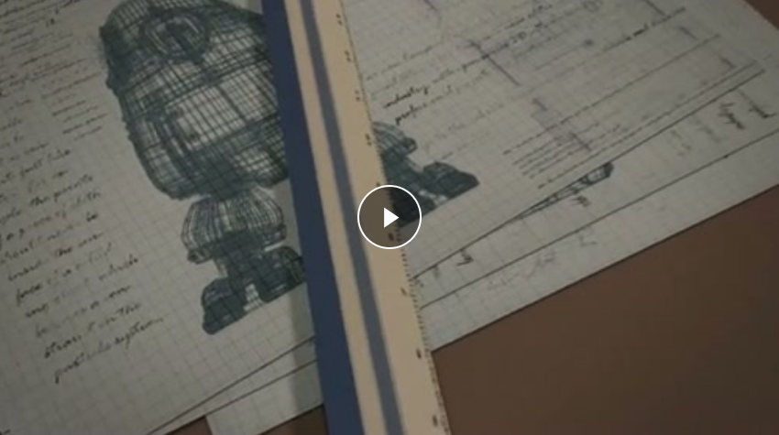
Girl and Robot

Slide 4
Today’s task
Imagine you are the girl in the story. You are going to write your diary about what happened today.
In a diary people often write about how they felt, so think about the emotions you have noticed in the film.
Dear Diary,
I bounced out of bed this morning, because I knew today would be the day!

Slide 5
You could start your diary entry like this.
Dear Diary,
I bounced out of bed this morning, because I knew today would be the day!

