Slide 1
Monday 15th March.
LO – I can write a recount. (cold write).
Please write the date and learning objectives in your books.

Slide 2
Words of the week.
The words this week can all be used in the writing of recounts.
The words of the week are:
experience, chronicle, vivid, memories and memorable.

Slide 3
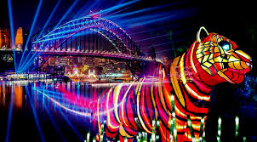
experience (noun) – an event or occurrence which leaves an impression on someone.
Going to the farm was a great experience.
Chronicle (noun) - a fictitious or factual work describing a series of events.
Vivid (adjective) - producing powerful feelings or strong, clear images in the mind.
"memories of that evening were still vivid"

Slide 4
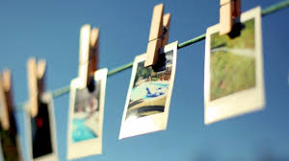
Memory (s) memories (pl) (noun) - something remembered from the past.
"one of my earliest memories is of sitting on his knee“
Memorable (adjective) - worth remembering or easily remembered, especially because of being special or unusual.
"he recalled memorable moments in his life"

Slide 5
What is a recount?

Slide 6
Now it’s time to write a recount.
You will have 30 minutes to write a recount.
Just try your best, this is just to help your teachers know what needs to be taught next in English.

