Slide 1
01.11.21
LO: To add and subtract 3-digit and 1-digit numbers – not crossing 10.

Slide 2


Learning Journey – Addition and Subtraction
In this unit we will…
Add and subtract multiples of 100
Add and subtract 1s
Add and subtract 3-digit and 1-digit numbers – not crossing 10
Add a 2-digit and 1-digit number – crossing 10
Subtract a 1-digit number from a 3-digit number – crossing 10
Subtract a 1-digit number from 2-digits – crossing 10
Add 3-digit and 1-digit numbers – crossing 10
Add and subtract 3-digit and 2-digit numbers – not crossing 100
Subtract a 2-digit number from a 3-digit number – crossing 100
Add 3-digit and 2-digit numbers – crossing 100
Add and subtract 100s
Subtract a 2-digit number from a 2-digit number – crossing 10
Add two 2-digit numbers – crossing 10 – add ones and add tens
Spot the pattern – making it explicit

Slide 3
Vocabulary:
addition
subtraction
column method
mental method
exchange
place value grid

Slide 4


Slide 6



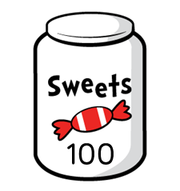
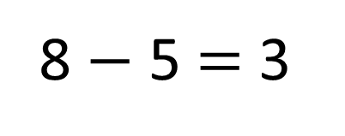
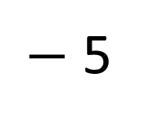
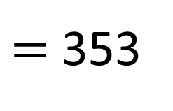
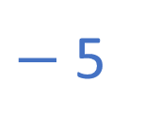
How many sweets in the shop?
358
$−$ 5
$=$ 353
8 $−$ 5 $=$ 3
$−$5
350
351
352
353
354
355
356
357
358
359
360

Slide 7
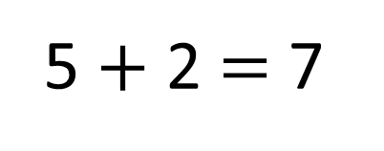
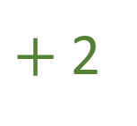
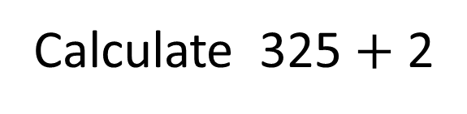
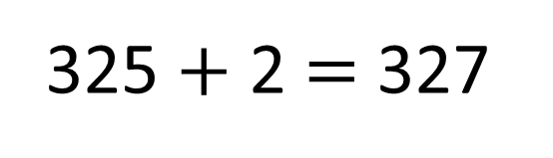
Calculate 325 $+$ 2
5 $+$ 2 $=$ 7
325 $+$ 2 $=$ 327
$+$2
320
321
322
323
324
325
326
327
328
329
330

Slide 8
Have a go at the questions

Slide 9
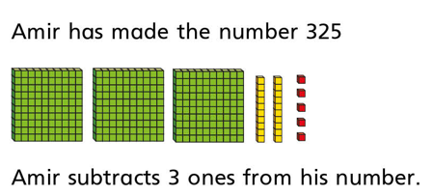
On your white boards, write the calculation to show Amir has done.
____ - ____
What is the answer to the calculation?

Slide 10

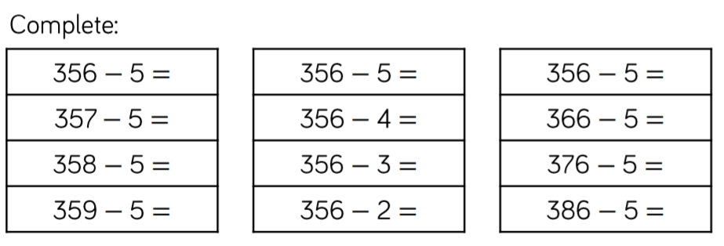

Slide 11

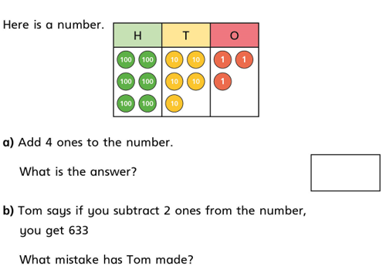

Slide 12

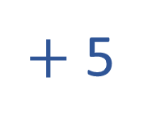
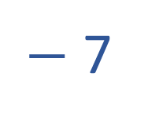
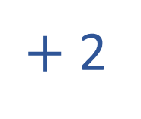
Have a think
$+$ 2
362
364
$−$ 7
897
890
$+$ 5
423
428

Slide 13




2
3
6
2
v
$$+$$
$$=$$
238
v
$$+$$

Slide 14

Have a think
4
2
0
0
6
1
1
3
3
v
$$+$$
2
v
$$=$$
463
v
$$+$$

Slide 15
Have a go at the rest of the questions on the worksheet

Slide 16
Jack has 534 team points and gets four more.
Tommy has 534 team points and loses four of his.
How many team points does each person have?
Who has the most?
Can you use the < and > symbols to compare their points?

Slide 17
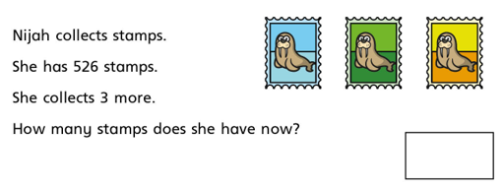

Slide 18
