Slide 1
Monday 13th July
LO – I can use my retrieval skills to answer questions about a picture.

Slide 2
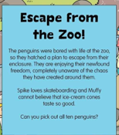
Look at the picture on the next slide closely.

Slide 3
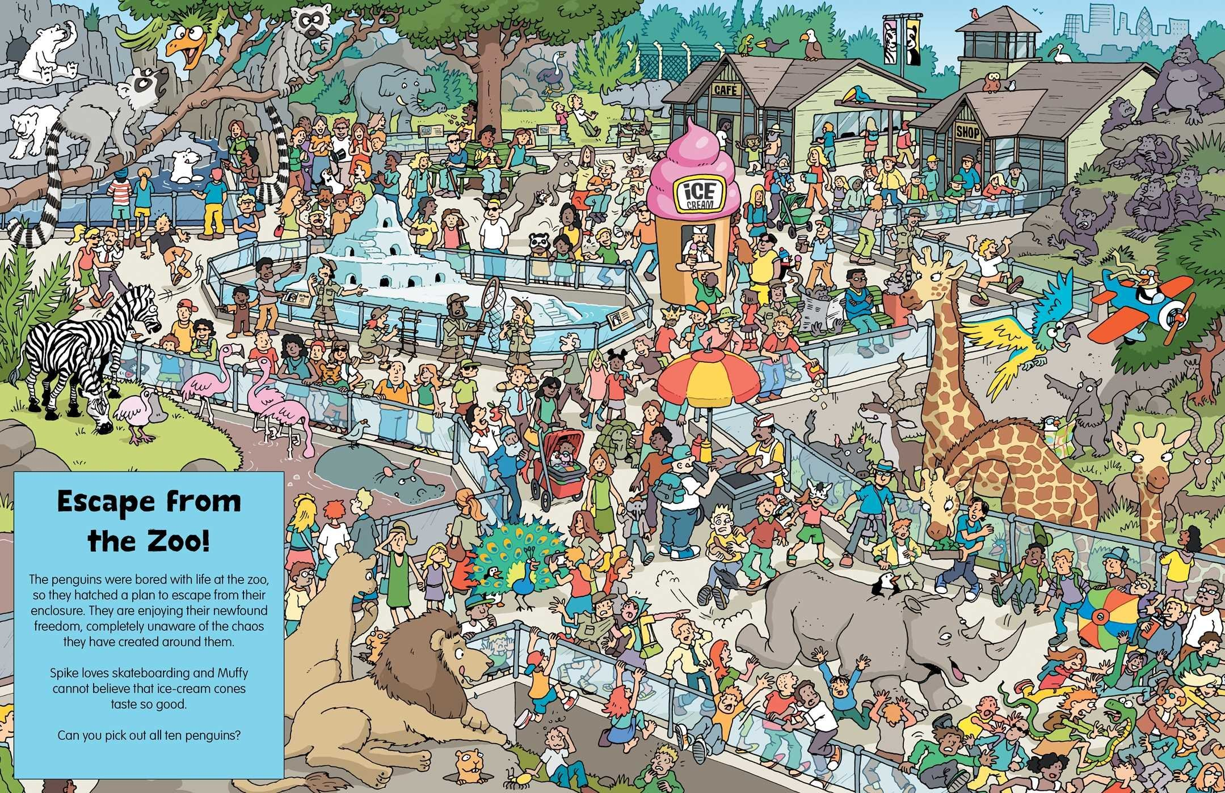

Slide 4
Once you have located the 10 penguins, can you do the following:
1. Circle two raccoons.
Tick two rhinos.
Tell me what type of animal is on top of the rocks?
What is being sold underneath the umbrella?
Can you name the type of bird that can be found in the water?
Who is riding on a rhino’s back?
Can you underline the preposition in each question above?
7. Can you find and star three people who are wearing glasses?
8. Choose three different types of animals and write sentences using alliteration e.g. Lazy lions looking at the little children.
9. Finally, write a descriptive paragraph about one of the animals.

Slide 5
Tuesday 14th July
LO – I can use my retrieval skills to answer questions about a picture.

Slide 6
Look at the picture on the next slide closely.
Can you find Wally, Wanda, wizard, Woof and Odlaw.
Look carefully they are all there.

Slide 7
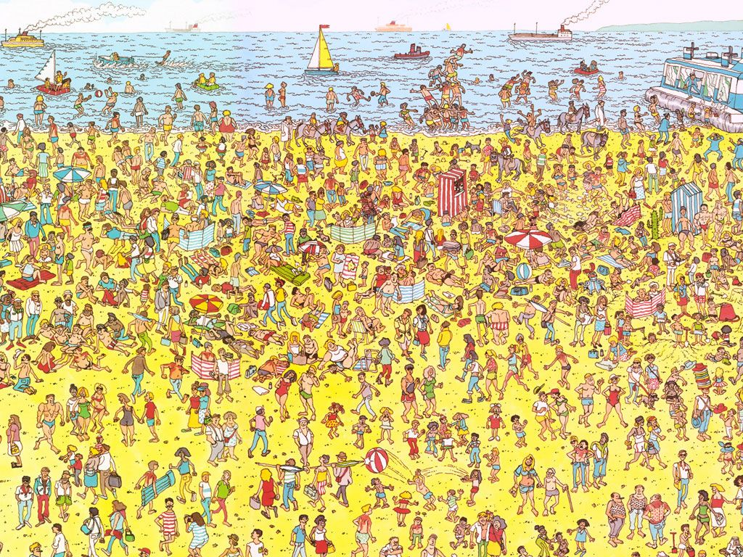

Slide 8
Can you answer the following questions using the Where’s Wally picture on the previous slide?
1. Can you circle 3 boats?
2. Tick 7 boys on the picture.
3. Count how many donkeys there are on the picture.
4. How many beach balls are there in the air?
5. Underline the umbrellas on the beach.
6. How many people are in the sea?
7. Write a description about the image. Try to look at some of the detail and think carefully about the vocabulary you choose to use.

Slide 9
Wednesday 15th July
LO – I can make a blackout poem using newspaper and a black felt tip.

Slide 10
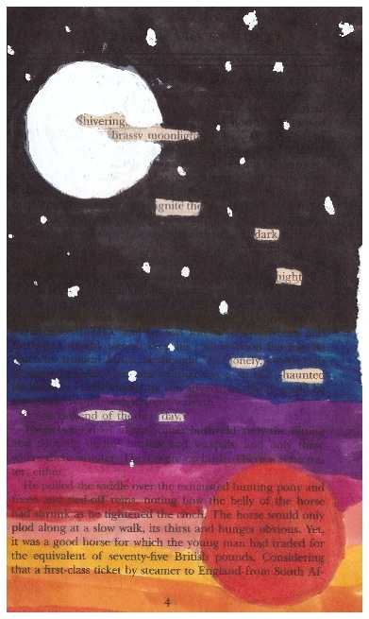
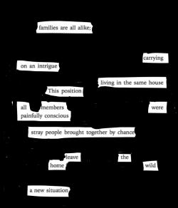
A black out poem – examples

Slide 11
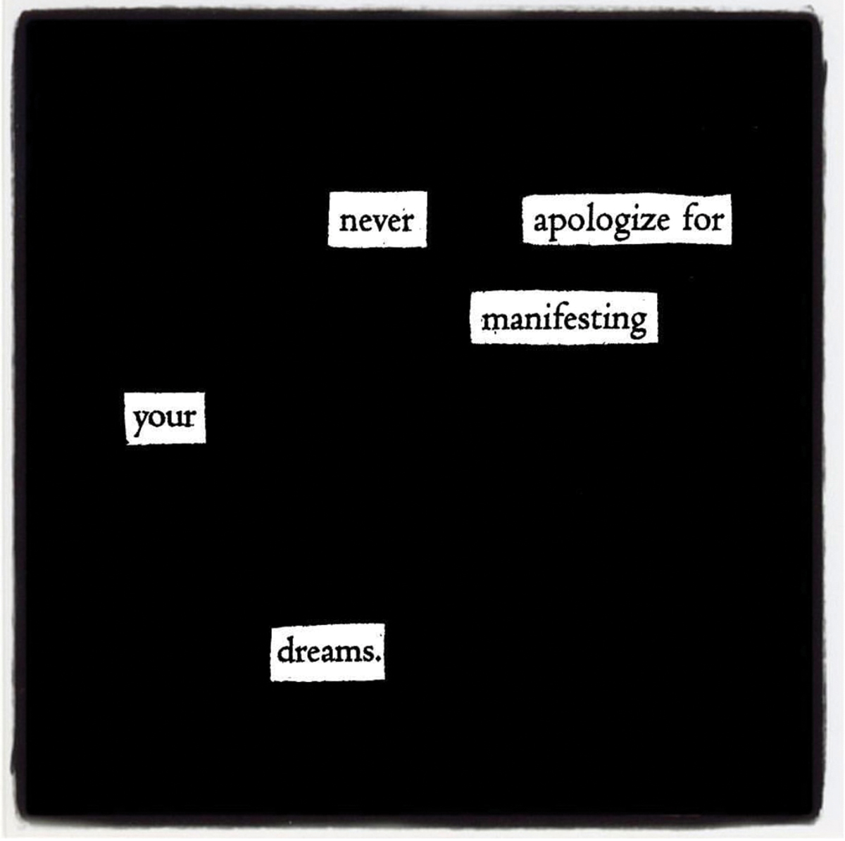

Slide 12
Blackout Poetry Anyone can be a poet (even if they don’t know it). Set your inner poet free with this alternative style of poetry. Preparation Find old newspapers and magazines at home or photocopy pages from books. You will also need coloured pens or pencils What’s a Blackout Poem? Look at the blackout poetry examples on the PowerPoint. Have you seen this type of poetry before? Blackout poems are made using pages from books, newspapers, or magazines. Blackout poets pick out single words or phrases from the existing text, then piece them together to make something new. This kind of poetry embraces randomness, and also gives people a chance to mix poetry and visual art.

Slide 13
How to become a Blackout Poet.
Find a pencil and a page of text.
Scan the page looking for a ‘theme word’ to inspire possible topics for their poem. Choose any word for your theme word – it’s about choosing something that stands out to you. Words may stand out because they have meaning or significance, for example, because they link to a personal value, a favourite feeling, or a special event. The meaningful theme word decides the topic of the whole poem.
Read the page more carefully. Lightly circle any words that connect to your theme word or resonate with you – it’s also OK to circle words just because they sound nice! This is all about self-expression! Don’t circle more than three words in a row. If possible, pick words that work on their own.
Piece together the circled words in the same order that the appear on the page (so, in English, top to bottom and left to right). Aim for about eight lines of poem – it’s up to you where a line stops and a new one starts.
Go back through their poem – do they want to remove any words? Are there any spaces where they need to add something? Experiment with a few different possibilities. If things aren’t working out, it’s OK to go back and repeat step three to find some more words.
Once you’ve settled on a final poem, erase any circles around words you’re not using.
Circle the words that you are using more obviously – you could use a pen or highlighter.
Share your poem with the your family (maybe by reading it out, or photographing and sharing). You could chat about what it means and how you pulled words together. Please share your finished poem on Seesaw.

Slide 14
Thursday 16th July
LO – I can make a blackout poem using newspaper and a black felt tip.

Slide 15
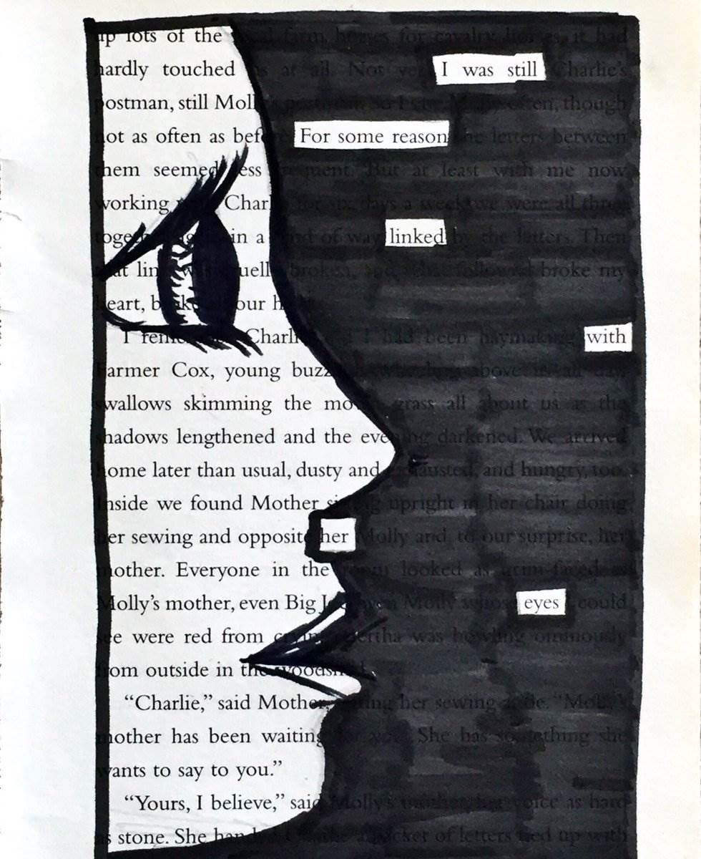
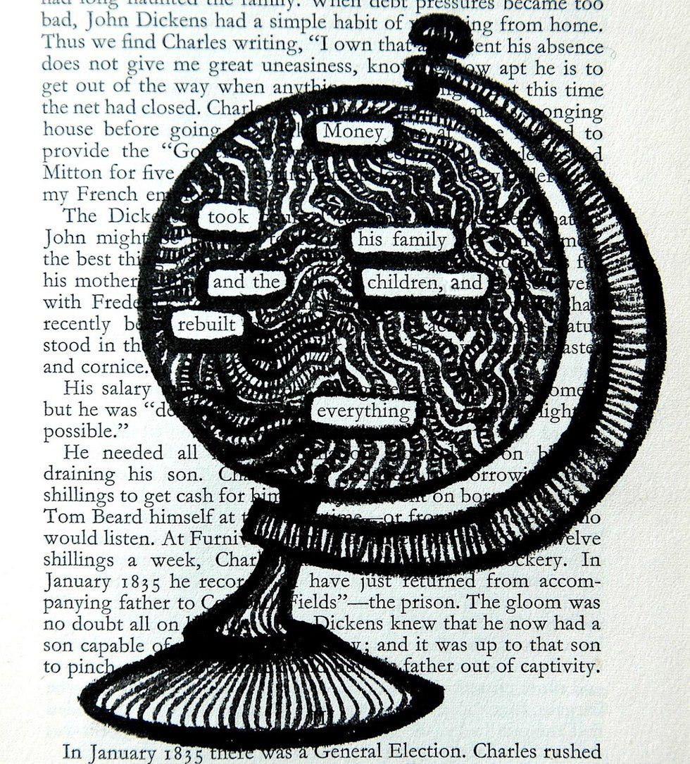
Blackout poem.
I would like you to make another poem as yesterday. Choose another theme. Think carefully and choose each word that you keep.
Share your poems with me on Seesaw.

Slide 16
Friday 17th July
LO – I can write a letter to the new Asia Class.
I can tell them about the class and what they have to look forward to and how our school works.

Slide 17
A letter for a new Year 4.
Can you believe it is the last day of the school year? I do not think anyone could have predicted what would happen this year.
I am so pleased that we will have some time together in September. I cannot wait to see you all, and hopefully be able to give you a huge hug and congratulate you on being such an amazing class.
I have one final task for you.
I would love to have some letters from you to share with my new class during our step up morning. I think it is great when children pass on their knowledge and wisdom.
Can you write a letter telling them about what makes our class unique? What do they need to do as Year 4’s? What are the expectations on them? Are there subjects/activities that they will do for the first time as Year 4s? Can you tell them about things that they have to loo forward to as Year 4 children?
If you have time, illustrate the letters too so that they can be put under the visualizer and the children will have something to look at. Can you also present them in your neatest joined up handwriting so they can see how beautifully children in Year 4 can write. Thank you. ☺
I look forward to reading your letters.

