Slide 3
5 focus writing.

Slide 4
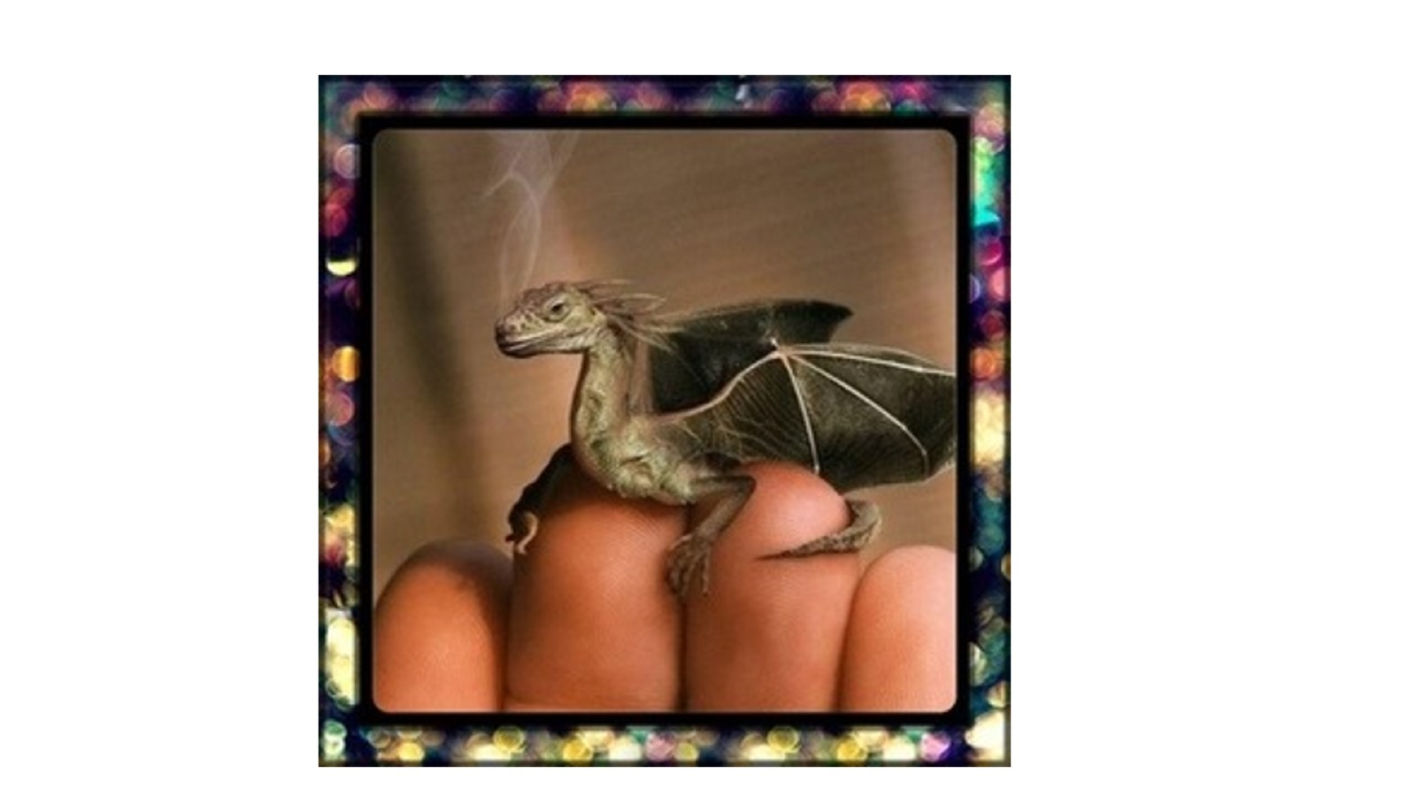

Slide 5
Tuesday 23rd November.

Slide 6
Everyone completing the drawing.

Slide 7
Wednesday 24th November Thursday 25th November..

Slide 8
Friday 26th November

Slide 9
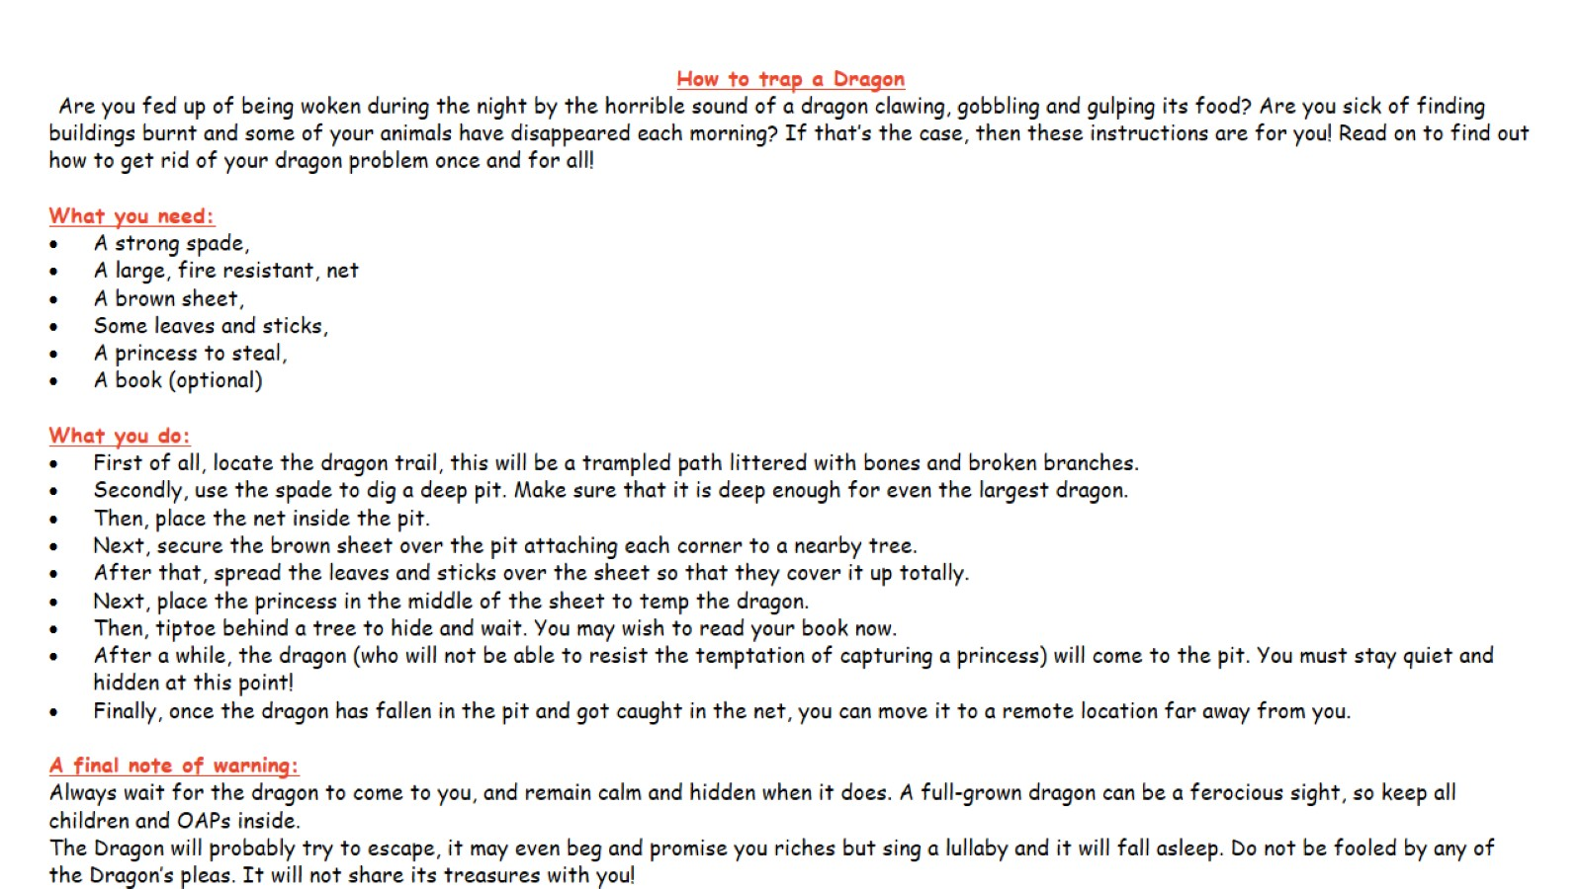

Slide 10
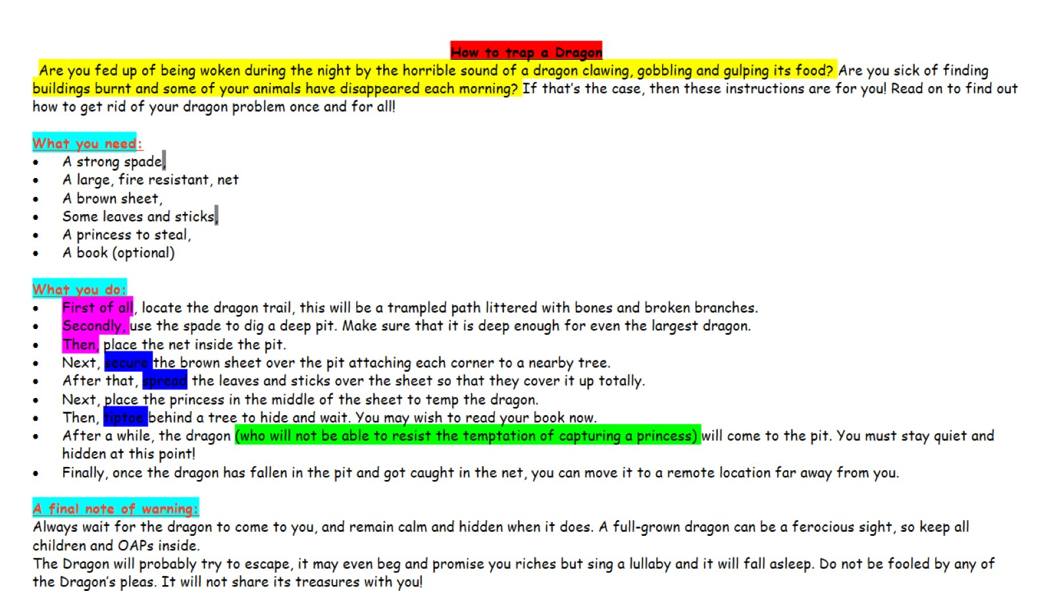

Slide 11
Tool kit for instructional writing

