Slide 1
04.11.21
LO: Subtract a 1-digit number from a 2-digit number (crossing 10).

Slide 2



Learning Journey – Addition and Subtraction
In this unit we will…
Add and subtract multiples of 100
Add and subtract 1s
Add and subtract 3-digit and 1-digit numbers – not crossing 10
Add a 2-digit and 1-digit number – crossing 10
Subtract a 1-digit number from a 3-digit number – crossing 10
Subtract a 1-digit number from 2-digits – crossing 10
Add 3-digit and 1-digit numbers – crossing 10
Add and subtract 3-digit and 2-digit numbers – not crossing 100
Subtract a 2-digit number from a 3-digit number – crossing 100
Add 3-digit and 2-digit numbers – crossing 100
Add and subtract 100s
Subtract a 2-digit number from a 2-digit number – crossing 10
Add two 2-digit numbers – crossing 10 – add ones and add tens
Spot the pattern – making it explicit

Slide 3
Vocabulary:
addition
subtraction
column method
mental method
exchange
place value grid

Slide 4


Slide 6
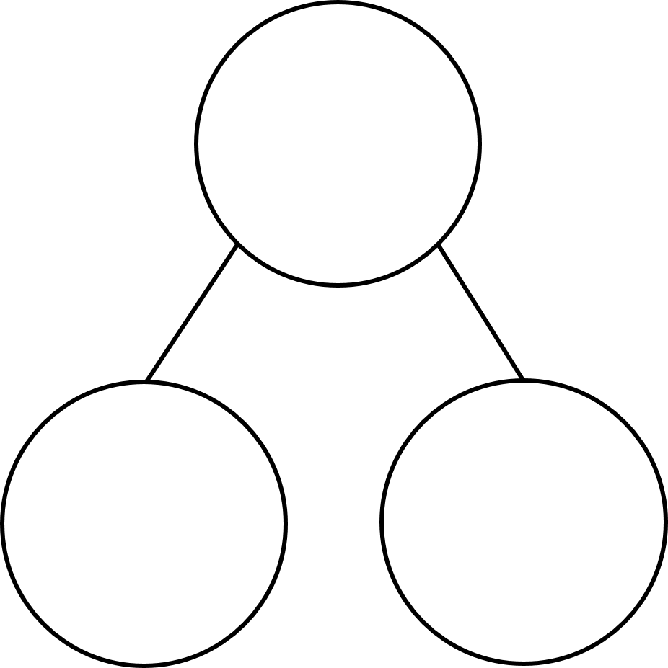
We can use number bonds to help us subtract!
8
6
2
Notes:
In this lesson we are going to use number bonds to help us add.
I am going to show a number, then I want you to shout what number you would add to it to make ten.
Let’s do one together.
Here is 6 so you would shout…..4! 6 + 4 makes 10
Here we go.

Slide 7
We can use number bonds to help us subtract!
8
7
1
Notes:
In this lesson we are going to use number bonds to help us add.
I am going to show a number, then I want you to shout what number you would add to it to make ten.
Let’s do one together.
Here is 6 so you would shout…..4! 6 + 4 makes 10
Here we go.

Slide 8
We can use number bonds to help us subtract!
7
4
3
Notes:
In this lesson we are going to use number bonds to help us add.
I am going to show a number, then I want you to shout what number you would add to it to make ten.
Let’s do one together.
Here is 6 so you would shout…..4! 6 + 4 makes 10
Here we go.

Slide 9
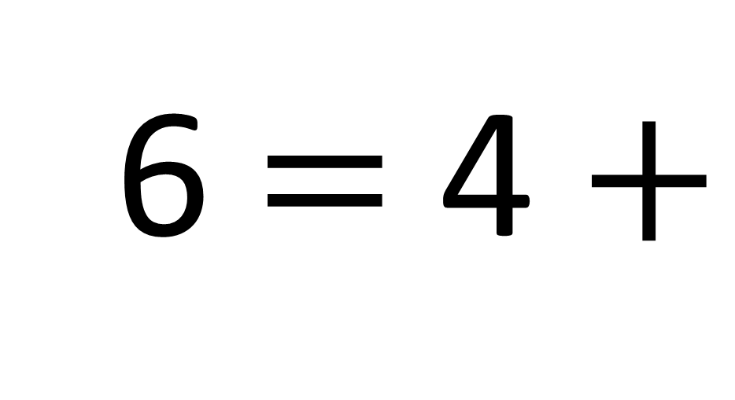
6 $=$ 4 $+$
2
Notes:
In this lesson we are going to use number bonds to help us add.
I am going to show a number, then I want you to shout what number you would add to it to make ten.
Let’s do one together.
Here is 6 so you would shout…..4! 6 + 4 makes 10
Here we go.

Slide 10
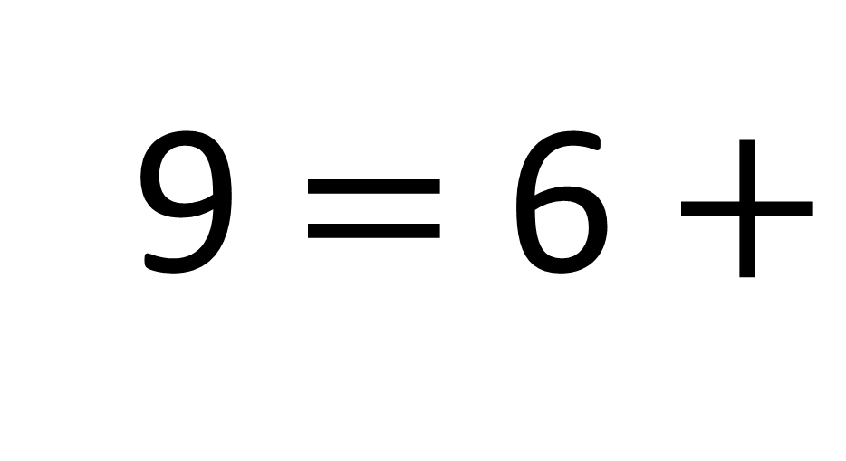
9 $=$ 6 $+$
3
Notes:
In this lesson we are going to use number bonds to help us add.
I am going to show a number, then I want you to shout what number you would add to it to make ten.
Let’s do one together.
Here is 6 so you would shout…..4! 6 + 4 makes 10
Here we go.

Slide 11
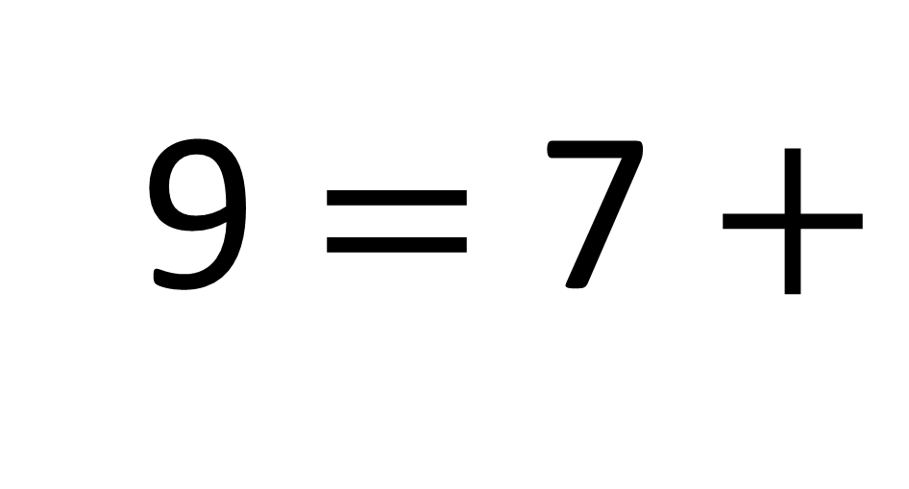
9 $=$ 7 $+$
2
Notes:
In this lesson we are going to use number bonds to help us add.
I am going to show a number, then I want you to shout what number you would add to it to make ten.
Let’s do one together.
Here is 6 so you would shout…..4! 6 + 4 makes 10
Here we go.

Slide 12
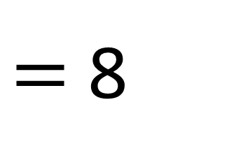
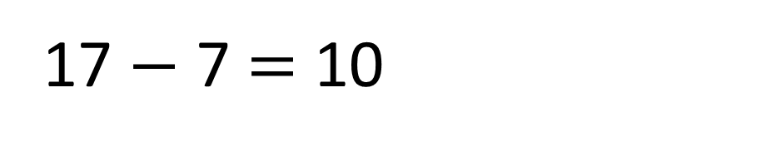
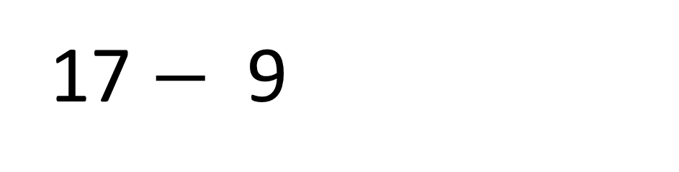
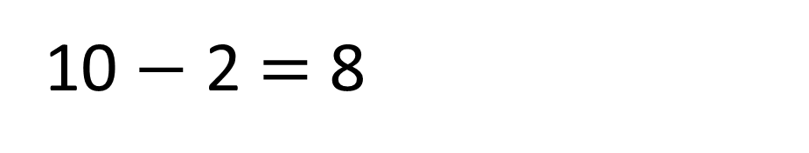
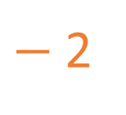
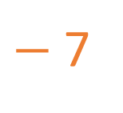
$−$2
$−$7
7
8
9
10
11
12
13
14
15
16
17
17 $−$9
$=$ 8
7
2
17 $−$ 7 $=$ 10
10 $−$ 2 $=$ 8

Slide 13
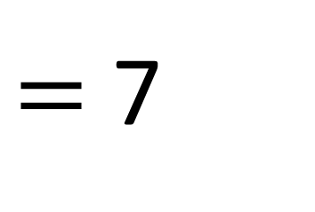
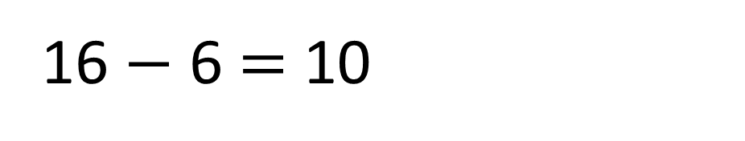
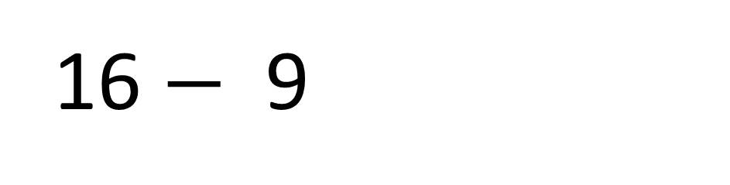
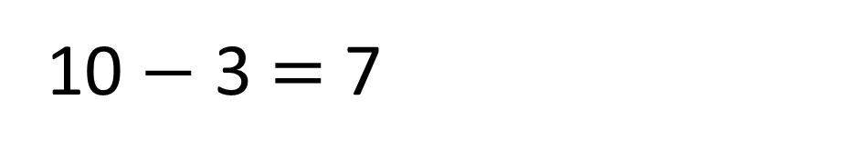
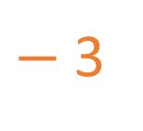
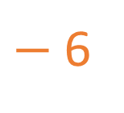
$−$3
$−$6
7
8
9
10
11
12
13
14
15
16
17
16 $−$9
$=$ 7
6
3
16 $−$ 6 $=$ 10
10 $−$ 3 $=$ 7

Slide 14

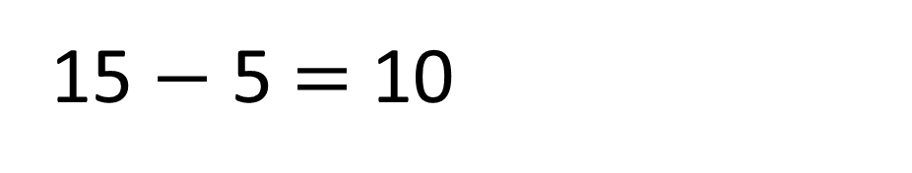
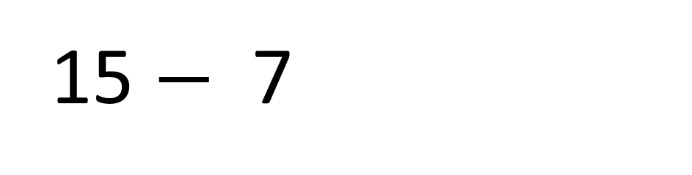
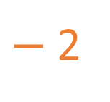
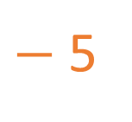
$−$2
$−$5
7
8
9
10
11
12
13
14
15
16
17
15 $−$7
$=$ 8
5
2
15 $−$ 5 $=$ 10
10 $−$ 2 $=$ 8
Have a think

Slide 15

52 $−$ 8
8
8
8
3
5
2
6
4
4
Which of the ways to partition 8 would be
most useful for this calculation?

Slide 16

84 $−$ 8
8
8
8
3
5
2
6
4
4
Which of the ways to partition 8 would be
most useful for this calculation?

Slide 17
Have a go at questions
1 - 3 on the worksheet

Slide 18


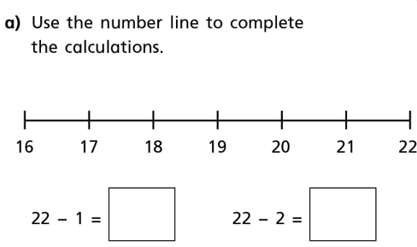

Slide 19
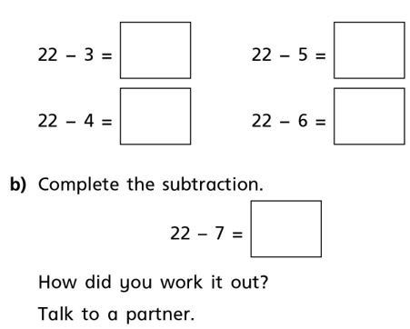
Write out in books.

Slide 20
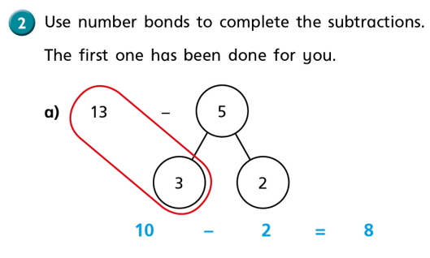

Slide 21

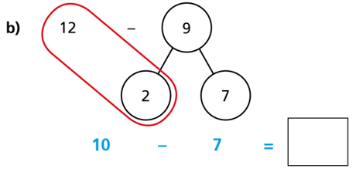

Slide 22
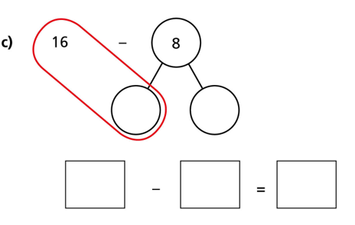

Slide 23
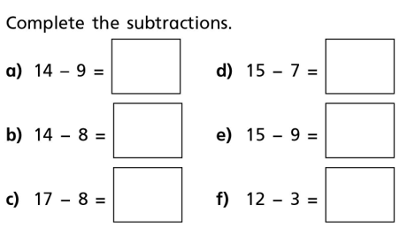
Write out in books.

Slide 24
Find the difference between 25 and 8
The difference between 25 and 8 is 17

Slide 25
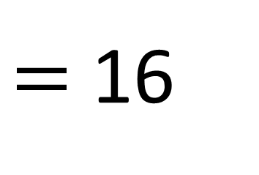

23 $−$ 7
$=$ 16

Slide 26
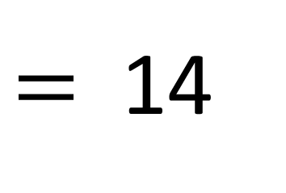

23 $−$ 9
$=$ 14
Have a think

Slide 27
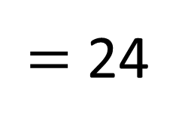

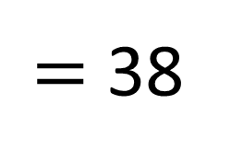
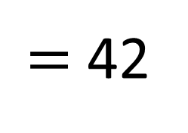


Which of the calculations will need an exchange and which will not?
30 $−$ 6
47 $−$ 5
$=$ 24
$=$ 42
45 $−$ 7
$=$ 38
Have a think

Slide 28
Have a go at the rest of the questions on the worksheet

Slide 29
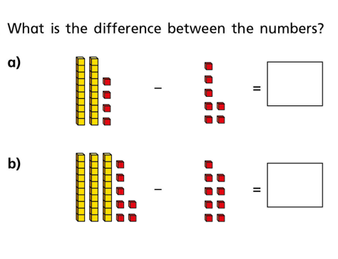
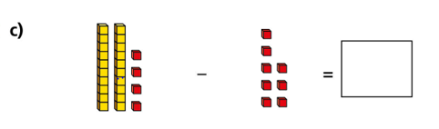

Show this practically under the visualiser.

Slide 30
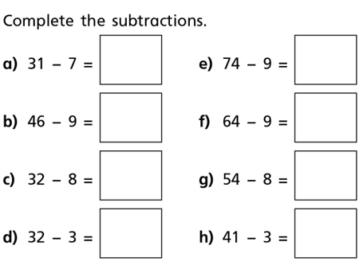
Write out in books.

Slide 31
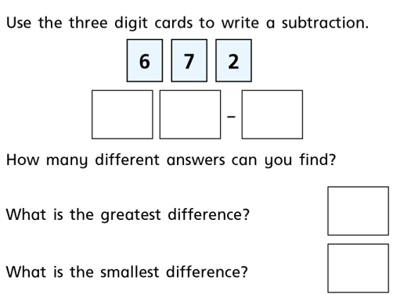
★ Star Challenge!

