Slide 1
L.O. I know my 12 times tables
30.3.21

Slide 2
0
12
24
36
48
60
72
84
96
108
120
132
144

Slide 3
0 × 12 = 0
1 × 12 = 12
2 × 12 = 24
3 × 12 = 36
4 × 12 = 48
5 × 12 = 60
6 × 12 = 72
7 × 12 = 84
8 × 12 = 96
9 × 12 = 108
10 × 12 = 120
11 × 12 = 132
12 × 12 = 144
Write this down on your whiteboard.

Slide 4
Lets practise our 12 times table with this song. Stand up behind your desk and dance along.
12 Times Tables Song

Slide 5
2.11 The 11 and 12 times tables Step 2:7
 | × 12
0 | 0
1 | 12
2 | 24
3
4 | 48
5 | 60
6 | 72
7
8 | 96
9 | 108
10 | 120
11 | 132
12 | 144
 | × 12
2 | 24
3
84
↑ − 12
↓ + 12
3 × 12 = 2 × 12 + 12
7 × 12 = 8 × 12 − 12
36
= 24 + 10 + 2
= 96 − 10 − 2
 | × 12
7
8 | 96
+ 12
− 12
0
12
24
36
48
60
72
84
96
108
120

Slide 6
12 × 5 =
60
10
2
5
50
10
12 × 5 = 10 × 5 + 2 × 5
= 50
+ 10
= 60

Slide 7
8 × 12 =
96
8 × 12 = 8 × 10 + 8 × 2
= 80
+ 16
= 96

Slide 8
4 × 12 = 60 – 12
5 × 12 = 60
= 60 – 10 – 2
= 50 – 2
= 48

Slide 9
0
6
12
18
24
30
36
42
48
54
60
66
72

Slide 10
Number | 0 | 1 | 2 | 3 | 4 | 5 | 6 | 7 | 8 | 9 | 10 | 11 | 12 | 13 | 14 | 15 | 16 | 17 | 18 | 19 | 20 | 21 | 22 | 23 | 24
Counting in 6s
Counting in 12s
✓
✓
✓
✓
✓
✓
✓
✓

Slide 11
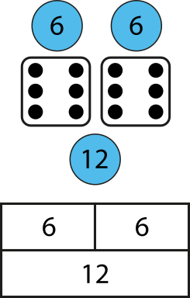
Notes:
Twelve is double six. Six is half of twelve.
Four times twelve is equal to forty-eight, so
double-four times six is equal to forty-eight.
Eight times six is equal to forty-eight, so
half-of-eight times twelve is equal to forty-eight.

Slide 12
How many groups of six are there?
6
× 6 =
36
How many groups of twelve are there?
3
× 12 =
36

Slide 13
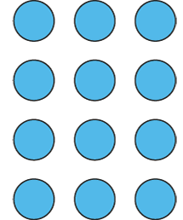
12 = 4 × 3
12 = 3 × 4

