Slide 1
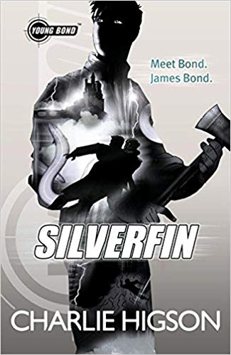
Silverfin
Chapter One
To ‘his heart sank’ – Lots to read, so read together
https://www.lovereading4kids.co.uk/extract/2366/Young-Bond-Silverfin-by-Charlie-Higson.html

Slide 2
Quick Start
What was hung on the fence?
Why is the boy there?
What does the boy have to eat?
What is the name of the lake?
What type of fish is the silverfin?
What bait does the boy try to use last?

Slide 3
Vocabulary Check
trespassers will be shot
he’d reluctantly gone home
pieces of turf
it wriggled enticingly

Slide 4
Individual Thinking
Look at Page 1
How did the boy know someone had been there since he was last there?

Slide 5
Partnered Talk
Look at Page 2.
Find three things that show the boy does not want to be caught.

Slide 6
Individual Thinking
Look at Page 2.
Approximately what time is it?

Slide 7
Individual Thinking
Look at Page 3
How long ago was the fence put up?
What did the boy do with his leftover food?
How had the boy hidden his holes?

Slide 8
Partnered Talk
Look at the paragraph beginning ‘before he’d died’.
Partner A: Why does the boy want to go fishing?
Partner B: How did the boy’s father die?

Slide 9
Partnered Talk
Look at the final four sentences of the extract.
What do you think is behind the reader?
Why do you think this?

Slide 10
Individual Thinking
Look at Page 4
How did Loch Silverfin get its name?

Slide 11
Individual Thinking
Look at the paragraph beginning ‘He skirted round the water’s edge’.
Find and copy three words that show that the loch is dangerous.

Slide 12
Partnered Talk
Look at Page 7
What makes the boy believe he might have caught the legendary Silverfin?
Find as much evidence as you can.

Slide 13
Solo Work
‘His heart sank’
Predict why the boy’s heart sank.

