Slide 1
Tuesday 18th January 2022
LO: To write a finding tale

Slide 2
Today, we are continuing with writing our finding tale.
What do we need to remember?
Let’s check if we have remembered everything…

Slide 3
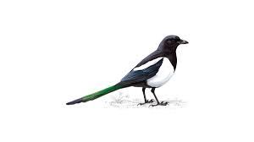
Remember to magpie from the original text as much as you like.

Slide 4
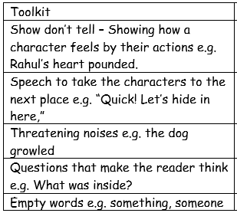
Also remember to include some or all of the features in the suspense toolkit.

Slide 5
Lastly, refer to your plan to help keep your story on track.
Today we are just going to write the next 2 paragraphs. We will do a shared write in school based on my plan, and then you will go ahead with your own writing.

Slide 6
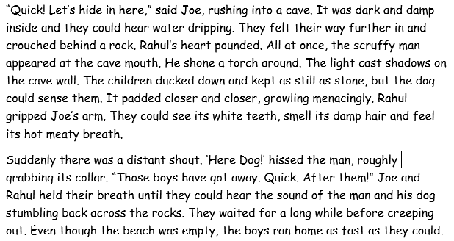
For those of you working from home, here are the next two paragraphs from the original text.

Slide 7
As you write, remember to keep reading what you have written to check it makes sense. Also check your spelling and punctuation.
I am sure you will remember to use your neatest handwriting too ☺

