Slide 1
L.O. I can solve problems using all 4 maths symbols
19.3.21

Slide 2
Recap you 8 times tables by writing it out.
0 x 8 =
1 x 8 =
2 x 8 =
etc

Slide 3
Year 4 | Week 6 | Day 5

Slide 4
In maths we use a mix of 4 symbols to complete calculations. They are…
Each of them have a different job and it is important when answering questions we make sure we use the correct method to get to the answer.

Slide 5
Today we are going to be aiming to solve problems using a mixture of all 4 of our symbols. It is important we read the questions and understand what it is asking us to do.

Slide 6
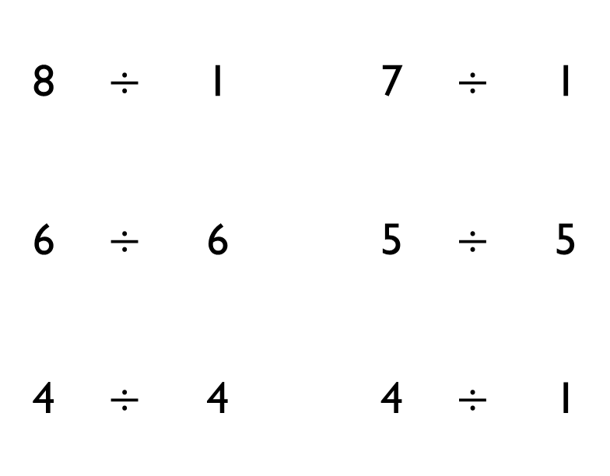
Use $<$, $>$ or $=$ to complete the following:
8 | $$÷$$ | 1 |  | 7 | $$÷$$ | 1
6 | $$÷$$ | 6 |  | 5 | $$÷$$ | 5
4 | $$÷$$ | 4 |  | 4 | $$÷$$ | 1

Slide 7
Mrs White’s class are selling tickets at £2 each for the school play.
The class can sell one ticket for each chair in the hall.
There are 7 rows of chairs in the hall. Each row contains 9 chairs.
How much money will they make?

Slide 8
Here is a number sentence.
350 $+$ 278 $+$ 250
Add the numbers in different orders to find the answer.
Is one order of adding easier? Why?
Create a rule when adding more than one number of what to look for in a number.
Stick this problem in your book and take some time to work through the question.

Slide 9
Use the number cards and $+$ or $−$ to make three calculations with an estimated answer of 2,500
1,295
1,120
4,002
1,489
3,812
1,449

Slide 10
Four children are in a race. The numbers on their vests are:
Use the clues to match each vest number to a child.
Jack's number is ten times smaller than Mo's.
Alex's number is not ten times smaller than Jack's or Dora's or Mo's.
Dora's number is ten times smaller than Jack's.
350
35
3,500
53

Slide 11
Now, there is a worksheet for you to answer with different problems. You will be using a mixture of addition, subtraction, division and multiplication.
Make sure you read the question and understand what it is asking you to do. You can highlight or underline key words to help you.
Remember to show your working. Any questions, ask us on Seesaw ☺

