Slide 1
16.01.21 LO: Converting decimals to fractions Year 6 Maths

Slide 2
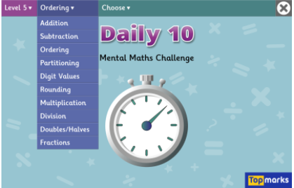
Daily Ten

Slide 6
Let’s warm up …
T | O | tth | hth
1) What number is represented in the place value chart? Write it in words and numerals.
2)
What fraction is represented on the bar model? Can you write it as a decimal?
3) What is the value of the digit 5? 46.95

Slide 7
T | O | tth | hth
1) What number is represented in the place value chart? Write it in words and numerals.
2)
What fraction is represented on the bar model? Can you write it as a decimal?
3) What is the value of the digit 5? 46.95
0.32
thirty-two hundredths
$\frac{\text{9}}{\text{10}}$
0.9
5 hundredths

Slide 15
P50 TYM

