Slide 1


Slide 3

2 $×$ 6 $=$
2 $×$ 7 $=$
2 $×$ 8 $=$
2 $×$ 9 $=$
2) Complete the number track.
3) 60 $+$ 12 $=$
70 $+$ 14 $=$
80 $+$ 16 $=$
90 $+$ 18 $=$
10 | 20 | 30

Slide 4
12
2 $×$ 6 $=$
2 $×$ 7 $=$
2 $×$ 8 $=$
2 $×$ 9 $=$
2) Complete the number track.
3) 60 $+$ 12 $=$
70 $+$ 14 $=$
80 $+$ 16 $=$
90 $+$ 18 $=$
14
16
18
10 | 20 | 30
40
50
60
70
80
90
100
110
120
72
84
96
108

Slide 6

















There are 11 players in a football team.
How many players are in 4 teams?
11
44
$+ + + =$
11
11
11
$× =$
4
11
44
Have a think
$× =$
11
4
44

Slide 7


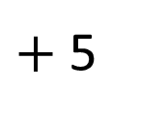
There are 11 players in a football team.
How many players are in 5 teams?
50
$+$ 5
Have a think
$× =$
5
11
55
$× =$
11
5
55

Slide 8
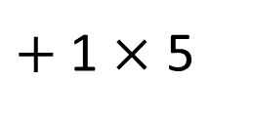
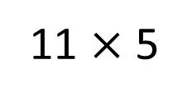
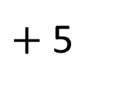
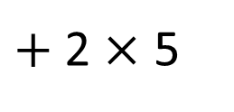
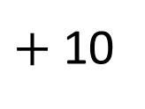

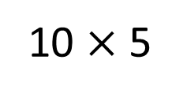
5 $×$ 12 $=$
60
10 $×$ 5
$+$ 2 $×$ 5
$+$ 10
50
$+$ 5
55
11 $×$ 5
$+$ 1 $×$ 5
$× =$
5
11
55
$× =$
11
5
55

Slide 9
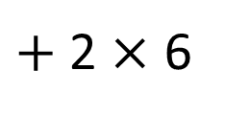
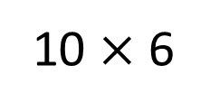
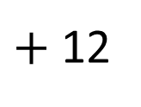

Have a think
6 $×$ 12 $=$
72
60
$+$ 12
10 $×$ 6
$+$ 2 $×$ 6
$× =$
6
12
72
$× =$
12
6
72

Slide 10
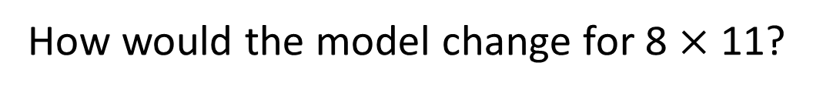


What multiplications are represented
by this array?
11
1
10
$× =$
7
11
77
7
70
7
$× =$
11
7
77
How would the model change for 8 $×$ 11?

Slide 11
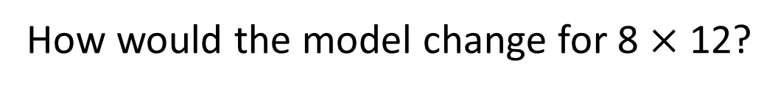
What multiplications are represented
by this array?
10
1
$× =$
8
11
88
7
70
7
8
80
8
How would the model change for 8 $×$ 11?
How would the model change for 8 $×$ 12?

Slide 12
What multiplications are represented
by this array?
1
10
2
$× =$
8
12
96
8
70
7
8
80
16
How would the model change for 8 $×$ 12?

Slide 13

Have a go at questions
1 – 4 on the worksheet

Slide 14
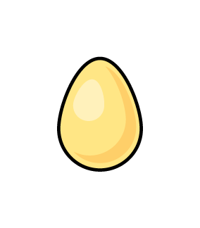
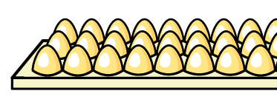
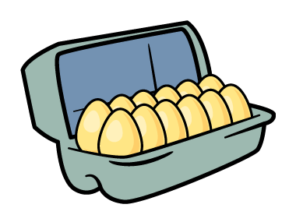
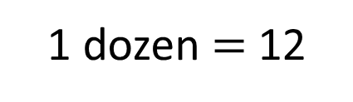
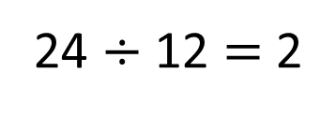
1 dozen $=$ 12
A box holds a dozen eggs.
How many boxes are needed for 24 eggs?
24 $÷$ 12 $=$ 2
2 boxes

Slide 15
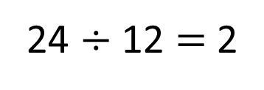
1 dozen $=$ 12
There are 24 eggs.
They are put into a dozen boxes.
How many eggs are in each box?
24 $÷$ 12 $=$ 2
2 eggs in each box

Slide 16
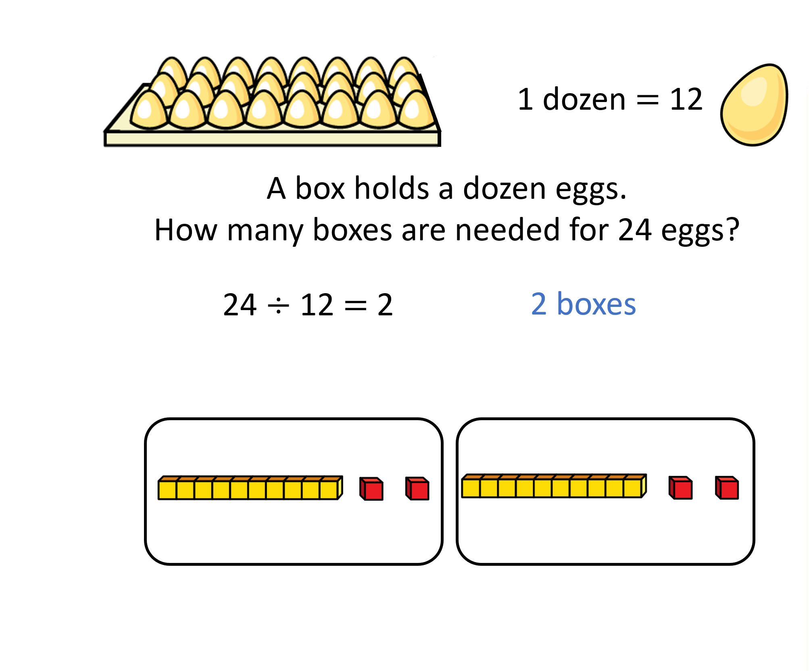
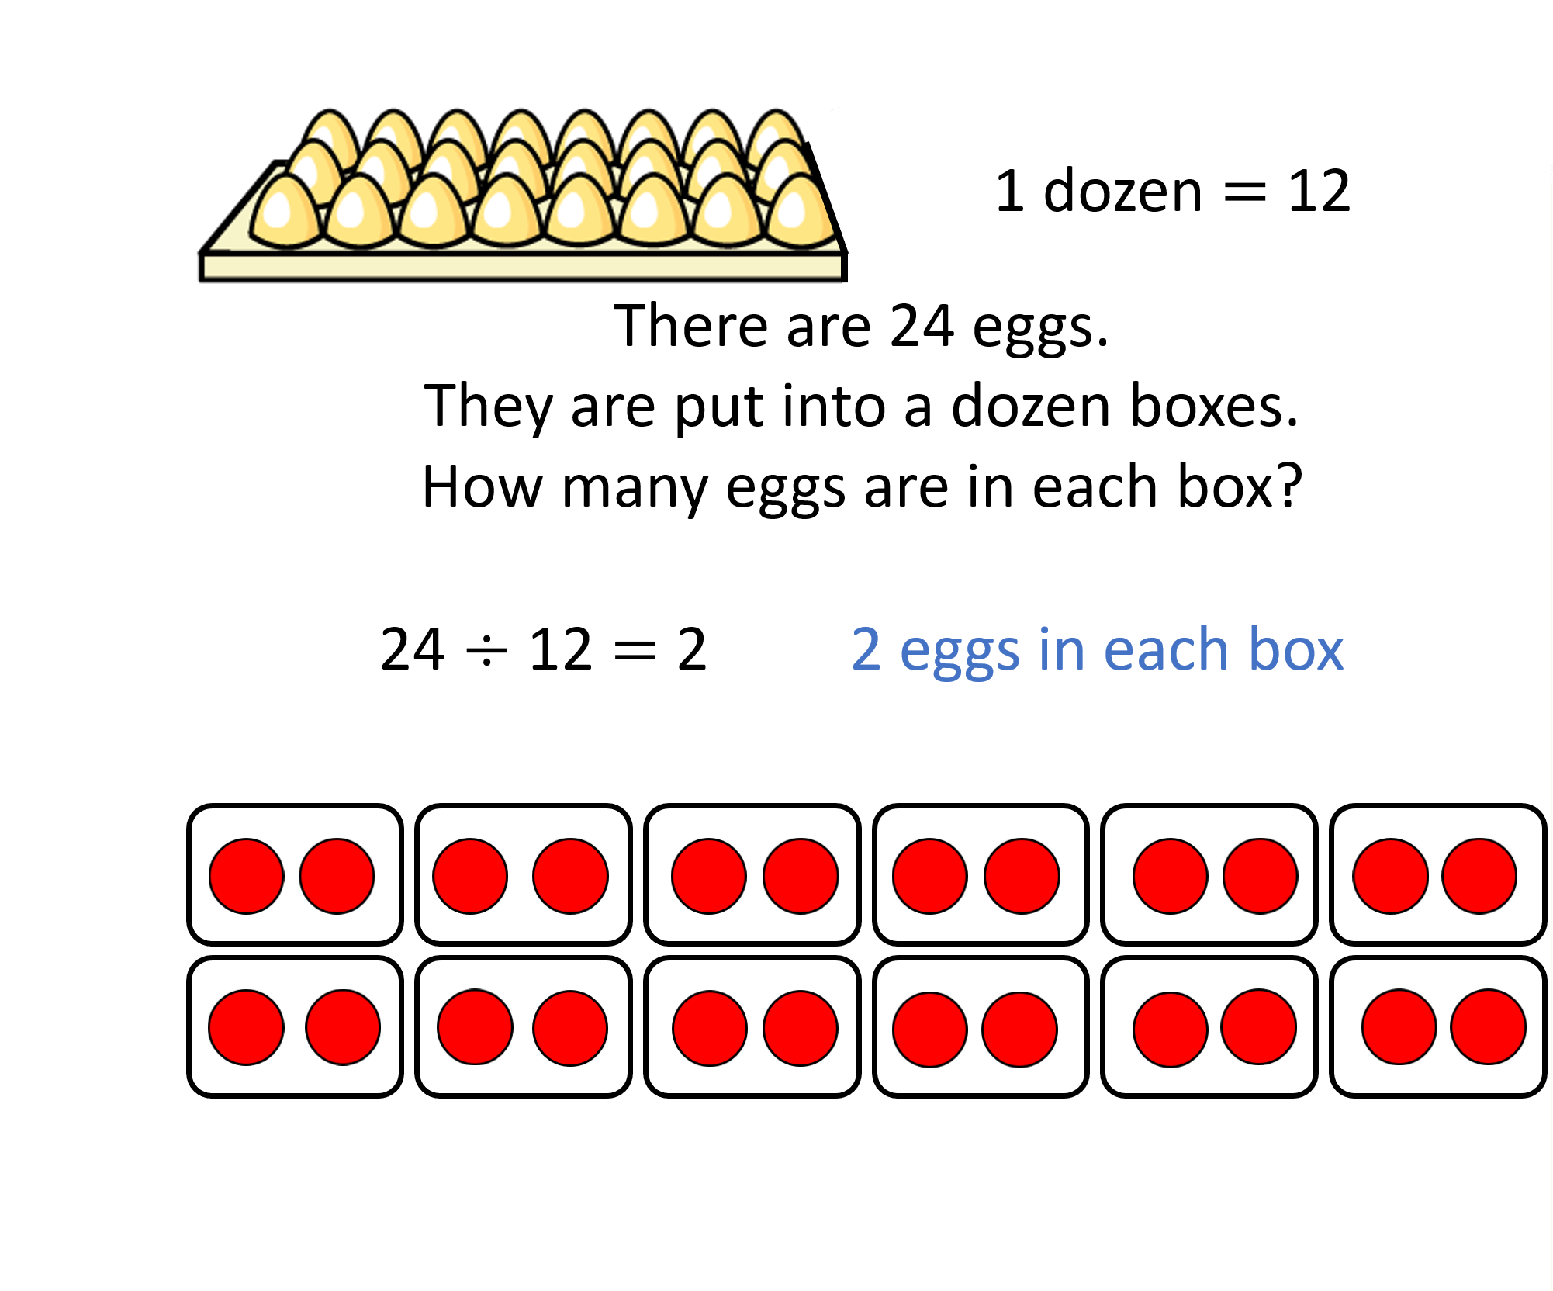
Grouping
Sharing

Slide 17

Think of a 2-digit number.
Reverse the digits to create a
new 2-digit number.
Find the sum of your two numbers.
Repeat with some other examples.
What do you notice?
Why does this happen?
24
$$+$$
42
Have a think

Slide 18

All divisible by 11
110
33
24
$$+$$
42
88
66
132

Slide 19
Have a go at the rest of the worksheet

