Slide 1
Monday 24th January
L.O. – I can write creatively about the video ‘Alma’.

Slide 2
This week we have a week of creative writing based around a video. That video is called ‘Alma’.
This is an animated video that is completely fictional. First, we will watch it with no sound and then discuss as a class. Once we are all comfortable, we will try watching it with sound. This video is meant to make you feel a little anxious and create suspense so do not worry if you get a funny feeling – that is what it is designed to do.
https://www.youtube.com/watch?v=Aw0uORumRts
How did it differ watching the video with sound compared to watching it without?

Slide 3
Today’s writing task is your free choice. You can choose a creative writing style that you enjoy – the choice is yours!
First, let’s thought shower some ideas as a class of potential pieces of writing we may want to do after watching Alma. Here are some of my ideas;
Instructions on how to return back to being human
A poem based on the film
A review of the film including you most and least favourite parts of the film and why.
What other ideas could we do?

Slide 4
Now, let’s quickly gather some vocabulary that we associate with the film ‘Alma’.
As a class, lets create a thought shower with some challenging vocabulary to do with the film.

Slide 5
Tuesday 25th January
L.O. – I can write creatively using a short burst writing technique.

Slide 6
Today we are going to be looking at a screenshot from the Alma film to inspire our writing.

Slide 7
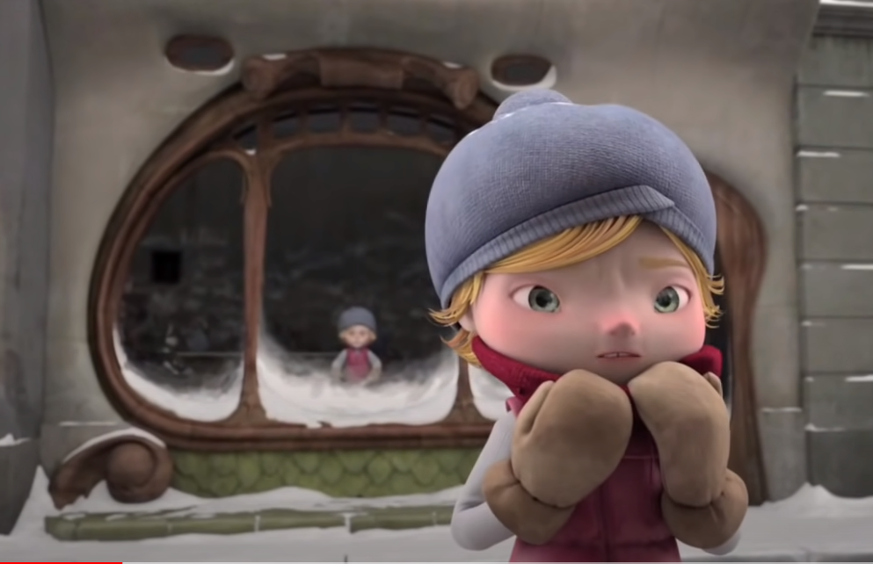

Slide 8
Let’s take 3 minutes to come up with some ideas about this image.
Think about the main things in the picture you may want to write about;
Alma
the doll
the window
the weather
the names in the reflection?
What adjectives can you think of, get a thesaurus if you like to help you come up with some challenging vocab.
Then, we will share our ideas as a class.

Slide 9
confused
fresh snow crunching beneath feet
face ready to engulf children
names on the wall of 1000 other children

Slide 10
What did we come up with?
Before you begin writing;
Really try to focus on every word you write.
What adjectives can you think of, get a thesaurus if you like to help you come up with some challenging vocabulary.
Don’t start every sentence with ‘the’ or ‘I’ – try to use only one each of these in your writing.

Slide 11
Wednesday 26th January
L.O. – I can write creatively from the main character’s point of view.

Slide 12
Today’s task is to write a diary entry as if you were Alma.
Let’s re-watch the video and try and get into character.
https://www.youtube.com/watch?v=Aw0uORumRts
To help do this, lets ask some questions and help create more of a back story;
How old am I?
Where am I?
Where am I going?
Who am I with?

Slide 13
There are lot’s of different stages to Alma, and she will be feeling very different emotions at different stages. Let’s think of some of the major points in the film and how Alma might be feeling in that moment. We will gather this as a class to help you with some ideas.
First, when she’s writing her name.
Next, when she see’s herself as a doll.
Then, when she can’t get into the shop.
Finally, when she turns into the doll.

Slide 14
Now, let’s put this altogether into one piece of writing. You may want to write a diary entry from Alma – which would start ‘Dear diary’.
Or, you may want to write a letter to someone (think back to our history lesson about the Battle of Bosworth). This could be a warning letter to a friend, a letter to a family member explaining where she is – the choice is yours!
I am looking forward to reading you creative writing.
Remember- this is from Alma’s point of view so you will be writing in the first person.
‘I’ did this….
‘I’ feel this way…
Imagine you are Alma!

Slide 15
Thursday 27th January
L.O. – I can write what I predict will happen next in a story.

Slide 16
Today’s English lesson will be looking at what happens next in Alma.
Let’s re-watch the video to refresh our minds of what happens.
https://www.youtube.com/watch?v=Aw0uORumRts
There has been no follow up to Alma so what happens next is completely up to you. There is no right or wrong answer. Perhaps Alma finds a way out, does her family come to look for her? Can she talk to the other dolls?

Slide 17
Let’s talk to our partners about potential story lines for what happens next.
Spend 2 minutes discussing and then we will put these ideas together in a class thought shower.

Slide 18
Try to be as creative as you can, and use a thesaurus to find some challenging vocabulary.
What happens next, you decide!
We will share some ideas from around the class throughout the lesson.

Slide 19
Friday 28th January
L.O. – I can write from a different character’s point of view

Slide 20
This is the final day of our writing about Alma.
Today we will be using some drama to help us get into the character of someone we haven’t met yet…
The shop owner!

Slide 21
Spend a few minutes now discussing with your partner potential ideas about the shop keeper.
Think back to the questions we asked to find out Alma’s backstory and ask them again;
How old am I?
Where am I?
Who am I with?
Why do I have the shop?
Am I evil or misunderstood?

Slide 22
First, we are going to do some hot seating.
This is where one student sits in the hot seat and pretends to be the shop keeper. We as the audience can ask them questions and they must answer as if they were actually the character.
This can help us think more about the shop keeper as a person and what they might be like.

Slide 23
Next, we are going to do something called conscience alley.

Slide 24
Now, using all of the drama we have just done, and your creative writing ideas from this week, I would like you to write from the point of view of the shop owner.
Really try and get into character and think about their part in the story.
Can you explain why they have such a cruel shop?
You can be as creative as you like.
I can’t wait to hear what you come up with!

