Slide 1
This term in PSHE our topic is: Dreams and Goals
Lesson 2 – My Dreams and Ambitions

Slide 2
I can identify a dream/ambition that is important to me I can imagine how I will feel when I achieve my dream/ambition

Slide 3
Vocabulary:
Dreams Goals Ambitions Future Aspirations

Slide 4
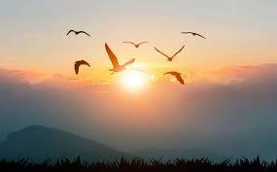
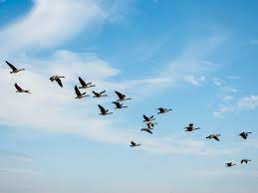
Calm Me

Slide 5
Calm Me
My favourite Year 3 children... come with me as we help our minds to get peaceful and calm. Let’s sit up nice and straight in our chairs. Imagine the golden thread is pulling up gently through the top of your head stretching your spine so you feel proud and dignified. Keep both feet flat on the floor and your hands loosely in your lap. Close your eyes gently as you ask your mind to focus on your breathing. We are breathing all the time but usually we don’t notice... but now I want you to notice that you are breathing and how nice it feels. Breathe in through your nose and count in your head 1,2,3,4, slowly, gently. Breathe out again feeling your tummy sink back in and hear your mind silently say: leave my troubles at the door. In... 1,2,3,4... Out... leave my troubles at the door. In... out... Breathe gently and be aware that your body is calming down as well…your muscles are relaxing, your arms, your shoulders, your tummy, your legs, your face…everything relaxing so you feel calm and peaceful. Your precious body is relaxed and your mind is feeling calm. Listen carefully to the chime and when you can no longer hear any sound start to bring your body and mind back into the classroom... wiggle your fingers and toes and bring that quiet mind back to focus on this moment right now. Let’s learn.

Slide 6
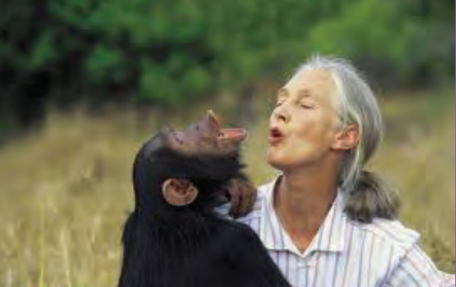
Open my mind
This is Jane Goodall with her chimpanzee. What do you think Jane dreamed about as a little girl?

Slide 7
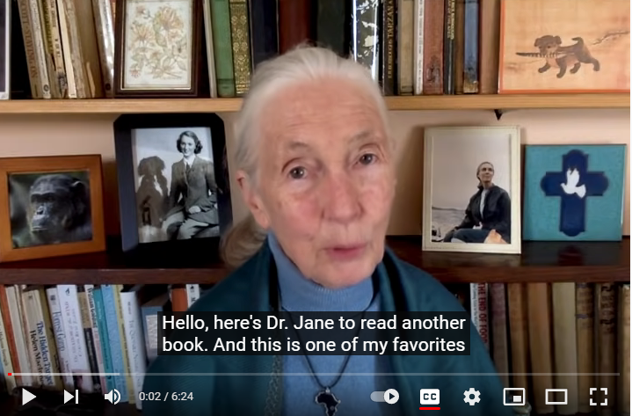
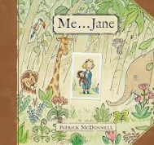
Let’s listen to Dr. Jane reading the story Me…Jane by Patrick McDonnell.

Slide 8
What do you think Jane’s dreams and goals were when she was a child?
How did she achieve these?
What are your dreams and goals?
Is it good to have dreams and goals?
How will you achieve your dreams and goals?

Slide 9
Let me learn
We are going to make a Garden of Dreams and Goals. Each class is going to contribute. Our contribution will be a big plant pot/window box of flowers showing our dreams and goals for the future.
You are each going to have a flower template. Draw your face in the centre of the flower.
Think carefully about your own dreams and goals. What would you like to do/be when you grow up? Draw or write these dreams on the petals of your flower.

