Slide 1
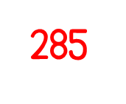
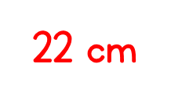
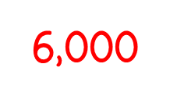
Year 5 | Week 2 | Day 1

Slide 4

1) 3 $×$ 8 $=$ 30 $×$ 8 $=$
2) 6 $×$ 7 $=$ 6 $×$ $=$ 420
3) 22 $×$ 13 $=$
4) 22 $×$ 14 $=$
$$×$$

Slide 5
1) 3 $×$ 8 $=$ 30 $×$ 8 $=$
2) 6 $×$ 7 $=$ 6 $×$ $=$ 420
3) 22 $×$ 13 $=$
4) 22 $×$ 14 $=$
24
240
42
70
286
So, if we know 22 $×$ 13 $=286,$
How can we easily work out 22 x 14?
308
$$×$$
20
2
10
200
20
3
60
6

Slide 7
23 $×$ 31
H | T | O
 | 2 | 3
 | 3 | 1
$$×$$
20
3
30
600
90
$$×$$
3
1
20
3
600 $+$ 90 $+$ 20 $+$ 3
$=$ 713
Now let’s look at the compact formal method:

Slide 8
23 $×$ 31
H | T | O
 | 2 | 3
 | 3 | 1
$$×$$
20
3
30
600
90
$$×$$
2
3
1
20
3
600 $+$ 90 $+$ 20 $+$ 3
$=$ 713

Slide 9
23 $×$ 31
H | T | O
 | 2 | 3
 | 3 | 1
$$×$$
20
3
30
600
90
$$×$$
2
3
1
20
3
9
0
600 $+$ 90 $+$ 20 $+$ 3
$=$ 713

Slide 10
23 $×$ 31
H | T | O
 | 2 | 3
 | 3 | 1
$$×$$
20
3
30
600
90
$$×$$
2
3
1
20
3
6
9
0
600 $+$ 90 $+$ 20 $+$ 3
$=$ 713

Slide 11
23 $×$ 31
H | T | O
 | 2 | 3
 | 3 | 1
$$×$$
20
3
30
600
90
$$×$$
2
3
1
20
3
6
9
0
$$+$$
600 $+$ 90 $+$ 20 $+$ 3
$=$ 713
7
1
3
1

Slide 12
23 $×$ 31
H | T | O
 | 2 | 3
 | 3 | 1
$$×$$
3
1
2
3
$($23 $×$ 1$)$
6
9
0
$($23 $×$ 30$)$
$$+$$
7
1
3
1
23 $×$ 31 $=$ $($23 $×$ 1$)$ $+$ $($23 $×$ 30$)$

Slide 13
41 $×$ 26
Have a think
H | T | O
 | 4 | 1
 | 2 | 6
$$×$$
6
2
4
6
$($41 $×$ 6$)$
2
$$+$$

Slide 14
41 $×$ 26
H | T | O
 | 4 | 1
 | 2 | 6
$$×$$
2
2
4
6
$($41 $×$ 6$)$
8
2
0
$($41 $×$ 20$)$
$$+$$
1
0
6
6
41 $×$ 26
$=$ 1,066

Slide 15
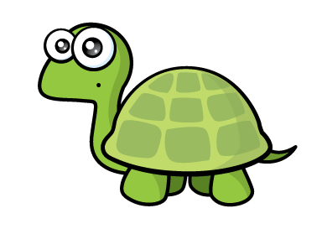
Have a think
32 $×$ 46 $=$ 320
Th | H | T | O
 |  | 3 | 2
 |  | 4 | 6
$$×$$
1
9
2
$$+$$
1
2
8
3
2
0
1
1

Slide 16
32 $×$ 46 $=$ 320
Th | H | T | O
 |  | 3 | 2
 |  | 4 | 6
32 $×$ 46 $=$ 1,472
$$×$$
1
9
2
$($32 $×$ 6$)$
$($32 $×$ 40$)$
1
2
0
$($32 $×$ 4$)$
$$+$$
8
1
3
4
2
7
2
0
1

Slide 17
32 $×$ 24
Let’s do this one together – work in your book
H | T | O
 | 3 | 2
 | 2 | 4
$$×$$
4
1
2
8
$(32$ $×$ 4$)$
1
$$+$$

Slide 18
32 $×$ 24
H | T | O
 | 3 | 2
 | 2 | 4
$$×$$
2
1
2
8
$(32$ $×$ 4$)$
6
4
0
$(32$ $×$ 20$)$
$$+$$
7
6
8
32 $×$ 24
$=$ 768

Slide 19
Have a go at the questions 1 - 4 on the worksheet

Slide 20
Tommy wants to find the area of the blue part of the rectangle.
35 cm
12 cm
12 cm
16 cm
7 cm
7 cm
Have a think

Slide 21
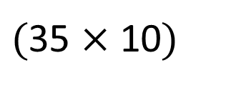
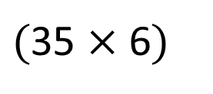
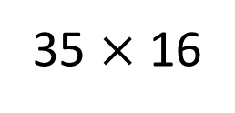
Tommy wants to find the area of the blue part of the rectangle.
35 $×$ 16
35 cm
H | T | O
 | 3 | 5
 | 1 | 6
12 cm
12 cm
16 cm
7 cm
7 cm
$$×$$
2
1
0
$($35 $×$ 6$)$
3
3
5
0
$($35 $×$ 10$)$
$$+$$
5
6
0

Slide 22
Tommy wants to find the area of the blue part of the rectangle.
35 cm
35 $×$ 16 $=$ 560
12 cm
12 cm
16 cm
7 cm
7 cm
Area of one rectangle:12 $×$ 7 $=$ 84
Area of both rectangles: 84 $×$ 2 $=$ 168
2
560 $−$ 168 $=$ 392 cm

Slide 23
Have a go at the questions on the next screen if you have completed all the ones on the worksheet

Slide 24
