Slide 1
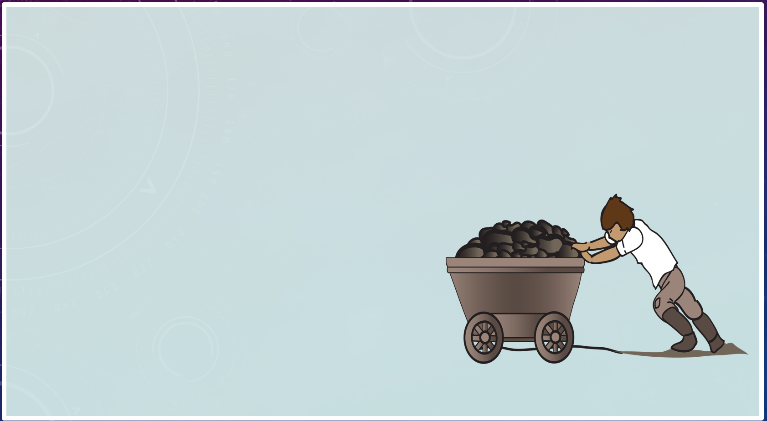
LO: What was life like for working Victorian children?
Objectives
To find out what sort of jobs were taken by Victorian children
To explore what life was like for Victorian working children

Slide 2
Look at these pictures What do you think the children are doing? What might they be feeling?

Slide 3
Children At Work
The pictures we just saw are images of children working during the Victorian period. When Victoria came to reign in 1837, not all children went to school like children today do. School was only for children from wealthy families who could afford it.
For poor families, life could be very hard. Children had no choice but to go to work to help earn money for their families – even sometimes children as young as four!
Work for children was mostly unpleasant, usually involving difficult and dirty jobs like going into coal mines, working in factories or sweeping chimneys.

Slide 4
Let’s look at what it was like for a child working in a coal mine
In your book write down 4 words that describe what this kind of work might have been like.

Slide 5
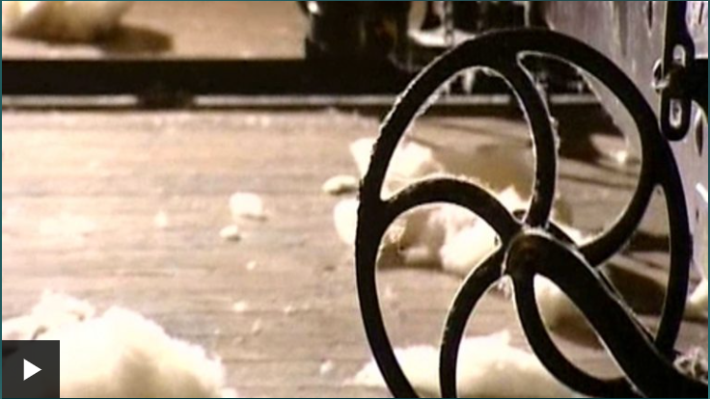
Let’s look at what it was like for a child working in the mills
In your book write down 4 words that describe what this kind of work might have been like.

Slide 6
Let’s look at what it was like for a child working in the fields
In your book write down 4 words that describe what this kind of work might have been like.

Slide 7
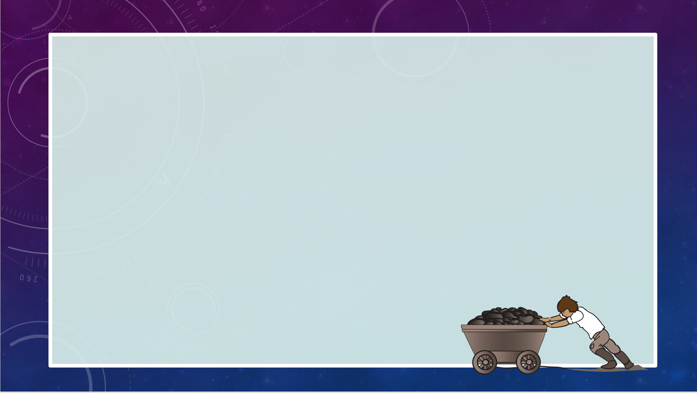
A World of Work
Jobs for Victorian Children
There were all sorts of jobs for children in Victorian times, and they usually tended to be the most unpleasant jobs that adults did not want to do.
It was seen as normal for children to work and many employers did not feel guilty about giving children the worst jobs. Children had no choice in the matter and for many, it was a way of helping their family to survive.
There was very little protection for children in terms of how they were treated at work. Conditions were poor and often dangerous, with children sometimes expected to work 12 hour shifts with no holidays.
Factory worker
Coal miner
Chimney sweep
Street seller
Housemaid
Rat catcher
Bird scarer
Farm worker
Which job would you like best?
Which one would you least like?

Slide 8
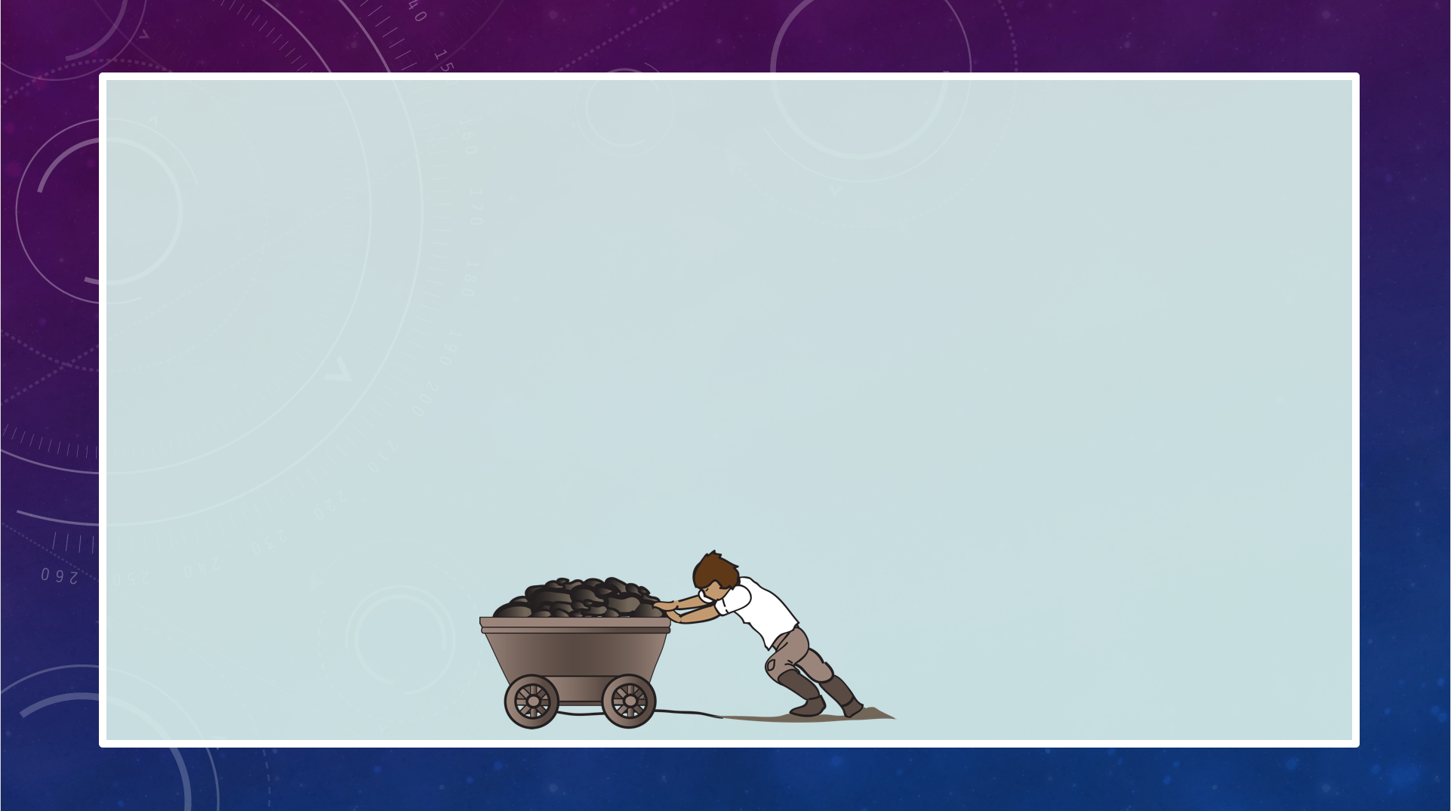
Spot Check
Answer these questions in your books:
Why did lots of children have to work in Victorian times?
Which type of children did not go to work?
What sort of jobs did children do?

Slide 9
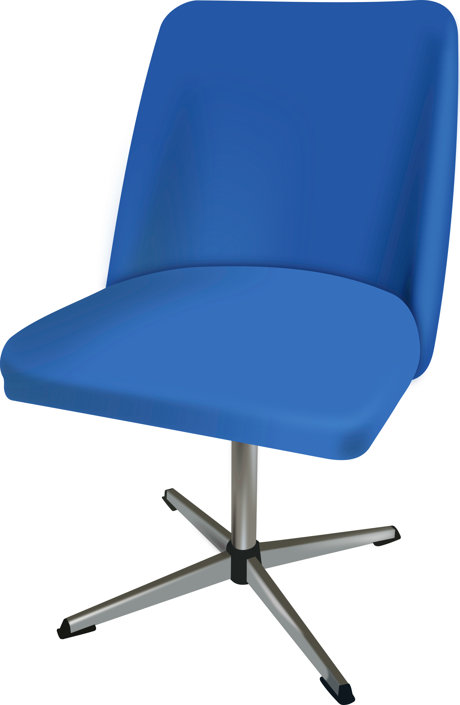
Plenary
Hot-seat
We need a volunteer to be in the hot-seat and to pretend to be a working child from Victorian times.
The rest of the class will ask the child worker questions about who they are, what they do for work and what it is like there.
Victorians Lesson 6
Life for Working Children

Slide 10
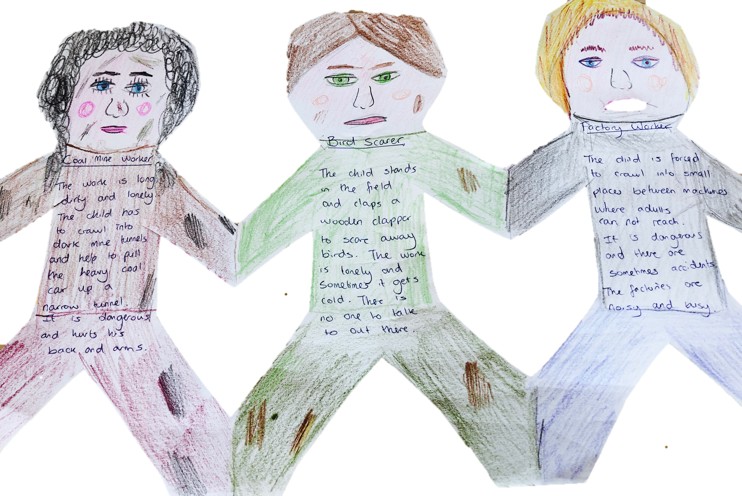
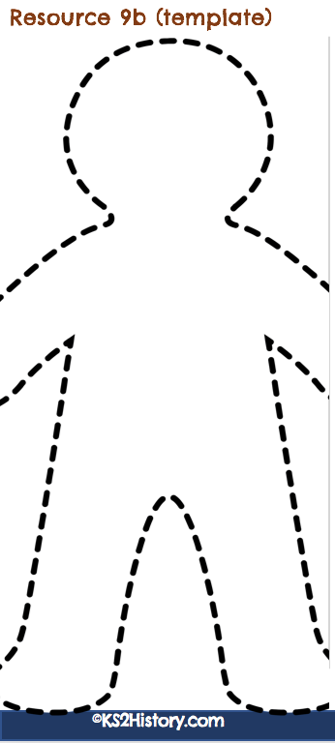
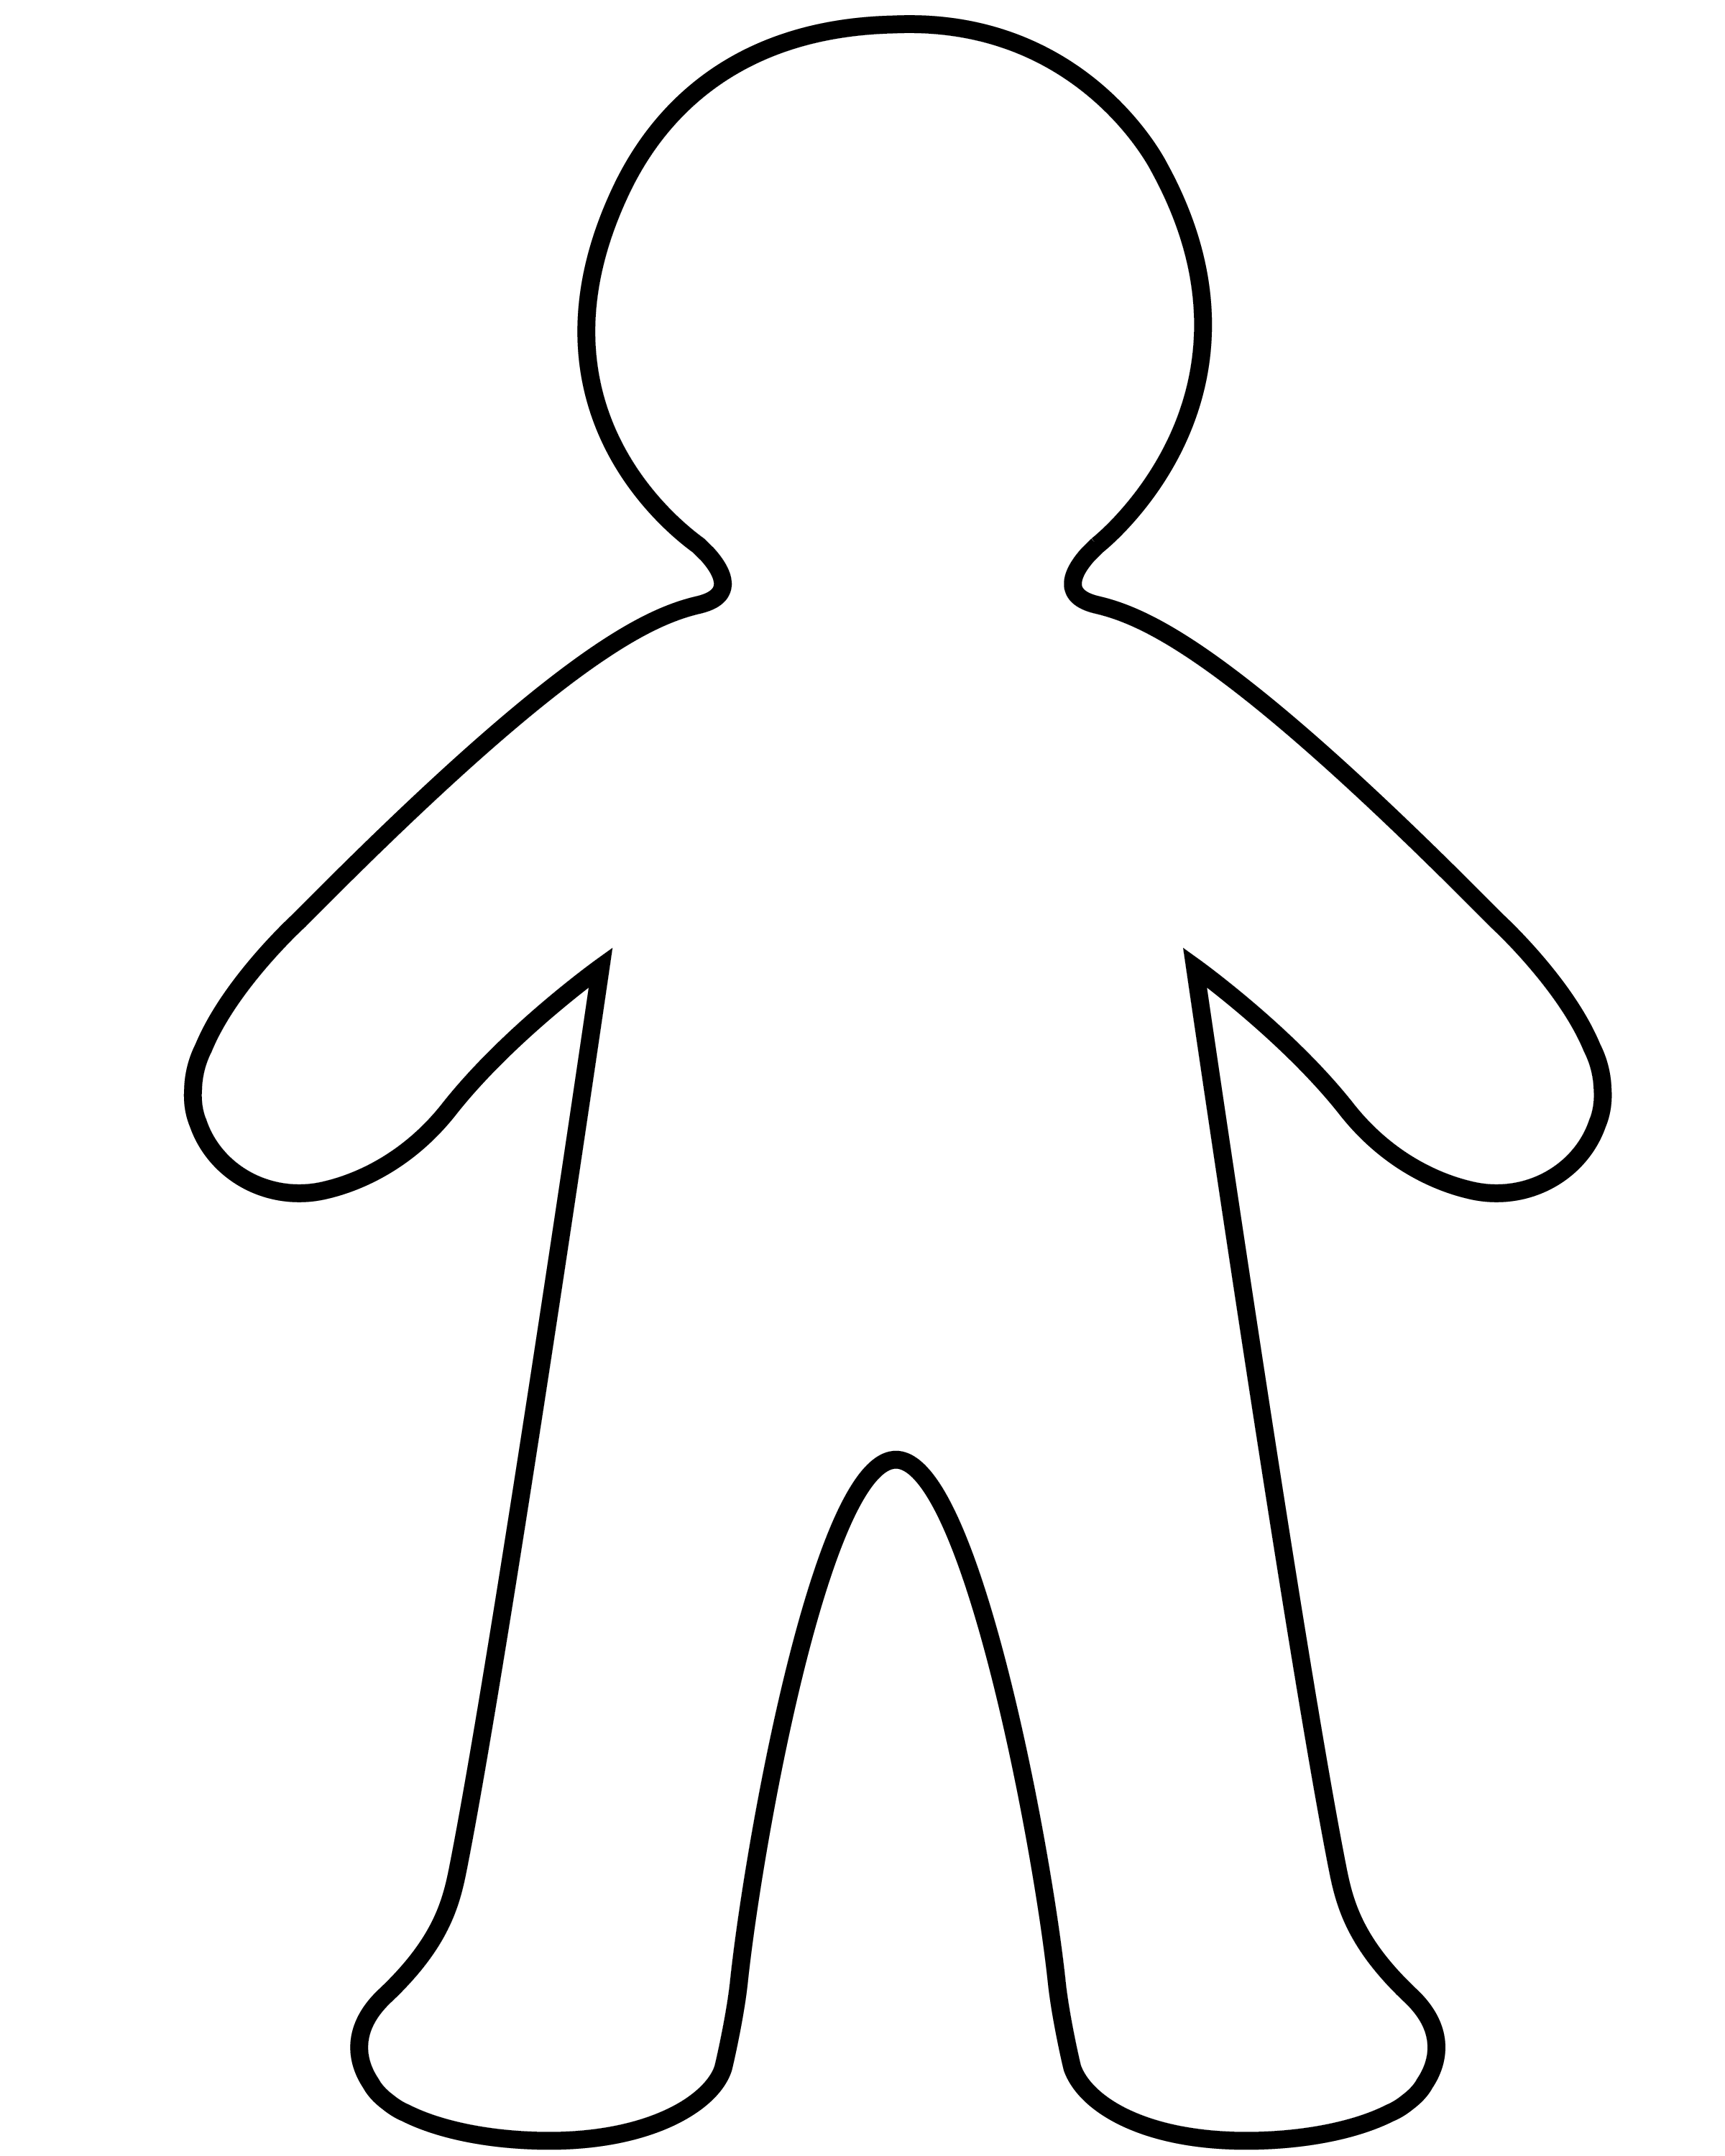
Paper Chain Children
Your task is to make a paper
chain of three Victorian working children.
Each child in your chain will represent a different child worker from Victorian times. On each one, write a few sentences about what their work is like.
Then you can decorate their faces and clothes.

