Slide 1
This week our English is all about Oracy.
Who can remember what Oracy is?
Talk to your partner.

Slide 2
That’s right, it means:
Being able to speak clearly so that others can understand you
Being able to understand what others say to you
So that you can communicate ☺

Slide 3
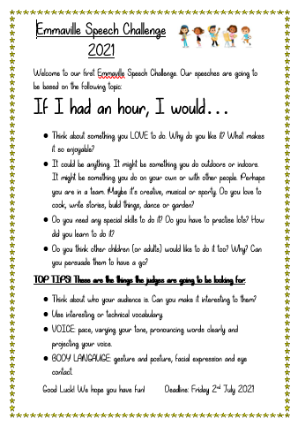
Our Oracy this week is going to focus on Presentational Talk. We are all going to be taking part in the
Emmaville Speech Challenge 2021
You have probably seen the poster in your classroom.

Slide 4
Over the course of the week, you are going to prepare and practice a speech.
There will be a winner from each class and overall school winners 1st, 2nd and 3rd.

Slide 5
First of all we have to plan and then practise, practise, practise.

Slide 6
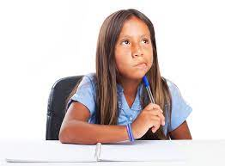
Wednesday 30th June 2021
LO: To plan a speech.
In today’s lesson, we are going to plan our speech.

Slide 7
The theme of the competition is:
If I had an hour, I would…
If you had an hour, what would YOU do?

Slide 8
Think about something you LOVE to do. It could be anything. It might be something you do outdoors or indoors. It might be something you do on your own or with other people. Perhaps you are in a team. Maybe it’s creative, musical or sporty. Do you love to cook, write stories, build things, dance or garden?
Have a look at the next slide if you need some ideas…
Then go through the questions on the slide after that.

Slide 9
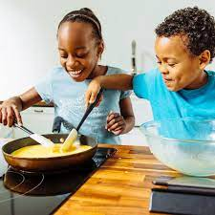
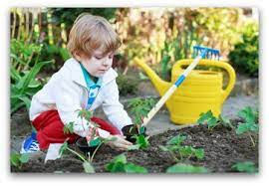
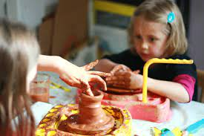
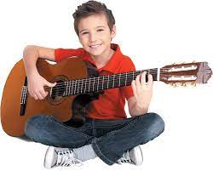
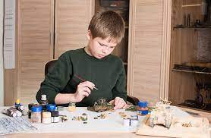
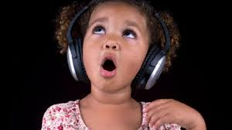
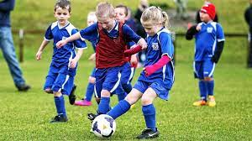
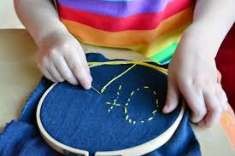
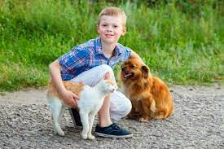
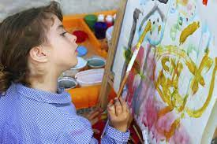
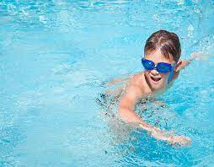

Slide 10
Why do you like it? What makes it so enjoyable?
Do you need any special skills to do it? Do you have to practise lots? How did you learn to do it?
Do you think other children (or adults) would like to do it too? Why? Can you persuade them to have a go?

Slide 11
We are now going to use the ideas sheet and planning sheet to write down our ideas.
Your speech should last about 2 minutes.

Slide 12
TOP TIPS! These are the things the judges are going to be looking for:
Think about who your audience is. Can you make it interesting to them?
Use interesting or technical vocabulary.

Slide 13
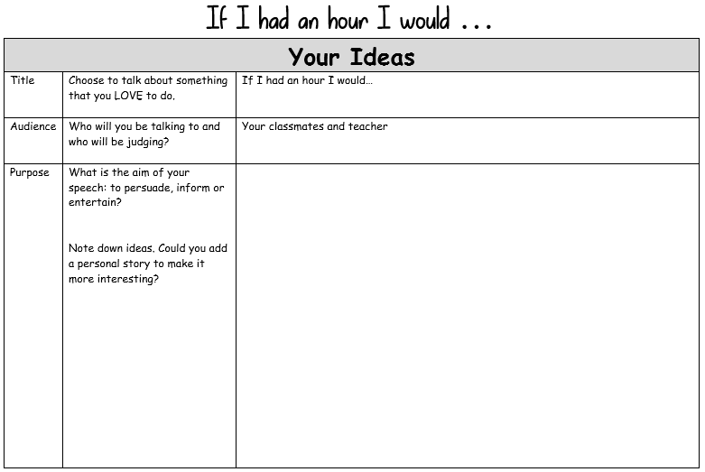
First let’s start with your ideas…

Slide 14
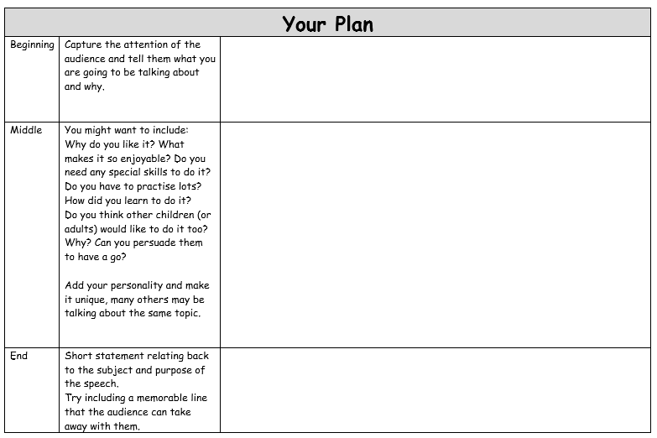
And now for your plan. We will spend about 15 minutes planning and then we will move onto writing our speech. We will have the rest of this lesson, and part of tomorrows to get our speech ready.

Slide 15
TOP TIPS! These are the things the judges are going to be looking for:
Think about who your audience is. Can you make it interesting to them?
Use interesting or technical vocabulary.

Slide 16
You are going to write out your speech so that you know what you are going to say.
Use your plan to help you so that your speech has a beginning, a middle and an end.

Slide 17
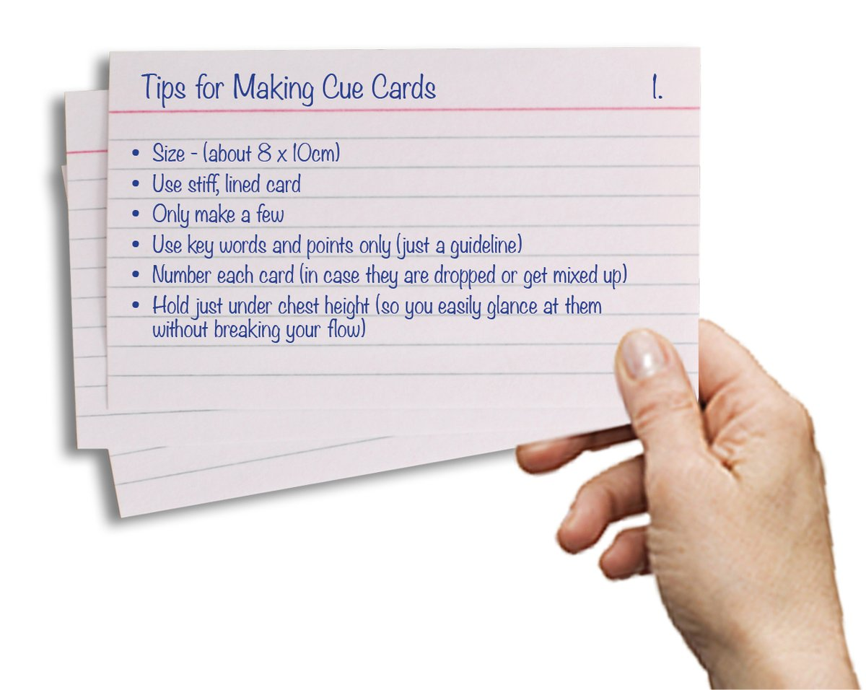
When you write your speech, you can either write it out on a sheet of paper or you can write each part on a cue card. This is a small sheet of paper or card where you just write the key points for that section of your speech. Some people find this easier. Other people might prefer to have the whole thing written out exactly as they are going to say it.

Slide 18
If you have written just the key points on cue cards, have a go at saying your speech from the cards to be sure that you have included everything you want to.
If you have written your speech out in full, read it through to check that it makes sense.
Tomorrow we are going to finish writing our speech, then most importantly… practise SAYING our speech.

