Slide 1
17.1.22
LO – I can divide 2-digit by 1-digit numbers.

Slide 2
Starter: 6 x tables activity. (3 mins)
TTYP: How could you partition 84?
Class discussion.

Slide 3
72 $÷$ 3 $=$
How many groups? How many in each group?
Tens | Ones

Slide 4
72 $÷$ 3 $=$
How many groups? How many in each group?
24
Tens | Ones
4 groups
3 in each
3 groups
4 in each

Slide 5
16 ÷ 2
16
There are cubes altogether.
There are groups of 2
16 ÷ 2 =
8
8

Slide 6
16 ÷ 4
There are 16 cubes altogether.
There are groups of 4
16 ÷ 4 =
4
4

Slide 7
16 ÷ 5
There are 16 cubes altogether.
There are groups of 5
There is cube remaining.
16 ÷ 5 = remainder
3
1
3
1

Slide 8
16 ÷ 6
Have a think
There are 16 cubes altogether.
There are groups of
There are cubes remaining.
÷ = remainder
2
6
4
16
6
2
4

Slide 9
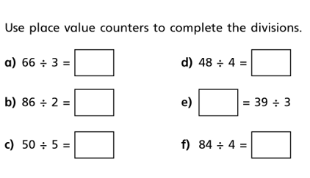
Cut out question 1 and stick it into your books.
1.

Slide 10
16 ÷ 4 $=$ 4
$−$ 4
0
1
2
3
4
5
6
7
8
9
10
11
12
13
14
15
16
16 ÷ 5 $=$
3
remainder 1
0
1
2
3
4
5
6
7
8
9
10
11
12
13
14
15
16

Slide 11
Have a think
16 ÷ 7 $=$
2
remainder 2
0
1
2
3
4
5
6
7
8
9
10
11
12
13
14
15
16

Slide 12
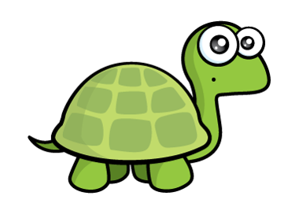
Do you agree with Tiny?
Have a think
16 ÷ 4 $=$ 4
17 ÷ 4 $=$ 4 remainder 1
18 ÷ 4 $=$ 4 remainder 2
19 ÷ 4 $=$ 4 remainder 3
20 ÷ 4 $=$ 4 remainder 4
5

Slide 13
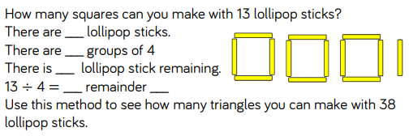
Look at this question: Can you see how each square needs four lolly sticks.
Complete the question.
TTYP: how many lolly sticks will be needed for each triangle? Use these stem sentences to help you write the question for triangles with 38 lolly sticks. We will talk as a class first.

Slide 14
21 $÷$ $=$ 4 remainder 1
5

Slide 15
73 ÷ 3 =
24
remainder 1
Tens | Ones

Slide 16
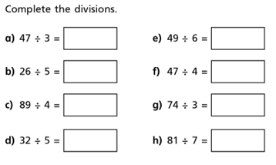
If it helps, you can use place value counters or a place value grid.
Think about what you already know about your times tables and use this information to help you with your work.

Slide 17
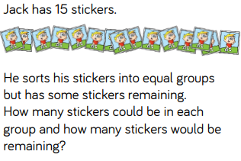
Challenge question 1
Stick this problem into your books and complete.

Slide 18
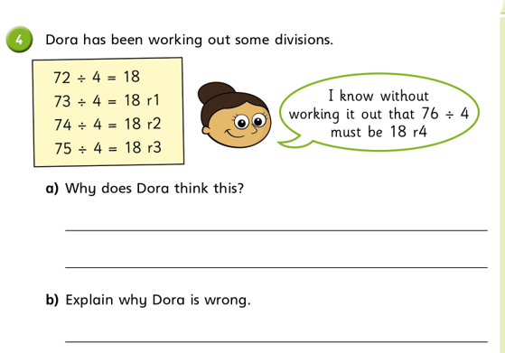
Challenge question 2
Stick this problem into your books and complete.
If you complete all of this work, then you can practise the division facts of one of the times tables that you find tricky.

