Slide 1
10.12.21
L.O. – I can divide by 100.

Slide 2

1) 1 hundred = ____ ones
1 ________$=$ 100 tens
2) £1 = _______ $×$ 1 p
£10 $=$ _______ $×$ 1 p
3) $\frac{\text{1}}{\text{10}}$ of 800 $=$ 800 $÷$ ____
$\frac{\text{1}}{\text{100}}$ of 800 $=$ 800 $÷$ ____
If you finish, practise your 7x tables, we are going to play hit the button next.

Slide 3
100
1) 1 hundred = ____ ones
1 ________$=$ 100 tens
2) £1 = _______ $×$ 1 p
£10 $=$ _______ $×$ 1 p
3) $\frac{\text{1}}{\text{10}}$ of 800 $=$ 800 $÷$ ____
$\frac{\text{1}}{\text{100}}$ of 800 $=$ 800 $÷$ ____
thousand
100
1,000
10
100
https://www.topmarks.co.uk/maths-games/hit-the-button

Slide 4

3
300 ÷ 100 = ___
300 = 3 groups of 100
7
700 ÷ 100 = ___
700 = 7 groups of 100
1,000 ÷ 100 = ___
10
1,000 = 10 groups of 100
30
3,000 ÷ 100 = ___
3,000 = 30 groups of 100

Slide 5
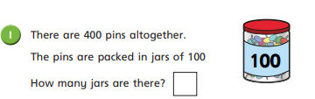
Complete question 1 on your worksheet.
If you finish, can you write your own word problem for your partner?

Slide 6
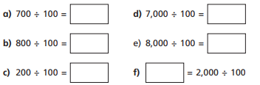
Copy and complete these calculations in your book.

Slide 7
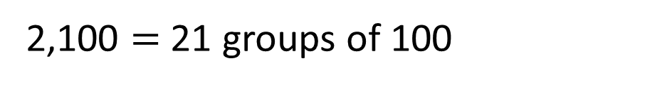
21
2,100 ÷ 100 = ___
2,100 = 2 thousands + 1 hundred
1 thousand = 10 hundreds
2 thousands = 20 hundreds
There are 21 hundreds altogether.
2,100 $=$ 21 groups of 100

Slide 8


Eva has three hundred 1p coins.
How many £1 coins is this equal to?
3
300p
100p
100p
100p
300 ÷ 100 = 3

Slide 9
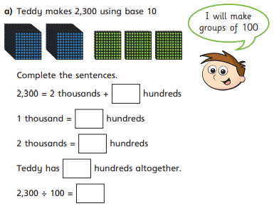
Have a go at question 3 on your worksheet.

Slide 10
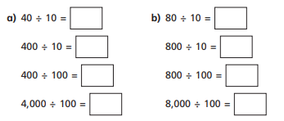
Copy and complete these calculations in your book.
What patterns do you notice?

Slide 11
Th | H | T | O
100 times
the size
100 times
the size

Slide 12
Th | H | T | O
One hundredth
the size
One hundredth
the size
To find one hundredth, we divide by 100

Slide 13




$×$ 100
$×$ 100
Th | H | T | O
$÷$ 100
$÷$ 100

Slide 14

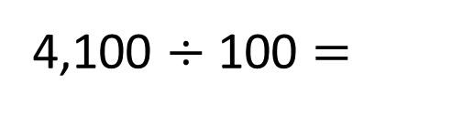

Th | H | T | O
$÷$ 100
$÷$ 100
4,100 $÷$ 100 =
4
1
41 is one hundredth the size of 4,100

Slide 15
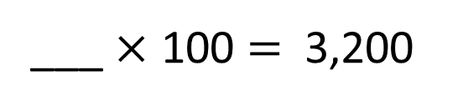

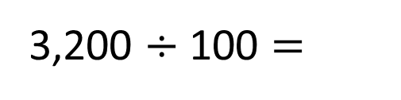

Th | H | T | O
$÷$ 100
$÷$ 100
32
___ $×$ 100 = 3,200
32
3,200 $÷$ 100 =
32 is one hundredth the size of 3,200

Slide 16


Th | H | T | O
$×$ 100
$×$ 100
32
___ $×$ 100 = 3,200
32
3,200 $÷$ 100 =
32 is one hundredth the size of 3,200
3,200 is one hundred times the size of 32

Slide 17
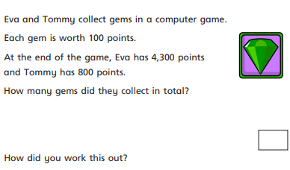
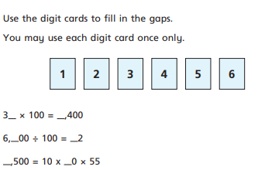
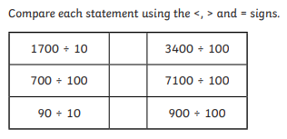
Work through the rest of the questions on your work sheet.
If you finish, there is a challenge question.

