Slide 3
1) What is one less than 6?
2) What is take away
3) If 9 $−$ 5 = 4, then 9 $−$ 4 =
4) What is this called?
1)
2)
3)
4)
1 | 2 | 3 | 4 | 5 | 6 | 7 | 8 | 9 | 10

Slide 4
1) What is one less than 6?
2) What is take away
3) If 9 $−$ 5 = 4, then 9 $−$ 4 =
4) What is this called?
1)
2)
3)
4)
5
3
5
Number track
1 | 2 | 3 | 4 | 5 | 6 | 7 | 8 | 9 | 10

Slide 6
Let’s have a look at some ways we can subtract using a tens frame and part whole model.

Slide 7
Fluency
Beth has 18 marbles. She gives 6 away.
How many are left?
18
18
-
6
=
12
6
12

Slide 8
Fluency
Ben has 15 pens. He gives 3 away.
How many are left?
15
15
-
3
=
12
3
12

Slide 9
Fluency
Kat has 19 beads. She gives 8 away.
How many are left?
19
19
-
8
=
11
8
11

Slide 10
We can also subtract by counting back on a number line.

Slide 11
Subtraction
Counting back
I can use a
number track
to count back.
16
18 $−$ 2 =
11 | 12 | 13 | 14 | 15 | 16 | 17 | 18 | 19 | 20

Slide 12
Remember to count 4 jumps.
4
3
2
1
11 | 12 | 13 | 14 | 15 | 16 | 17 | 18 | 19 | 20
I can count back 4!
16, 15, 14, 13
16
$$−$$
4
$$=$$
13
12

Slide 13
Try it again, Tiny.
4
3
2
1
11 | 12 | 13 | 14 | 15 | 16 | 17 | 18 | 19 | 20
16,
15,
14,
13
OK! I will.
17
$$−$$
4
$$=$$
13

Slide 14
In pairs, get a number track. Can you complete the subtraction number sentences using your number line?

Slide 15
Have a think
Counting back
using a number line
6
7
8
9
10
11
12
13
14
15
16
17
18
19
20
19
$$−$$
2
$$=$$
17
17
$$−$$
3
$$=$$
14
14
$$−$$
1
$$=$$
13

Slide 16
Have a think
Counting back
using a number line
4
3
2
1
6
7
8
9
10
11
12
13
14
15
16
17
18
19
20
15
$$−$$
4
$$=$$
11

Slide 17
Have a go at the questions on the worksheet. When you have completed it, have a go at the challenge.

Slide 18
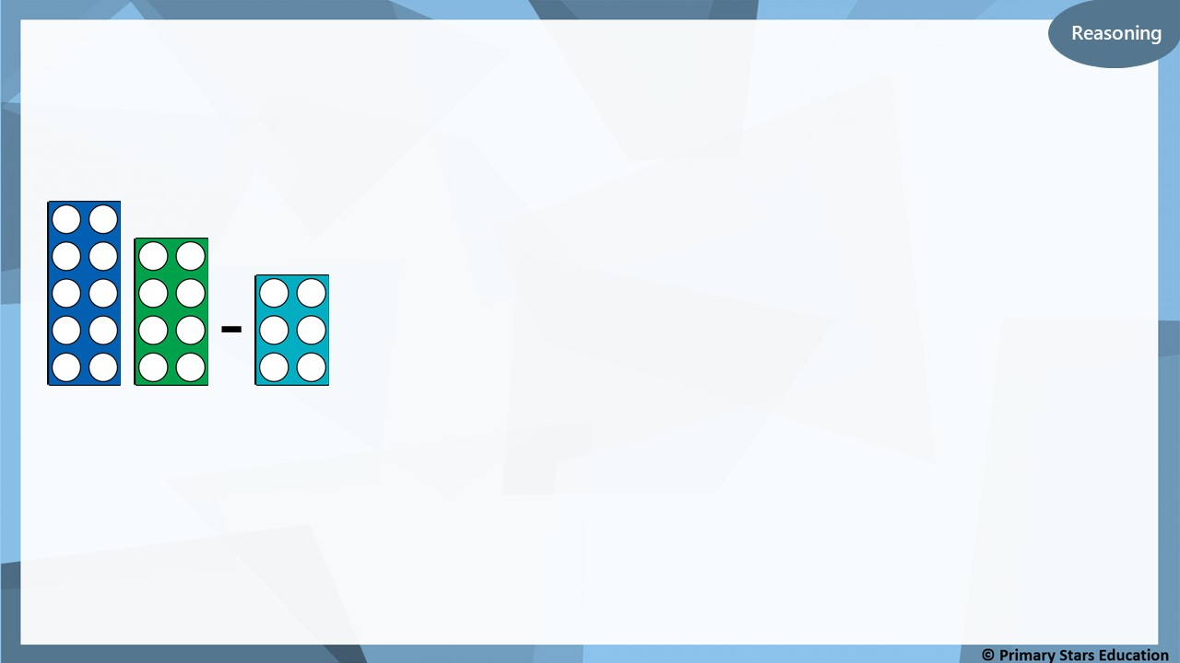
Which number line represents the number frames?
- 6
A)
0
1
2
3
4
5
6
7
8
9
10
11
12
13
14
15
16
17
18
19
20
- 8
-
B)
0
1
2
3
4
5
6
7
8
9
10
11
12
13
14
15
16
17
18
19
20
- 6
C)
0
1
2
3
4
5
6
7
8
9
10
11
12
13
14
15
16
17
18
19
20
Explain how you know.
C is correct as it shows 18 – 6 = 12

