Slide 1
23.11.21
L.O. – I can subtract lengths.

Slide 2
Convert the measurements.
1 cm $=$ ______ mm
10 cm $=$ ______ mm
100 cm $=$ ______ mm
2) 502 $−$ 48 $=$ 499 $−$ ____
3) Find the difference between 2 and 6
Please practise your 9x table, we are going to play hit the button next.

Slide 3
Convert the measurements.
1 cm $=$ ______ mm
10 cm $=$ ______ mm
100 cm $=$ ______ mm
2) 502 $−$ 48 $=$ 499 $−$ ____
3) Find the difference between 2 and 6
10
100
1,000
45
6 $−$ 2 $=$ 4
https://www.topmarks.co.uk/maths-games/hit-the-button

Slide 4
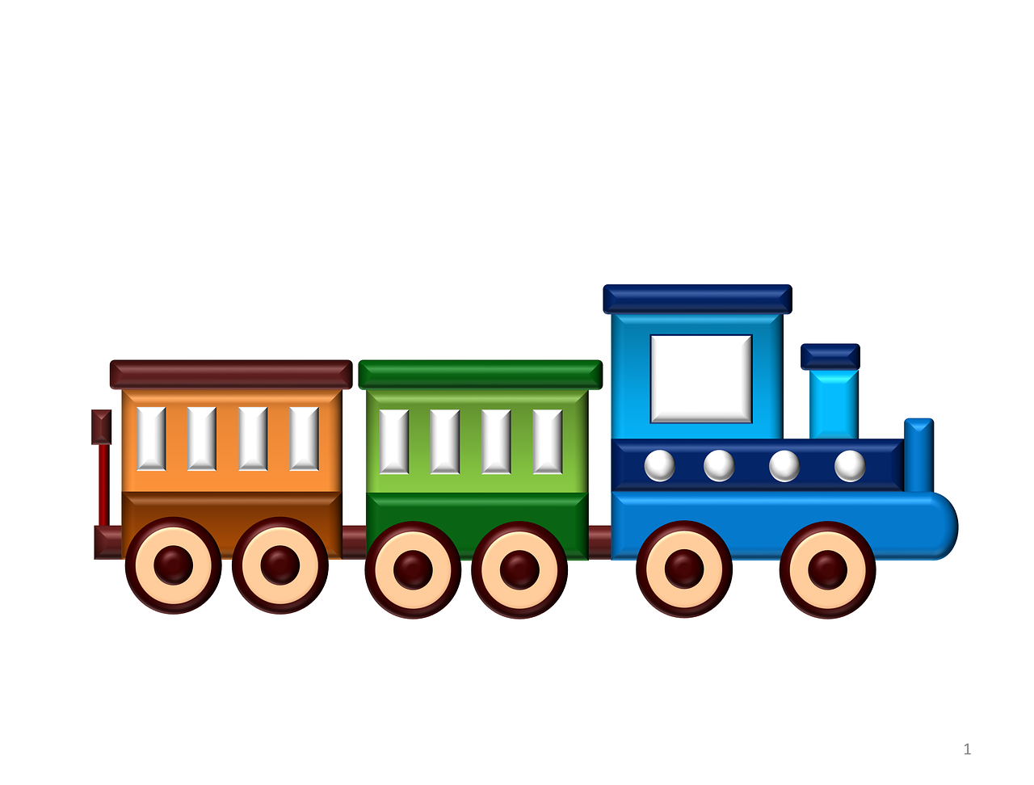
6
The train is ____ cm long.
40
The tube is ____ mm long.
6 $−$ 2 $=$ 4
4 cm $=$ 40 mm
How much longer is the train than the tube?
The train is 2 cm/20 mm longer than the tube.

Slide 5
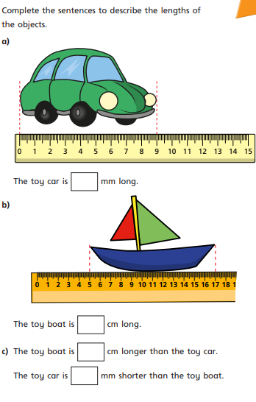
Let’s work through this question together as a class.

Slide 6
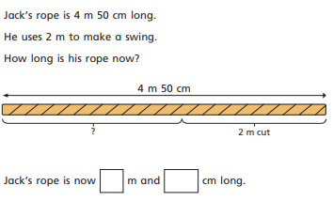
Please complete question 1 of your worksheet.
How long would the rope be if 25cm more were cut off?

Slide 7
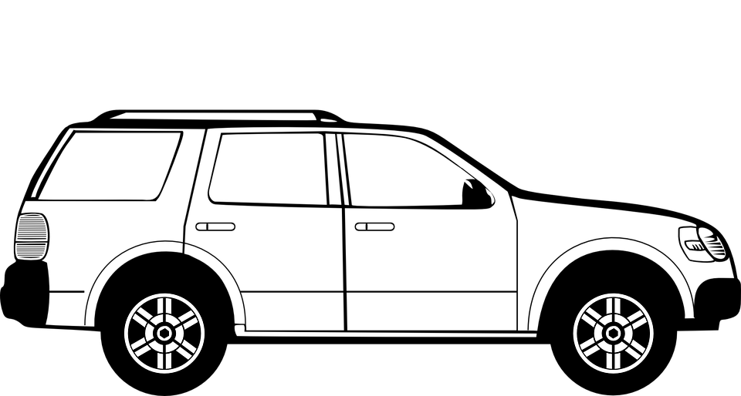
The large car is 145 cm longer than the small car.
The large car is 4 m 2 cm long.
How long is the small car?
____ m ____ cm
2
57
H | T | O
3 | 9 | 9
1 | 4 | 2
H | T | O
4 | 0 | 2
1 | 4 | 5
4 m 2 cm
Large
402 cm
145 cm
$$−$$
?
Small
257 cm $=$ 2 m 57 cm
2
5
7

Slide 8
Have a think
2
1) 3 cm $−$ 10 mm $=$ ____ cm
3 cm $−$ 1 cm $=$ 2 cm
10
2) 9 cm $−$ 80 mm $=$ ____ mm
90 mm $−$ 80 mm $=$ 10 mm
90
3) 1 m $−$ 100 mm $=$ ____ cm
100 cm $−$ 10 cm $=$ 90 cm

Slide 9
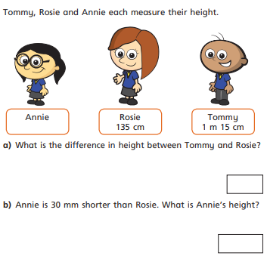
Work through question 2 on your worksheet.

Slide 10
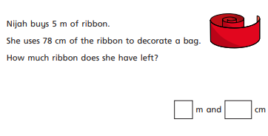
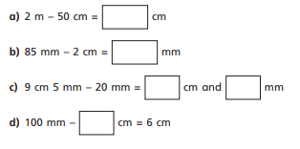
Please complete question 3 on your worksheet and then write out the number sentences underneath in your book.

Slide 11
Complete the table so that each
row and column adds up to 1 m.
Have a think
90 mm | 50 cm | ____ cm
___ mm | 401 mm | 589 mm
90 cm | ____ mm | 1 mm
= 1 m
= 1 m
= 1 m
= 1 m
= 1 m
= 1 m
1 cm = 10 mm
1 m = 100 cm
10 cm = 100 mm
1 m = 1,000 mm
100 cm = 1,000 mm

Slide 12
Complete the table so that each
row and column adds up to 1 m.
90 mm | 50 cm | ____ cm
___ mm | 401 mm | 589 mm
90 cm | ____ mm | 1 mm
41
1 m = 100 cm
10
1 m = 1,000 mm
99
9 cm + 50 cm + ____ cm = 100 cm
401 mm + 589 mm = 990 mm
500 mm + 401 mm = 901 mm
99
59 cm + ____ cm = 100 cm
____ mm + 990 mm = 1,000 mm
1,000 mm $−$ 901 mm = ____ mm
41
10
____ cm = 100 cm $−$ 59 cm
1,000 mm $−$ 990 mm = ____ mm

Slide 13
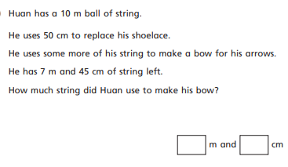
Please complete the final question on your worksheet.
If you finish there is a challenge question.

